Slide 1

Seattle Regional Office
July 2019
Presented by Pritz Navaratnasingam
Director Seattle Regional Office

Slide 2



VBA Three Priorities
Provide Veterans with the benefits they have earned in a manner that honors their service
Ensure we are strong fiscal stewards of the money
entrusted to us
Foster a culture
of collaboration
PROGRESS
PROGRESS
PROGRESS
Collaborating with all those who support our Veterans: traditional VSOs, post-9/11 Veterans groups, state and county VSOs, Congress, GAO, IG, OMB, and other federal agencies.
Focus is on continuing
to improve timeliness, increase quality, and
resolve legacy appeals.
Applying financial management best practices to execute our budget.

Slide 3
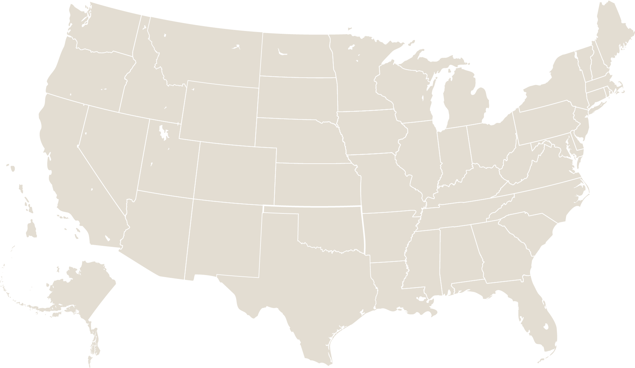








VBA Beneficiaries Served & Dollars Paid in FY2019 Q2
VBA FOOTPRINT: FY18
Compensation: Paid $23.8B to nearly 4.8M Veterans & Survivors
Pension: Paid $806M to nearly 251K beneficiaries
Education: Provided $3.0B to 488K beneficiaries for all EDU programs
VR&E: Over 4K Veterans received employment, independent living, or persisting in school
Housing: Guaranteed 119K loans totaling $31.9B
Insurance: Provided $1.2T in coverage to 6M beneficiaries
Education
Compensation
Insurance
Vocational Rehabilitation
and Employment
Transition
and Economic Development
Pension and Fiduciary
Home Loan Guaranty

Slide 4




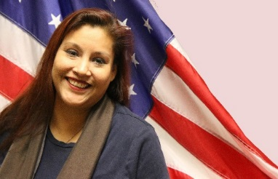
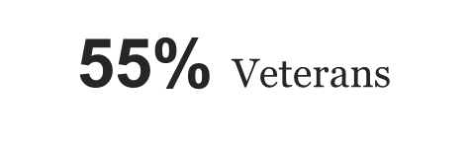
Seattle Overview
The mission of the Veterans Benefits Administration is to serve as a leading advocate for Servicemembers, Veterans, their families and survivors, delivering benefits and services that honor their service, assist in their readjustment, enhance their lives, and engender their full trust.
VSC
VR&E
758 Employees
DRAS
DROC
Notes:
From Manila to San Juan, it’s not quite fair to say the sun doesn’t set on VBA, but it’s pretty close
Employees: 23,509 (August 2018)
FTE: 22,182 (2018 current estimate)
FTE: 23,692 (2019 Request)

Slide 5
VBA Accomplishments
INITIATIVE | RESULT
JULY 4TH CHALLENGE encouraged claims processors to complete 255,000 claims from May 6, 2019 through June 30, 2019. This is a 20% increase. | COMPLETE! Claims processors were able to complete the challenge. As a result, they were given the 5th of July as a holiday.
TELE_COUNSELING provides Veterans the opportunity to meet with their Vocational Rehabilitation Counselors virtually. | COMPLETE! Veterans are able to reduce the need for travel. Appointments with beneficiaries average over 1,000 per month.
PREDISCHARGE REDESIGN explored business process changes to reduce the processing time in the Disability Evaluation System (DES). | Four recommendations: Require a Multi-Disciplinary Brief (MDB), Eliminate the statutory requirement to offer an Impartial Medical Review (IMR), Process Department of Veterans Affairs (VA) and DoD DES activities in parallel, and Eliminate the policy requirement for a Formal Physical Evaluation Board (FPEB) Appeal.
TIMLINESS OF CLAIMS PROGRESS to provide Veterans with accurate and timely service. | The FY19 Quarter 2 shows the average days to complete is 127.8 days, just 2.8 days above the 125 day target.
HOMELOAN GUARANTEES to protect lenders from loss if the borrower fails to repay the loan. | 31K Veterans were able to avoid foreclosure in FY19 Q2. Specially adapted house assistive technology grants totaling 800K were awarded in the 2nd quarter as well.
5
Notes:
VBMS
As of EOM April, processed 7.6M rating and non rating claims in VBMS since inception.
It is used in All 56 ROs and 5 District Offices, 148 VHA facilities and NCA, by VSOs, in the Appeals Management Center / Pension Management Centers and BVA
National Work Queue
The average number of days a claim awaited first development action has dropped from almost 25 days in January 2016 to 10.5 days in April 2017.
The amount of time claims that are awaiting a rating decision has dropped from 29 days in January 2016 to less than 7 days in April 2017.
Phase Two – non-rating work began in April 2017
Centralized Intake
As of EOM April 2017, VBA has extracted more than 612,000 inactive files from 11 Regional Offices including Philadelphia, Wilmington, Detroit, Indianapolis, Roanoke, St. Petersburg, Baltimore, Wichita, Boston, Togus, and Waco.
Decision Ready Claims
Pilot launched this month (May 2017) in St. Paul
Requires accredited VSO representation
Assessing expansion and rollout after the pilot to other ROs, national expansion, and expansion to other types of compensation claims

Slide 6
VBA Accomplishments
INITIATIVE | RESULT
PAPER EXTRACTION digitized inactive paper claims to reduce processing time and save money previously budgeted for storage. | COMPLETE! VBA removed nearly 8 million files across nearly 60 locations, improving processing time, reducing our physical footprint and saving taxpayer dollars.
CENTRALIZED INTAKE centralizes and digitizes all claims, further streamlining our processes and creating a fully digital operating environment where claims may be processed and delivered electronically. | Scanned over 4.29B IMAGES since inception, and reduced the average mail processing time for Regional Offices (ROs) to 13.2 BUSINESS DAYS from a peak of 55 business days in the beginning of 2015.
AUTO-ESTABLISHMENT OF CLAIMS populates data from scanned images to establish new claims for Veterans; zero VA staff data entry. | Over 56K CLAIMS have been auto-established since inception in May 2017. Has the potential to decrease claim processing time by UP TO 5 DAYS while also decreasing error rates through automation.
NATIONAL WORK QUEUE prioritizes and distributes workload across the nation based on VBA workforce’s real-time capacity. | The average days to complete a Veteran’s claim is 122.3 DAYS FYTD. Now processing Pension claims and managing new appeals work in the NWQ.
CENTRALIZED BENEFITS COMMUNICATION MANAGEMENT centralizes all printing and mailing, which all 56 regional offices previously did individually, to improve productivity and streamline correspondence with Veterans on their claims. | Over 9.2M letters have been generated, resulting in SAVINGS OF APPROX. $2.4M in postage costs.
6
Notes:
VBMS
As of EOM April, processed 7.6M rating and non rating claims in VBMS since inception.
It is used in All 56 ROs and 5 District Offices, 148 VHA facilities and NCA, by VSOs, in the Appeals Management Center / Pension Management Centers and BVA
National Work Queue
The average number of days a claim awaited first development action has dropped from almost 25 days in January 2016 to 10.5 days in April 2017.
The amount of time claims that are awaiting a rating decision has dropped from 29 days in January 2016 to less than 7 days in April 2017.
Phase Two – non-rating work began in April 2017
Centralized Intake
As of EOM April 2017, VBA has extracted more than 612,000 inactive files from 11 Regional Offices including Philadelphia, Wilmington, Detroit, Indianapolis, Roanoke, St. Petersburg, Baltimore, Wichita, Boston, Togus, and Waco.
Decision Ready Claims
Pilot launched this month (May 2017) in St. Paul
Requires accredited VSO representation
Assessing expansion and rollout after the pilot to other ROs, national expansion, and expansion to other types of compensation claims

Slide 7
POLICY UPDATES FY19
Presumption of Herbicide Exposure and Presumption of Disability During Service for Reservists Presumed Exposed to Herbicides (effective 10/22/2018)
Appeals Modernization (effective 02/19/2019)
Purple Heart Priority Processing (effective 02/26/2019)
Blue Water Navy
POLICY
UPDATES
Notes:
https://www.va.gov/ORPM/FY_2019_Published_VA_Regulations.asp

Slide 8

VASRD Update
Updating the VA Schedule for Rating Disabilities
VA is updating the 15 body systems of the VA Schedule for Rating Disabilities (VASRD) to modernize and improve the delivery of benefits to Veterans:
    Completed:
    Dental & Oral
    Endocrine
    Gynecological & Breast
    Eye
    Skin
    Hematologic & lymphatic
The updates will better reflect modern medicine, clarify rating criteria, help VA claims processors make more consistent decisions with greater ease, and ensure greater understanding of VA decisions
    Pending:
    Infectious Diseases (proposed rule published 2/5/19)
    Genitourinary
    ENT/Respiratory
    Neurological
    Cardio
    Digestive
    Mental
    Musculoskeletal
8

Slide 9

Appeals Modernization
The Veterans Appeals Improvement and Modernization Act took effect on February 19, 2019.
It creates a new, streamlined decision review process, which features three lanes:
  Higher-Level Review Lane – An entirely new review of the claim by an experienced adjudicator
  Supplemental Claim Lane – An opportunity to submit additional evidence
  Appeal Lane – Review by the Board of Veterans’ Appeals
The Appeals Management Office’s (AMO) Decision Review Operations Centers (DROCs) have processed the intake of over 9,200 AMA claims since February 19, 2019.

Slide 10

Forever GI Bill Implementation
One of the most significant changes to the Post-9/11 GI Bill since its inception
Notable changes in the bill’s 34 sections include:
  Provides 200+ additional Term FTE spread over FY18 (157) and FY19 (50)
  Makes the Post 9/11 GI Bill a lifetime benefit – does away with 15-year limit
  Restores GI Bill entitlement and provides relief to those affected by school closures
  Provides full Post 9/11-GI Bill benefits to Purple Heart recipients
  Includes Fry Scholarship into the Yellow Ribbon Program
  Expands eligibility for National Guard and Reserve
  Establishes a STEM Scholarship Program
  Makes changes to the transferability to spouses or children upon death of originally designated dependent
Since passage, VA has notified over 12,000 Veterans affected by school closures and restored almost 15,000 months of entitlement so they can get back to school
Over 350 area career and technical schools are now approved to offer an independent study program to Post-9/11 GI Bill beneficiaries, and VA has implemented 25 GI Bill related provisions

Slide 11


