Slide 1

Knowing what’s at stake-–Estate Planning and LTC Planning (VA Aid and Attendance )
Notes:
Add your name and firm info here, and change the title if desired.

Slide 2

Evergreen Elder Law
Who Are We
MISSION:
Help seniors and families understand their options and protect their futures.
Advise and guide our clients to best possible outcome
Provide peace of mind with compassion,
integrity and empathy.

Slide 3
Knowing your options is half the battle
Estate Planning
POAs
Medical
Durable
LTC Planning/ Asset Preservation

Slide 4
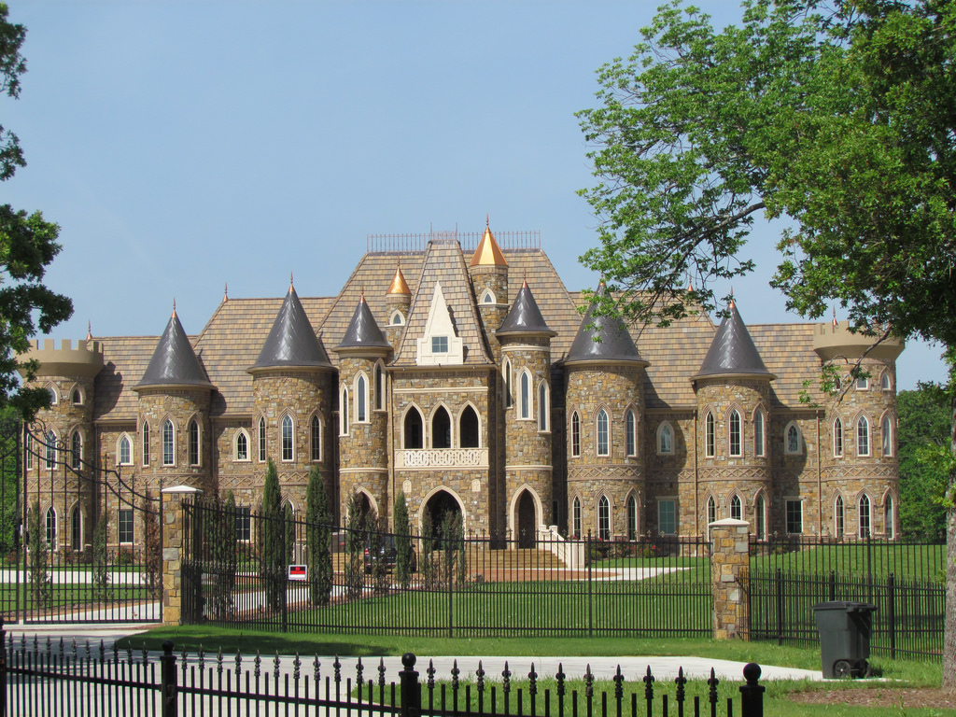
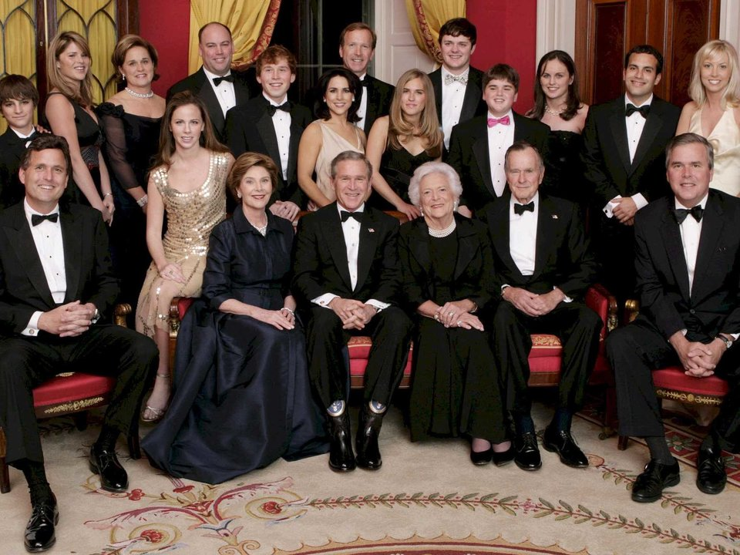

What constitutes as an Estate??

Slide 5





THE REALITY FOR MOST OF US

Slide 6
So what is an Estate Plan and what should it include
Last Will and Testament
Durable Power of Attorney for finance
Power of Attorney for Healthcare
Revocable/Irrevocable Trust

Slide 7
At Evergreen Elder Law we go the extra mile….
Special Needs Pop up Trust
Community property agreement
HIPPA Authorization
Attorney Authorization
Healthcare Directive/Living will
Anatomical Gift Form
“What to do when a loved one dies” checklist
A binder to keep all your family information, and financial information such as accounts and passwords.

Slide 8
At Evergreen Elder Law, we also….
Keep
Keep your original documents
Talk
Talk to you about your final arrangements
Educate
Educate you on LTC planning and asset preservation
Supply you with trusted referrals
Supply

Slide 9


We want to help you:
Understand your options
Protect your assets
Make a plan for the unforeseeable
Have peace of mind

Slide 10


And Here are The Facts…
Approximately 10,000 people a day are turning 65
Average Life Expectancy is 84
75% of all of here will need some form of LTC
Average cost of LTC can ranges from $1K-17K per month

Slide 11


WHAT IS LONG TERM CARE
“LONG TERM” MEANS
“CARE” MEANS
MORE THAN 100 DAYS
ASSISTANCE OR HELP

Slide 12
Long Term Care can be provided
At home
Alternative Living Facility
Independent living
Assisted Living
Adult Family Home
Memory Care
Skilled Nursing Facility

Slide 13
Costs
Assisted Living Facilities range from $3,500- $12,000 per month
Private room in a nursing home in WA State is $102,200 annually
Memory care or Skilled nursing costs range from $12,000-$17,000 per month
In home care, average cost per month of a home care worker is $18.00-$30.00 per hour
And lastly the cost of caring for your loved ones at home, and keeping them safe and well cared for, can leave the care giver exhausted and depressed

Slide 14
How do people pay for the care they need?
Cash
LTC Insurance
Medicaid
And in the case of many of you VA Aid and Attendance Pension Benefit

Slide 15

What is the VA Aid & Attendance Benefit?
Monthly cash benefit paid to eligible wartime Veterans or their surviving spouses
Helps to defray cost of long term care
  In Home Care
  Assisted Living
  Adult Family Home
  Skilled Nursing
  May include some types of independent living situations
Notes:
The purpose here is to give a quick reminder of what VA pension benefits are without getting into too much detail.

Slide 16

VA Pension
VA Pension: Cash Benefit
Single Veteran = $1,881 per month
Married Veteran = $2,230 per month
Surviving Spouse = $1,209 per month Married Veterans= $2,984 per month

Slide 17
Rules To Qualify
90 days consecutive active duty
At least one of those days during period of war
Received anything other than a dishonorable discharge
Must have 2 medical needs
(ADL’s)
Meet the asset and income test
Which is how an Elder Law Attorney will be able to qualify you by re-allocating the assets into exempt areas

Slide 18

Periods of Conflict are as follows:
WWII - December 7⁻ July 26, 1947
Korea - June 27, 1950 - January 31, 1955
Vietnam - August 5, 1964 - May 7, 1975
Gulf War – August 2, 1990 - TBD
  (24 Months Active Duty Required, for Gulf War)
Thank you to all our military personnel for the sacrifices you have made for our freedom

Slide 19

What Qualifies As Medical Needs?
Assistance with:
Transfer
Walking
Feeding
Bathing
Driving
Toileting

Slide 20

Who can make a medical needs determination?
You may be pre-qualified if you are currently living in an assisted living or skilled nursing facility.
If you are receiving home care a qualified Medical Professional or a Professional Assessment Service may help qualify you.

Slide 21
Asset-Income Qualification
Once we’ve qualified the assets, we must now address the income cost of care ratio.
Cost of care needs to exceed the income to qualify the Veteran.
Cost of care may include
In home care
Assisted living
Skilled nursing
Adult Family Homes
In some cases the rent for independent living situations
Medical costs which include prescription costs, insurance costs and some supplies.

Slide 22

Preplanning/Asset Preservation
An Elder Law Attorney is able to formulate strategies to safe guard your desired future by moving assets.
We know preplanning for the Long Term Care needs that you may or may not have can seem absurd…but here are some things to consider.
  There is a 3 year look back period
  Certain transfers of real property and liquid assets will be allowed
  Liquid assets can be a maximum of $123,600 at time of application

Slide 23

Why Do I Need An Elder Law Attorney?
The qualification process can be complicated, and its about to get more difficult to qualify immediately.
There are legal strategies that can help you qualify faster, while preserving more of your assets.
A VA Accredited Elder Law Attorney will keep in mind that your care costs could sky rocket. While qualifying you for VA, they keep an eye on Medicaid planning for your future if you should need it.
Notes:
Many members of the public may think an attorney is not necessary, so this slide is designed to help them understand why your services are necessary.
You may want to further explain what other planning may need to be done: powers of attorney, living wills, revocable trust and/or will.

Slide 24

Don’t Wait
Make an appointment to meet with us. We have set aside time for crisis planning, and for pre-planning/asset preservation.
At Evergreen Elder Law we look forward to working with families and seniors. We offer Estate Planning, Long Term Care Planning and Estate Administration. We like to think of it as, a continuum of care. We want to serve families from one generation to the next.
Notes:
Customize your call to action – what do you want listeners or attendees to do next?

Slide 25

Thank You for your service, and thank you for joining us. We know what’s at stake.

