Slide 1
Introduction to Equity, Diversity, and Inclusion (EDI)
Notes:
Herminia Esqueda
5 min
Welcome to “Introduction to EDI”
Equity, Diversity, Inclusion, social justice, unconscious bias, implicit bias, explicit bias, privilege, ethnicity, racism, LGBTQ, gender identity. All that terminology! It can be overwhelming. It can be uncomfortable. So uncomfortable that it’s tempting to just ignore there’s an issue and maybe it will just go away. But it’s not going away. We just ask that you “Do the best you can until you know better. Then when you know better, do better”.
We don’t promise that you will be fluent in the EDI language today but we hope that you will take enough away that you begin to view things thru an EDI lense. Sometimes we don’t enter those conversations about equity, diversity and inclusion for fear of someone calling you out “I don’t think that means what you think it means” or offending someone, “Do I call you Mexican, Hispanic, Chicana or Latina?”. Even today the terms we will be using may have different meanings to different people, based on their experiences. We’ve tried to capture a list of common EDI terms and we’ve made them available to you as a handout. Hopefully, discussing some of those terms today will help you with some self-awareness and self-reflection on how I can do better now that I know better, and make you more comfortable to have those EDI conversations.
But First some introductions…

Slide 2
Welcome
Sawubona – I see you
Ngikhona – I am here
Introduce yourself to someone you are not sitting next to and tell them a little known fact about yourself
Notes:
5 min - Herminia
In Africa the Zulu tribe greets each other with Sawubona
The response is “I am here”. Because you are not considered present until someone sees you.
We are a small group so go find someone that you are not sitting next to and tell them a little known fact about yourself. You may be surprised at what you have in common.
The point of EDI is to allow our lense to see who is at the table, value our differences and perspectives, and notice who is not present that needs to be there.
My name is Herminia Esqueda and a little known fact about me is that I was part of a Mexican Folkloric dance troupe in college.

Slide 3
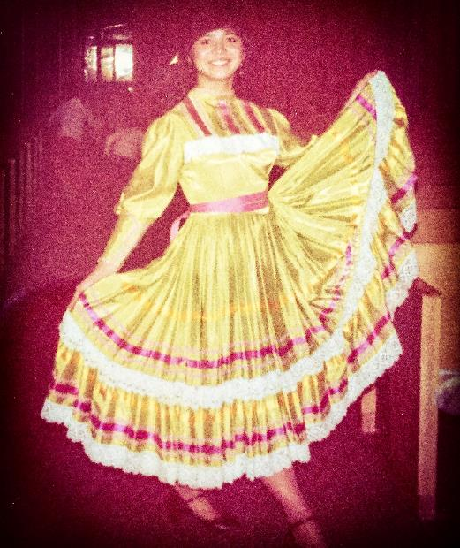
Introductions
Notes:
5 min - Herminia
In Africa the Zulu tribe greets each other with Sawubona
The response is “I am here”. Because you are not considered present until someone sees you.
We are a small group so go find someone that you are not sitting next to and tell them a little known fact about yourself. You may be surprised at what you have in common.
The point of EDI is to allow our lense to see who is at the table, value our differences and perspectives, and notice who is not present that needs to be there.
My name is Herminia Esqueda and a little known fact about me is that I was part of a Mexican Folkloric dance troupe in college.

Slide 4
Why EDI?
ESA Strategic Plan:
Support and promote a diverse and inclusive workforce.
Notes:
5 min. The Why? Jessica
Part of the triple bottom line is employee engagement and customer satisfaction. In order to do that we have to be proactive and intentional about supporting and promoting a diverse and inclusive workforce.
Measures: Increase two EDI Employee Survey questions from 71% to 74% “always” and “usually”
Increase the number of Certified Diversity Professionals and Executives.
Implement EDI initiatives – Leadership support, HR opportunities,
Community of Practice, and middle manager forums
Identifying creative solutions to internal challenges through diversity.
✓ Creating physical environments that welcome and support diverse teams equitably.
✓ Trust-building among diverse colleagues, stakeholders, and constituents.
✓ Demonstrating social justice, racial equity, and inclusion excellence through outstanding service
that regards “barriers” as moveable.
✓ Learning to include and leverage the perspectives of our diverse customers.
✓ Transformational performance that drives talent outcomes through meaningful employee,
supervisor and leadership dialogues.
✓ Increased team cohesiveness based on trust, effective conflict resolution, accountabilitycommitment, and group goal accomplishment.
✓ Increased opportunities for professional mastery, development, contribution, engagement,recognition, promotion, and retention based on embedding principles of equity, diversity andinclusion.
Because a critical piece to EDI is dialogue. Dialogue with our peers, clients, stakeholders, and partners to communicate our values and our actions.
Learning terminology is the beginning of educating ourselves so we can implement EDI practices within ESA. Language is and always will be an essential element in the struggle for understanding among peoples. Changes in the words and phrases we use to describe each other reflect whatever progress we make on the path toward a world where everyone feels respected and included.
At ESA we believe EDI is important for our customers and in the work of eliminating poverty. To do that we need to build EDI into the culture by educating and implementing EDI practices within ESA. This workshop is a part of that education piece.
You’re not going to learn everything about EDI in this workshop. This is merely an introduction. Hopefully to start taking steps to become self-aware and finding your blind spots. Nobody can do this work for you. We have included articles and information on the ESA EDI Sharepoint site for you to read and watch videos. Sit in your discomfort, listen, read, watch, and learn.
We have to communicate, we have to dialogue, we have to talk and then build systems to implement EDI into our policies, practices, and culture. It begins with speaking the same language.

Slide 5
Jessica Gempler
Instructional Designer
Community Services Division
Notes:
Good Morning. My name is Jessica Gempler and I am with Community Service Division. I have been with the department for 20 years and have been part of the training and design team for the last several years. We are responsible for developing training to over 3000 staff members’ in various CSO and call centers statewide. For the last ten years, I have been working on bringing comprehensive poverty training to our division. Makes sense, right. Our programs serve customers that are various levels of the FPL.
This has been a labor of love for me. I wanted my staff to better understand and treat with kindness and respect those on the other side of the counter. Because for most of my life, that is where I stood.

Slide 6
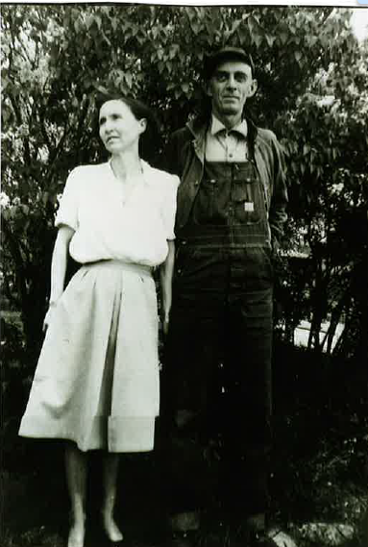
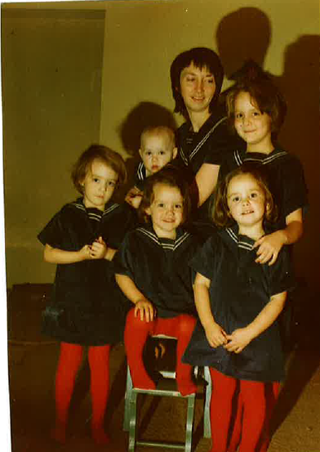
Notes:
My grandparents married during the great depression and spent their honeymoon looking for work in the Midwest. After the birth of their youngest (my mom) the doctors recommended they relocate from Kansas to Selah, WA where they could be treated for tuberculosis at the state TB hospital there. So with their seven kids in tow, they came west. My grandfather died and my grandmother was left to raise her kids.
My mom married my dad instead of finishing school and had six kids. My dad skipped out when I was 2 and rarely paid child support. My mom worked sometimes three jobs to support us, but minimum wage doesn’t stretch that far so she relied on safety net programs: low income housing, food stamps-you name it. Since my mom worked a lot she was rarely home, and we kids raised ourselves. We lived in low-income housing in ethnically diverse areas. My best friends were Mexican. I grew up learning Spanish and going to Mass and experiencing their culture. Because of my friendships with people of color, I knew from my neighborhood what words were OK to say and which words would get me in trouble.

Slide 7
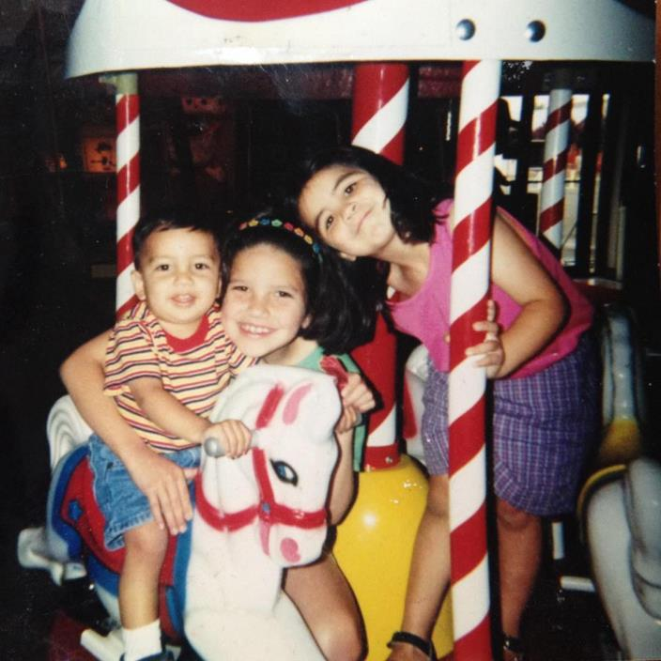
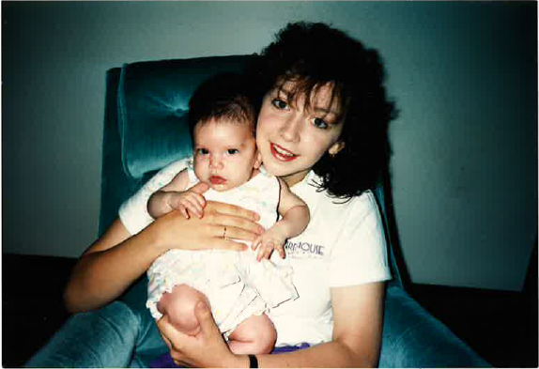
Notes:
Growing up I understood the challenges faced by those in poverty. My family was impacted by the challenges many in poverty face: homelessness, drug dependency, legal issues and of course teen pregnancy. I had my daughter Olivia at 17 and dropped out of school - her brother and sister soon followed. I have worked hard to break the cycle of poverty for my family but it has been a long journey. Their father was often unable to work due to circumstances related to his combat duty and our relationship unraveled.
My ex is Mexican American, the child of first generation agriculture workers who came to the US as part of the bracero program. My kids were raised with his family and my best friend’s family in a vibrant culture of food and music and Mexican tradition. When my kids were little I began to realize that the TV shows they watched and the books they read had characters that looked like me, not my kids. So I searched hard for books and toys that looked like them. I wanted them to have figures that were celebrated and normalized because representation matters.
Because I grew up surrounded by the cultural diversity of my community, friends, and my first husband, I thought I knew how the language of cultural diversity and inclusion. I worked hard to protect and support the ethnic and racial diversity of my own friends and relations. I learned about what they needed from me, and the language that they needed me to speak as a white family member and friend.

Slide 8
Notes:
My ex is Mexican American, the child of first generation agriculture workers who came to the US as part of the bracero program. My kids were raised with his family and my best friend’s family in a vibrant culture of food and music and Mexican tradition. When my kids were little I began to realize that the TV shows they watched and the books they read had characters that looked like me, not my kids. So I searched hard for books and toys that looked like them. I wanted them to have figures that were celebrated and normalized because representation matters.
Because I grew up surrounded by the cultural diversity of my community, friends, and my first husband, I thought I knew how the language of cultural diversity and inclusion. I worked hard to protect and support the ethnic and racial diversity of my own friends and relations. I learned about what they needed from me, and the language that they needed me to speak as a white family member and friend.

Slide 9
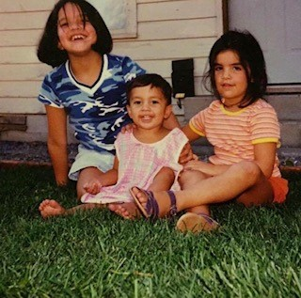
A person's enduring physical, romantic, and/or emotional attraction to another person
Sexual Orientation
Notes:
My youngest – Solomon – first came out as gay as a middle schooler, though they now identify as queer. When Solomon came out, I understood that it had to do with their sexual orientation – who they were romantically attracted to.
Sol presented as more feminine even as a toddler dressing up in their older sisters pink dresses and playing with Barbie’s. They were bullied starting in elementary school and living in our conservative community, safety was always an issue. If sol were choosing to wear something pink, I would remind them that it might result in teasing. Were they sure they wanted to take that risk? I worked hard at trying to change their behavior or expression instead of working on changing the world to be more accepting. I didn’t know better.

Slide 10
A person's enduring physical, romantic, and/or emotional attraction to another person
Sexual Orientation
Gender Identity
One’s internal sense of being male, female, neither of these, both, or another gender(s).
Gender Expression
How a person chooses to express their gender through their appearance.
Notes:
I am cisgendered. It is a term for people whose gender identity matches the sex that they were assigned at birth. Transgender people are those who were assigned one sex at birth but align more closely with spectrum different gender identity. Some trans people experience and express gender differently. Many trans people, like my child, identify with many aspects of femininity but not wish to describe themselves as women. Sol chooses to use they/them pronouns.
Sol identifies as Trans feminine, that is their gender expression, and how they choose to express their gender through their appearance and their pronouns are they/them/theirs. It took me a while to understand all of this and I have learned that it is now my own responsibility to advocate for them and educate others

Slide 11
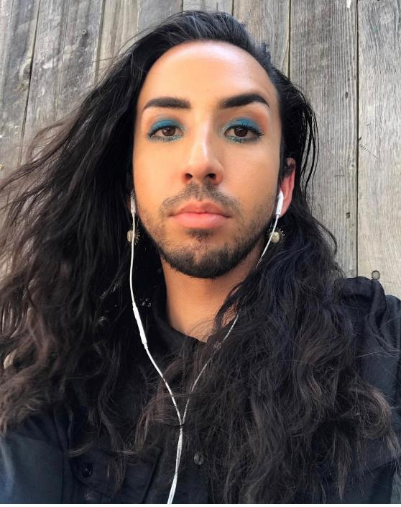
Transfeminine- assigned male at birth, but identify with femininity to a greater extent than masculinity.
Notes:
is a term used to describe transgender people who were assigned male at birth, but identify with femininity to a greater extent than with masculinity.

Slide 12
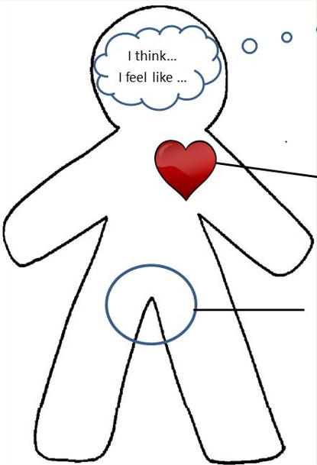
Gender Identity
Female Male
Trans/Gender Non-conforming
Sexual Orientation
Heterosexual Homosexual Queer Bisexual Pansexual Asexual Questioning
Sex assigned at Birth
Female Male Intersex
Gender Expression
Masculine Feminine Neutral Androgynous
Notes:
I knew how to do poor and I knew how to do Mexican but I didn’t know much about the , lesbian, bisexual, or queer community or experience. I knew that it was important to find role models for my kid to relate to. This was hard There weren’t kids books or dolls of gay, queer, or trans kids and this was before I am Jazz was on TV. So I set out finding ways for Sol to know that they belonged and there were others like them. I found people that I could lean on and learn from. People I could introduce Sol to or casually mention in stories. “My friend Brian and his husband bought a new puppy.” People I could ask questions or share pictures of Sol and their prom date. I wanted to show Sol that there were others in the community that were just like them leading lives that were full who had partners and took vacations and had cute puppies. That were successful doctors and lawyers and state workers. Because representation matters.

Slide 13
Notes:
I told only my closest friends at work about Sol, not because I was embarrassed or wasn’t proud of them but because in conservative Yakima I chose to not invite criticism or critique. A few years ago after the shooting at the Pulse nightclub in Orlando when I saw pictures of the victims and they all looked like my queer, Latinx child; I decided that it was past time for me to remain silent. I could choose to not talk about it but Sol and others like them didn’t have that choice.

Slide 14
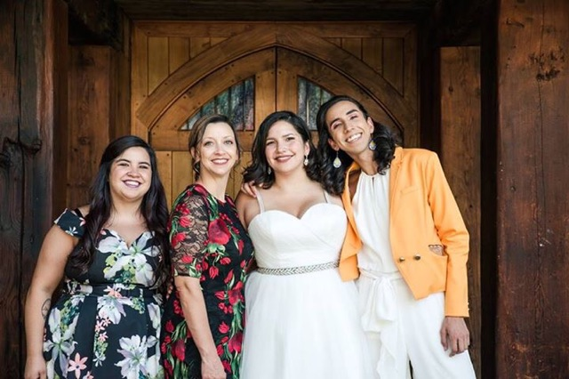
Notes:
So why is a straight, cis gendered white woman up here talking about diversity? Because I relied on Brian and Sol to teach me about the LGBTQ community and terms. But I don’t want Sol to continue having to do that emotional labor. I can use my privilege to start the dialogue about EDI so we can learn more and do better.

Slide 15
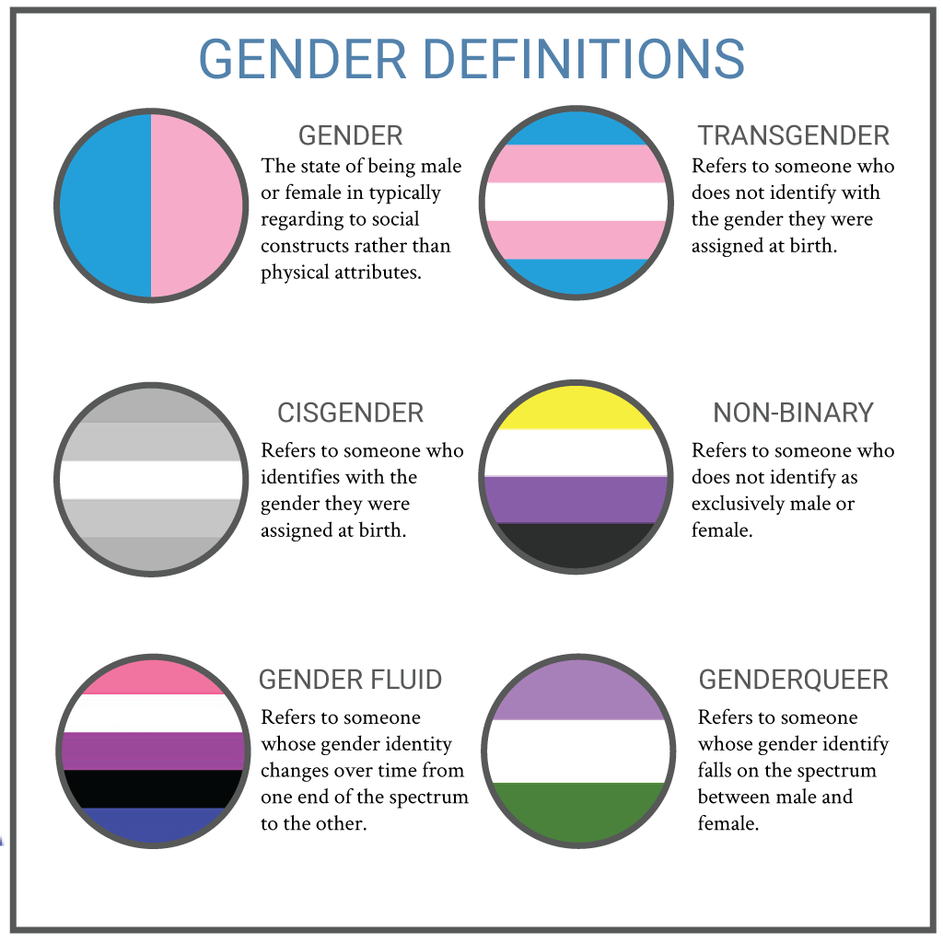
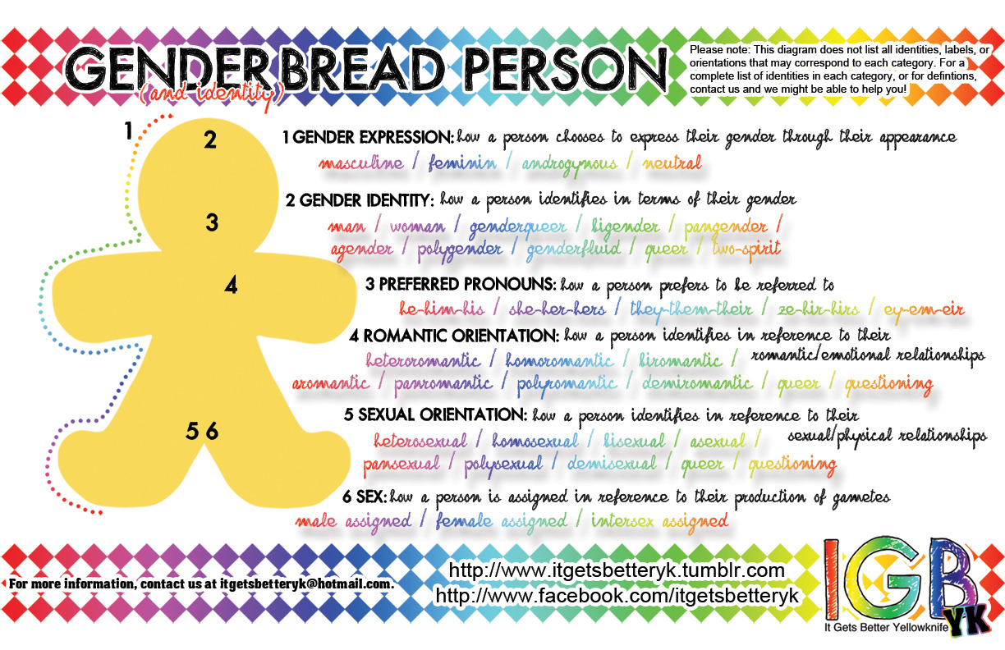

Slide 16
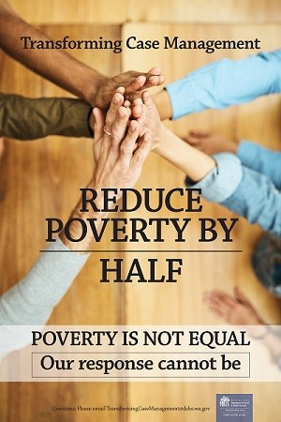
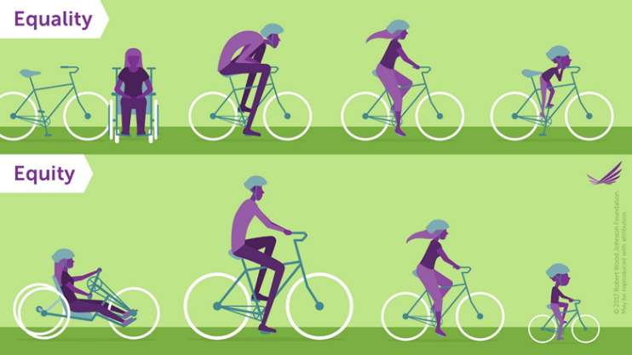
Equity
Equality: Sameness-Everybody gets exactly the same thing regardless of need.
Equity: Fairness-Everybody gets what they need to have the same opportunity or experience.
Notes:
5 - 10 min - Herminia (don’t forget candy)
We’re going to talk about
“As part of our commute trip reduction program, I get to be Oprah today and I am giving away bicycles. “You get a bike” and “you get a bike” and “you get a bike. You all get a bike. Outside we have 100 Diamondback 14 speed 26 inch Men’s road bikes. “ Not really. Sorry. But this is an example of equality.
5 – 10
Equality is Sameness-Everybody gets exactly the same thing regardless of need.
That bicycle might make life better for my friends and neighbors. I shouldn’t have any hard feelings. They did offer me the bike too and it was free. I guess I can give it to someone and make their life better. I can’t complain because I was treated the same. If I complain some people might even say, “Why are you complaining? Everybody got the same thing.” We may have even said it ourselves, “ If I made it with the same resources you had, then why can’t you make it, just pick yourself up from your bootstraps” That’s equality.
Now, what if I told you there are men’s and women’s, and children’s bikes and beach cruisers, and mountain bikes, and three wheel cruisers and stabilizer wheel kits and tricycles and you get to pick the best one that works for you. Now that’s equity. Everyone gets the one that best fits their needs. Better yet, what if you could custom order your bike? Now everyone has the same opportunity to ride a bike to work. What if you don’t know how to ride a bike, or have no place to store it, or live on a busy freeway? Maybe carpooling, or a bus or train pass would benefit you more.
Equity is Fairness-Everybody gets what they need to have the same opportunity or experience.
How can we incorporate that into the workplace? What does equity look like in the workplace? Everyone answers? PDF example lift versus move an object.
Fancy bike represents peanut Baby Ruth’s - How many here like Butterfinger? Are you happy that I gave you peanut M and M’s? Yes!!
Is there anyone here who cannot eat Peanut M and M’s due to an allergy or medical condition? Is it fair that you cannot get to work because this bicycle does not work for you? No. How about if I offer a women’s bicycle represented by the plain M&M’s? Will a shorter bicycle work for you? Yes, Who wants a women’s bicycle? However, you may not need a bicyle to get to work. You live a distance away and rather have a bus pass. Represented by these sugar free.
I saw this poster on the wall in a CSO and thought wow, that’s EDI. Transforming Case Management is an example of recognizing that our response cannot be the same for everyone.

Slide 17
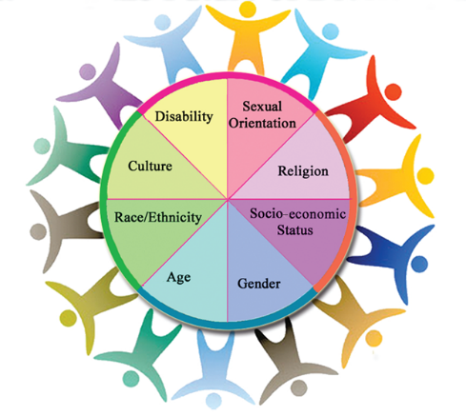
Diversity
Diversity: Difference-Variety of human identity, culture, experience.
Notes:
10 min – 15 min Herminia (Jessica will introduce activity)
Diversity in the workplace is just as important, because representation matters.
Diversity is Difference-Having a variety of human identity, culture, experience. It is all-inclusive and recognizes everyone and every group as part of the diversity that should be valued. When we are diverse we have a variety of ideas and perspectives because we have different experiences. Diversity needs to be cultivated, supported, and reinforced.
Diversity is not only about ethnicity, it’s age, abilities, sexual orientation, religion, gender, socio-economic status. We each represent an intersection of all of these areas which makes each of us unique. I may be a person of color but my experiences are not the same as my friend Leland. I may be a woman but my experiences are not the same as my friend Marianne. When we are intentional about including different intersections, we create spaces where we can learn from different lenses.

Slide 18
Identity Activity
Place your name in the center circle of the structure below.
Write an important aspect of your identity in each of the satellite circles – an identifier or descriptor that you feel is important in defining you. For ex. Asian American, female, mother, athlete, dancer, Jewish, photographer etc.
Choose one of the options at the bottom of the page to share with your partner.
Notes:
Jessica
Activity: At the end of your terminology packet is a circles activity called - Who am I?
Ask participants to write their names in the center circle. They should then fill in
each satellite circle with a dimension of their identity they consider to be among
the most important in defining themselves. Give them several examples of
dimensions that might fit into the satellite circles: female, athlete, Jewish, brother,
educator, Asian American, middle class, etc.
Write down a stereotype they have heard about one dimension of their identity that fails to describe them accurately. Ask
them to complete the sentence at the bottom of the handout by filling in the
blanks: "I am (a/an) ____________ but I am NOT (a/an) _____________." Provide
your own example, such as "I am a Christian, but I am NOT a radical right
Republican."
Take five minutes to share your four identifiers and your sentence with your partner.
If time does not allow for the activity, explain diversity:

Slide 19
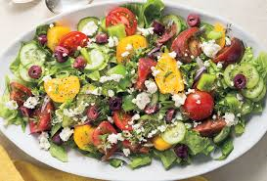
inclusion
Inclusion: Participation-Not just asked to join in but being seen, heard, and valued.
Justice: Liberation-The structural, systemic, and historical barriers that have been in the way of some people and groups are identified, owned, and removed.
Notes:
5 minutes - Herminia (share interview panel story) What is the impact in your world when not everyone is represented and included?
It’s not enough to be diverse. It’s not enough to have representation. If we valued them enough to include them then we need to value them enough to assure their participation so we can hear their perspective and ideas. We need to be intentional about Inclusion AND participation, being intentional so that everyone is seen, heard, and valued.
How do we do this at work? Write ideas on board/paper. As facilitators making sure everyone has an opportunity to share their ideas. As supervisors creating balance so that some team members are not the only ones voicing their opinions. That may mean different methods in gathering ideas. Committees and workgroups making sure all needed voices are at the table, not just those that always volunteer. Safety Committee or Planning Committee needs to include someone who is impaired. LEP committees should include bilingual staff. Create meeting agendas for those who have different learning styles to absorb information. We need to think about how we work moving forward. Hiring for differences to make sure staff, management, and leadership not only represent our communities but the different populations are seen, heard, and valued by impacting our policies and procedures.
Which takes us to Justice: Liberation-The structural, systemic, and historical barriers in that way of some people and groups are identified, owned, and removed. Justice ensures: (I grabbed this from the internet)
that people receive their “fair share” of the goods available,
that people receive “fair treatment” from their institutions,
that people’s actions conform to the rules of “fair play” and
that injustices are adequately addressed.
What happens when we smother a salad in ranch dressing? Or smother that ice cream with syrup and whip cream? You’ve now made it all taste the same and the individual flavors are unrecognizable. That’s what happens when we have diversity but not inclusion.
I like to use food salad as an example, At a salad bar we have all these individual toppings like carrots, peas, beets, or maybe you prefer cheddar cheese, croutons, and cottage cheese. Each item by itself may be ok but altogether it makes for a better salad. That’s our goal with diversity, to be a better salad.
Maybe that’s too healthy, I also like to think of us as ice cream. I know some of you like the simplicity of traditional vanilla, chocolate, or strawberry. But many, if not most of us prefer a combination of flavors, for example, chocolate chip mint, dulce de leche, strawberry cheesecake, cookies and cream, salted caramel. A mix of flavors that together make a better ice cream.
Wrap up: That’s what diversity does. It brings together a mix of human identiy, culture, and experience for a better team, office, and organization. By recognizing people’s similarities and differences, we can become better employees and stronger leaders. In order to help people learn how to recognize and correct steotypes, to find common ground and to be able to work with and celebrate difference within the team, open communication about diversity must be fostered.
Share interview story
Question for the group - What happens in the workplace if we only have diversity but not inclusion?
5 min

Slide 20
Breakout Session – Terminology Handout
- Pick a partner
- Each pick a term or two to discuss definition and understanding
- How do these terms impact the workplace and your everyday life-10min.
Notes:
As time allows – Jessica
10 – 20 min.– Introduce Activity
This activity is to help you learn to appreciate the importance of language in discussing EDI and how the PROCESS of discussing the definitions adds to the understanding of the terms.
Pick one term from the definitions list , turn to the person next to you discuss the term. Feel free to get up and find a pair.
The goal is to interact to gain insight and understanding and to seek to learn and understand
1 minute to introduce activity. Talk for 5 minutes about your terms
Now talk five more minutes – How do these terms impact the workplace and your everyday life.
and 4 minutes to bring it back as a group for anything that stood out to you
Story is important for connection, empathy, representation, perspective,

Slide 21
Notes:
Herminia
Let’s all say the color of the word out loud altogether, from top to bottom starting with row one

Slide 22
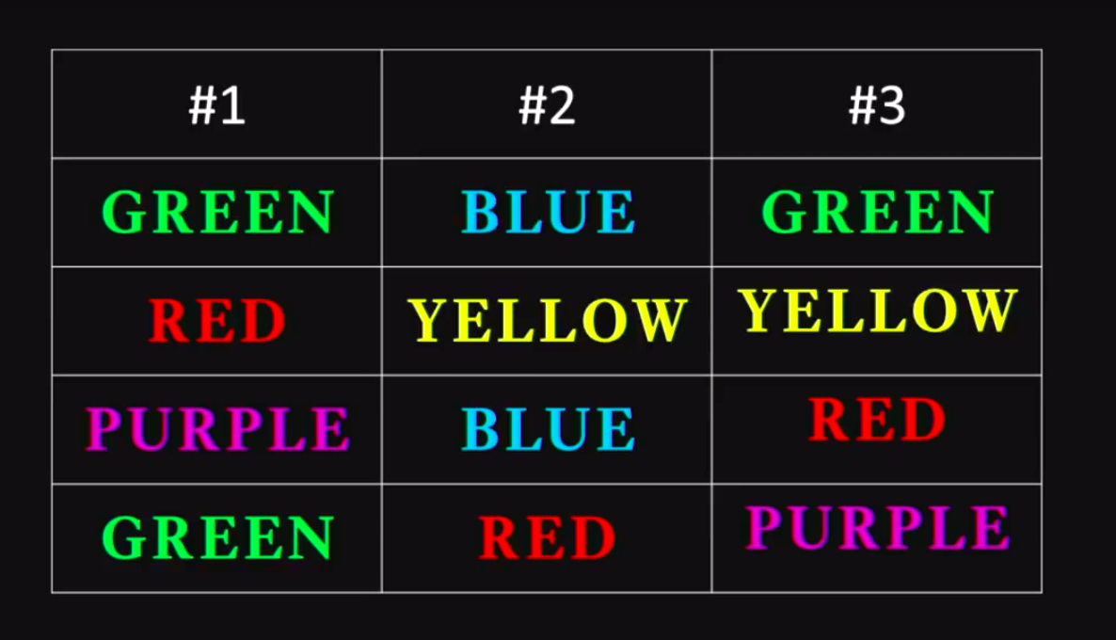
Notes:
Let’s do it again

Slide 23
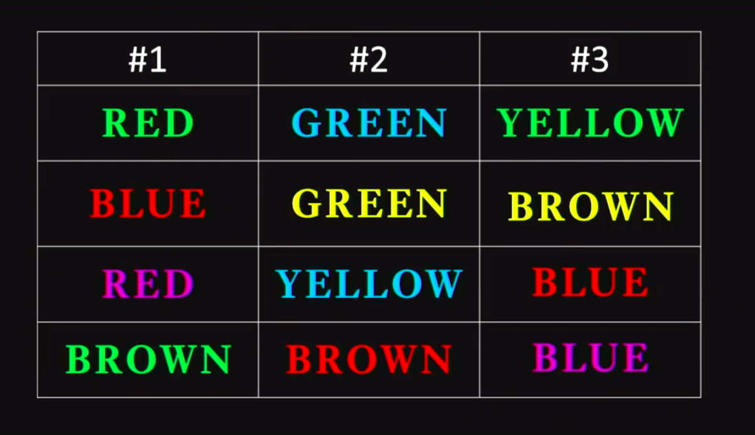
Notes:
Let’s do it again.
Which time was the hardest? Why?
Our brains are trained to form paths so we can respond quickly based on how we have been trained to respond previously.
Sometime regardless of what your values are..
Everyday we do that to people..
We have unconscious thoughts that evaluate others; sometimes we may even surprise ourselves when those thoughts are in complete conflict with our values,

Slide 24
Say something about this…
Implicit Bias – Also known as unconscious or hidden bias. Implicit biases are negative associations that people unknowingly hold. They are expressed automatically, without conscious awareness.
Homework:
First Thoughts…. – For one day write down your first thoughts when you encounter, read, or hear about someone who is different than you…
Notes:
Everyday we do that to people..
We have unconscious thoughts that evaluate others; sometimes we may even surprise ourselves when those thoughts are in complete conflict with our values,
When those thoughts evaluate one group and its members over another it’s implicit bias, especially when we don’t even realize that we did it. The myth is that we think that only bad people have implicit bias. All people have implicit bias.
Share Millie story
The first step is to recognize them.
If you care to know yourself better so you can do better. Here is a little homework exercise called First thoughts. So in order for them to go from implicit to explicit, write it down. For one day, note your first thoughts when you encounter, or read, or hear about someone who is different from you. Do not judge your first thoughts, just write them down. Now it’s going from implicit to explicit. Reflect on the list, did you evaluate? Was it a bias?
I said earlier that I was going to share a little bit more about myself.

Slide 25
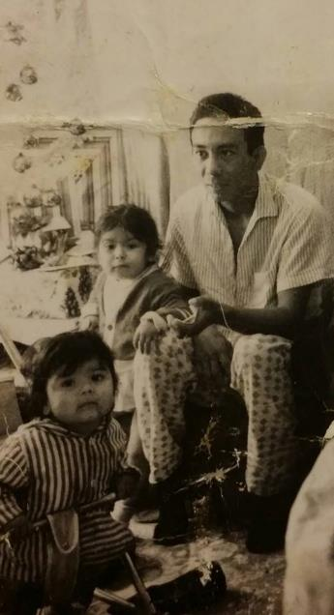
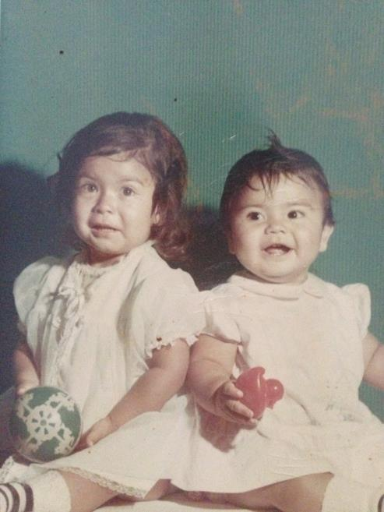
My Story Herminia Esqueda

Slide 26
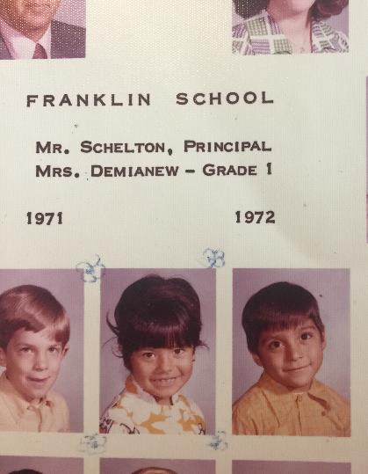
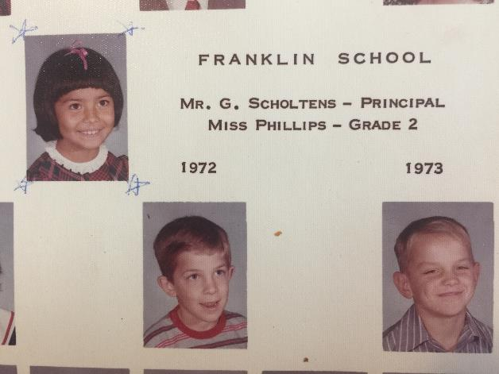

Slide 27
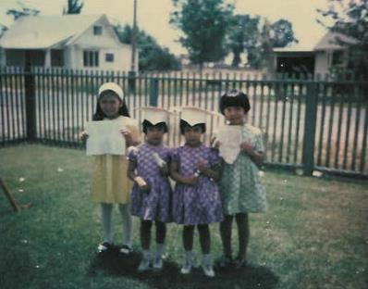
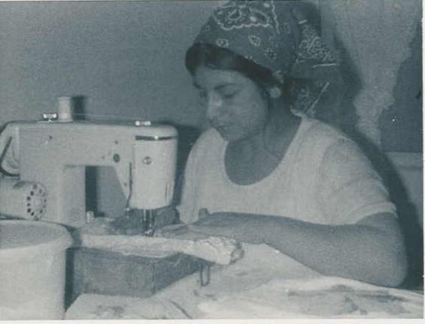
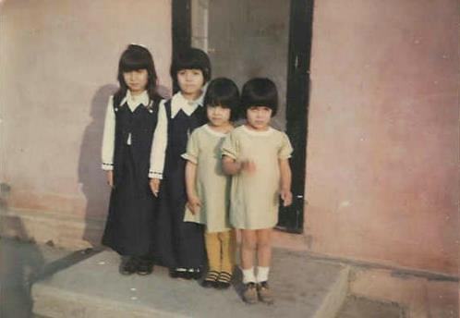

Slide 28
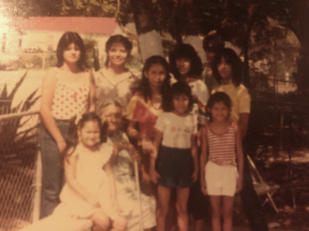

Slide 29
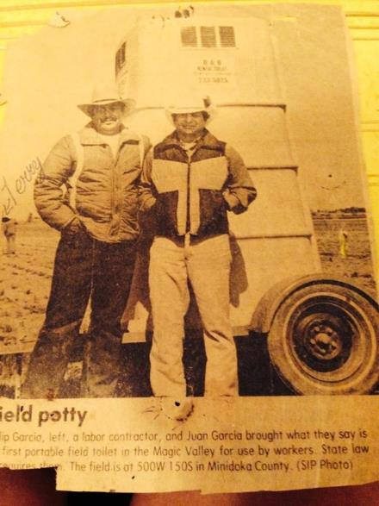

Slide 30
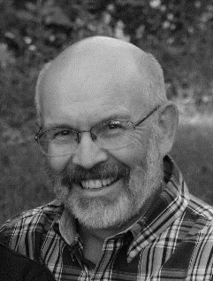
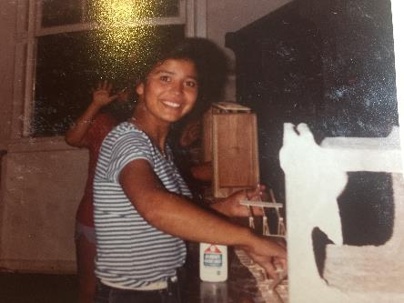
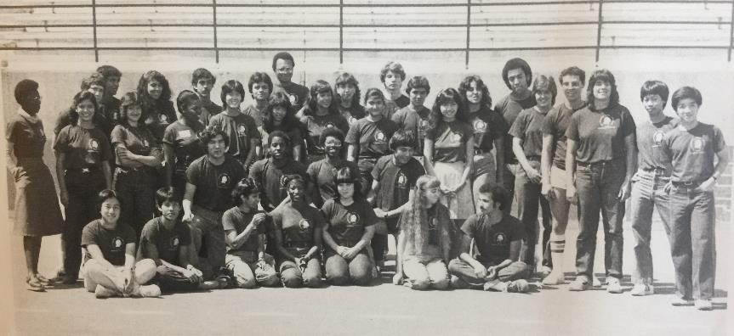
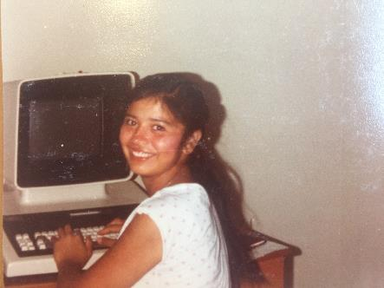

Slide 31
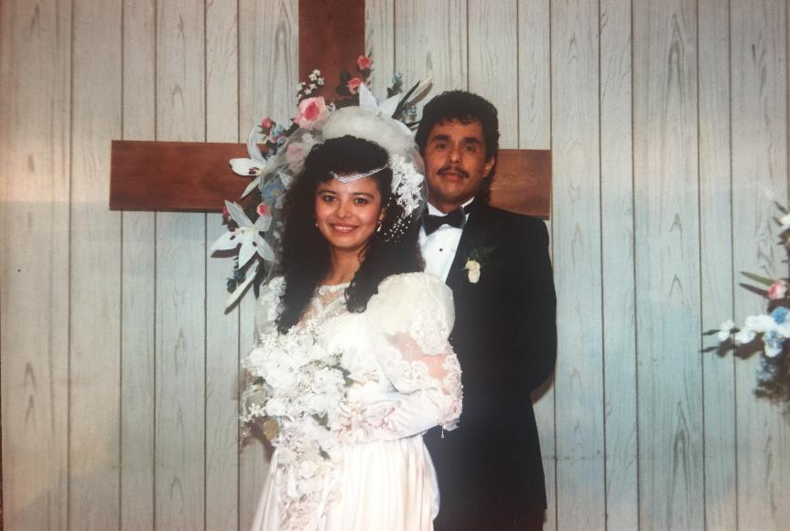

Slide 33
Personal Vision Statement
I do not have a spirit of shame, bitterness, fear, hate or self-pity.
But a spirit of love, power, forgiveness, compassion, and justice, to live a life of service so that no one is invisible.
Notes:
Sawubona
I am a Latina, I am a dancer, I am a Math geek, I am a Christian

Slide 34
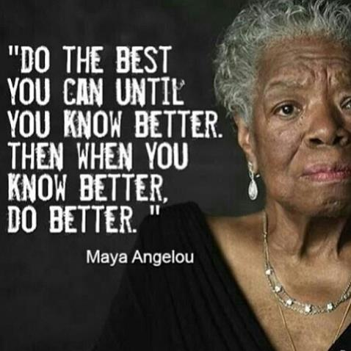
Wrap Up: Now that you know a little bit better, how will you do better? What else can we do to continue to have this conversation?
Notes:
5 min. Wrap up – Jessica
How can you incorporate what you learned today?
There are so many more terms we did not cover. There’s words that we did not include on the list. Terminology is always changing. The key thing self awareness – hopefully you are aware of some new terms that have made you think about equity, diversity, and inclusion in new ways. Go out and educate yourself, there are articles and videos on the ESA Sharepoint site. Start there.

Slide 35
Contact Information
Jessica Gempler
CSD Instructional Designer
509-655-0117
Gempler.Jessica@dshs.wa.gov
Herminia Esqueda
CSD IT Team
509-439-5309
Esqueda.Herminia@dshs.wa.gov
Notes:
If you have any questions, feel free to contact

