Slide 1
WorkSource The Key to Landing Your Next Career

Slide 2
Overview
What is WorkSource?
What services are available for veterans and transitioning service members?
What do we do for employers?
How about government employment?
Tips to landing a career

Slide 3
Executive Order 19-01*
Governor Inslee’s First EO in 2019
Honors military spouses and extends many benefits afforded veterans:
Expands and renames WA State Military and Readiness Council
Mandates agency targets for procurement from veteran and military spouse-owned businesses
Orders development of veteran and military spouse employment plans by agencies
Extends Veterans Employee Resource Group (VERG) to military spouses
Mandates development of centralized data share and information warehouse

Slide 4
Supporting the bases
Engagement at TAP and/or CAPSTONE briefings:
WorkSource roles
Registration in WorkSourceWA (for TSMs remaining in WA)
Warm handoff to gaining AJC (in or out of state)
DVOPs or AJC staff reach out to TSM/Veteran upon arrival at new home of record
Reengagement at moment of greatest need
Seamless hand-off

Slide 5
Employer Recognition Programs
YesVets
Annual Hire-a-Veteran Award
DOL/VETS HIRE Veteran Medallion Award

Slide 6
YesVets Program

Slide 7
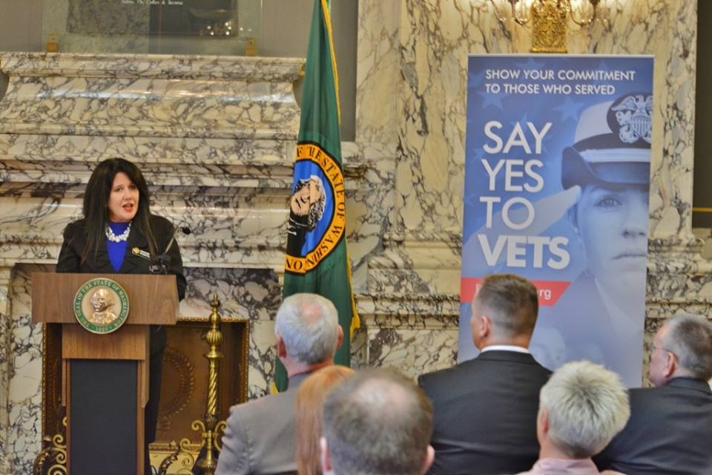
YesVets Program

Slide 8
HIRE Vets Medallion Program
Employers:
Certificate/Award from the Secretary of Labor
Rights to a “digital” Medallion with year of award to use, including as part of an advertisement, solicitation, business activity, or product
Criteria:
3 Categories: Large (500+ employees); Medium (50-500 employees); Small (<50 employees)
2 Award Tiers: Platinum and Gold

Slide 9
HIRE Vets Medallion Program
Measured Areas:
Percentage of new hires who are veterans
Percentage of veterans who were retained
Veteran integration assistance programs
Affinity Group
Leadership Program
HR Initiative
Pay Differential Program
Tuition Assistance Program

Slide 10
Rural Veteran Support
Consolidated Veteran Services Representatives
DVOP/LVER Hybrid
6 Locations: Wenatchee, Colville, Walla Walla, Cowlitz-Wahkiakum, Grays Harbor, and Clallam
Rural Tribal Outreach
Two CVSR positions (one East; one West)
Building structure; involving Tribal veterans

Slide 11
New or on the Horizon…
Military Spouse Focus
Included on WorkSourceWA Landing Page
Hilton Honors Military Program
Military OneSource Partnership
Dedicated Support for Justice Involved Veterans
Increased Focus on Military Transition

