Slide 1
Mental Health Services in Washington DOC 2019
Bart Abplanalp, Ph.D.
Chief Psychologist – West
Washington State Department of Corrections

Slide 2
Mental Health in Prisons
Pathways through the prison
Assessment of mental health needs
Mental health providers in DOC
Veteran population in prison
Mental health services available (general vs. veterans)
Challenges in Re-Entry

Slide 3
DOC Facility Locations

Slide 4
Gender
Race

Slide 5
Veteran Population in DOC

Slide 6
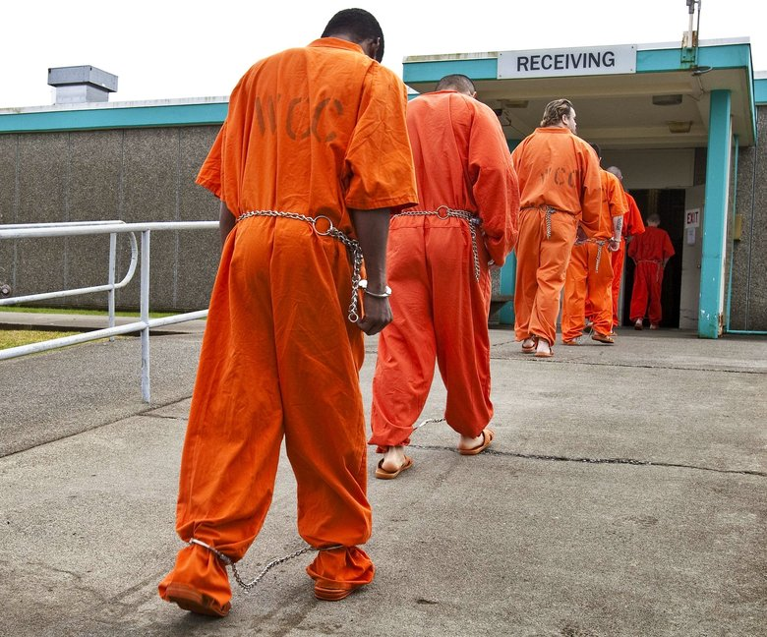
Intake Screening
Occurs at Reception
WCC – Shelton
300-400 per week
WCCW – Gig Harbor
20-40 per week
Mental Health Professional
Masters Level or above
Triage
Self-reported need
Active symptoms
Functional impairment
Behavioral observations

Slide 7
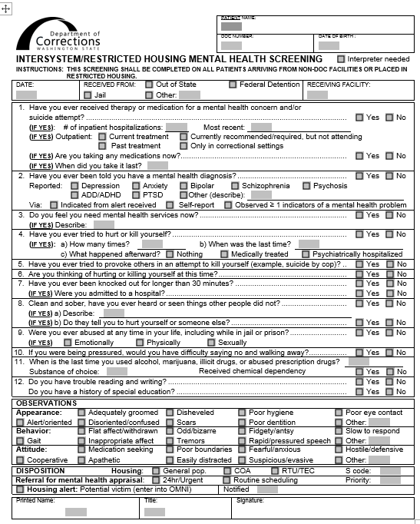
MH Screening
Brief screening tool (<10minutes)
Medications
History of :
Treatment
Hospitalization
MH diagnoses
Current/past :
Medications
MH symptoms
Suicide attempts/ideation
Desire/need for treatment
Behavioral observations

Slide 8
Housing need
GP – General Population
COA – Close Observation Area
RTU – Residential Treatment Unit
Mental Health Appraisal/Assessment need
Urgent – within 24 hours
Routine – within 14 days
PREA concerns
Prison Rape Elimination Act

Slide 9
Prevalence of Mental Disorder
Prison U.S.
Substance abuse 70-90% 5-10%
Antisocial personality 15-50% 1-3%
Mood disorders 15-35% ~10%
Psychotic disorders 10-20% 1-2%
Most disorders are over-represented in correctional settings
Generally accepted figure is that 15-35% of those incarcerated have a major mental disorder
Slightly higher in female populations
Notes:
The take-home message of this slide is that the concentration of mental illness in prisons is SIGNIFICANTLY HIGHER than in the general population. Prisons have come to be known as “the new asylums” in that more folks are receiving treatment for major mental disorders within correctional facilities than through providers in the community and this significantly taxes our already limited resources. It may be helpful to point out that the structure and routine of prisons can often mask some of the more overt symptomatology that would be more readily manifest in the community, where a greater number of stressors and destabilizers might be present.
It is also important to lay the groundwork for the next slide, which points out that although there may be a greater concentration of the mentally ill in prisons, it does not translate into an increased risk for violence with this population and in fact makes these inmates more likely to be the victims of crime or predation due to their level of impairment, degree of distress, and/or lack of organization.

Slide 10
Mental Illness in Prison
1/3 with any potentially qualifying diagnosis (about 50% of women)
22% seriously mentally ill (16% severe mood disorders, 6% psychosis)
About 5% with debilitating symptoms
20% in active Tx (close to 40% of women) – treatment refusal a problem in substantial minority of SMI

Slide 11
Mental Illness in Prison
Substance abuse/dependence problems
At least 75% of WA DOC population
Much higher percentage with history of physical and/ or sexual abuse as children
PTSD is overrepresented –high chance of witnessing or being a victim of violence
Underdiagnosed TBI, FAS/FAE, and other cognitive disorders

Slide 12
Mental Health Treatment
Referral process
Screening triage
Inmate self-referred (“Kite”)
Staff referral
Emergency
Eligibility based on Offender Health Plan (OHP)
Medical necessity
Symptom severity
Functional impairment
CRC and “3 for Free”
Primary Therapist assignment
All inmates in active treatment (typical caseload = 80-100)
MHA, MHU, Treatment Plan

Slide 13
Mental Health Treatment
Case management
Individual therapy
Various orientations
Limited (CBT, CPT, EMDR)
Group treatment
Psychoeducational and process-oriented
Closed and open ended
Examples: anxiety, depression, trauma-focused, DBT
Crisis responding
Psychiatric services
MH is the gatekeeper
Pts seen every 90 days

Slide 14
Challenges for Mental Health in DOC
High caseloads due to concentration of MI in prison
MI is considered a stigma/weakness
MI are much more likely to be the victims of violence and exploitation
Common release problems
$40 gate money
Greyhound bus ticket
30 day supply of meds
Releasing homeless
Felony conviction makes employment and housing difficult

Slide 15
Challenges for Mental Health in DOC
Creating true community-based transition program
Work Release requirements can make it difficult for SMI to succeed
Availability and timeliness of community MH follow-up
Placement into supported living
ORCS is a great example of what can go right

Slide 16
Future Directions
Improved coordination of care – medical/CD
Develop structured psychological Tx
More effective than meds for many conditions
Stronger psychosocial rehab focus in residential
Continue to develop trauma-related services
Stronger training and services directed at suicide prevention
More robust training to be done by MH staff
Improved assessment
Strengthen transitional programming and services
Better community liaison, placement
Expand DOC outpatient services?

Slide 17
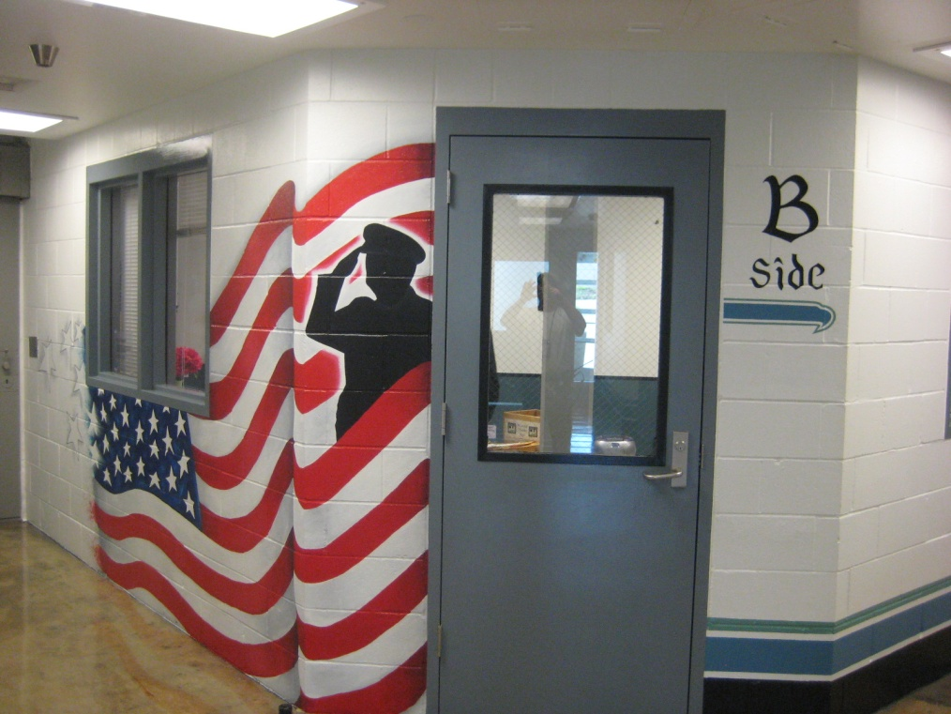
SCCC VETERANS UNIT Together we serve.

Slide 18
What the program is about…
Veterans helping Veterans.
Quiet, clean living environment.
Access to Veterans programs.
Links to Veteran resources.

Slide 19
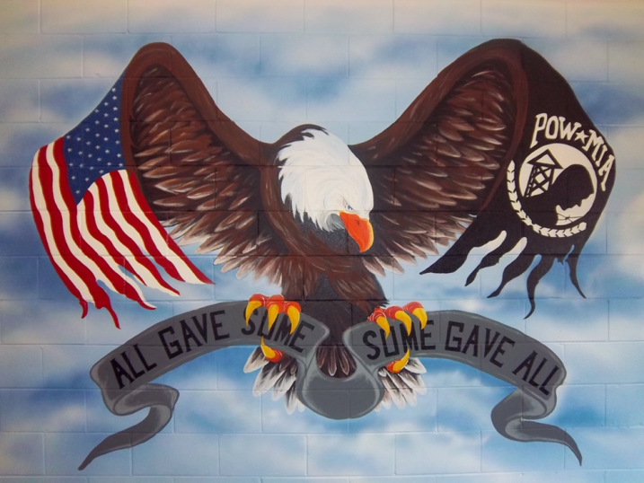
Where did the idea come from?
The idea of SCCC Veteran offenders planted the seed…
Belief that military veterans have special needs and should be taken care of.
Florida DOC: SCCC H5 Veterans Unit is molded after the very successful Veteran’s Dormitory Program at the Gulf Correctional Institution in Florida. This veterans program is a Re-Entry Initiative designed to assist former military Veterans who will be returning to society in the near future. The Veterans’ Dormitory Program also provides a stable and structured environment designed to facilitate the learning process that our courses offer as well as providing for positive social interaction between veterans.

Slide 20
WA DOC Established Veteran Units
Stafford Creek Corrections Center – Aberdeen, WA (Minimum Custody)
Coyote Ridge Corrections Center – Connell, WA (Minimum & Medium custody

Slide 21
Program’s Moto & Mission…
MOTO: Together We Serve.
MISSION STATEMENT: The SCCC Veterans Unit strives to enhance the wellbeing of incarcerated Veterans and increase their chance at successful community reentry by providing an opportunity to closely associate with like-experienced individuals, making resources available to address their special needs, and helping them to establish a dedication to positive living.

Slide 22
Program Goals:
Enhance Veteran offenders’ overall prison behavior and personal wellbeing by giving them an opportunity to closely associate with like-experienced individuals.
Establish a group of staff that are familiar working with the complex Veterans services systems and the special nature of Veterans.
Make available support resources and programs to cater to the special needs of Veterans.
Reduce the financial burden on DOC and Washington State by assisting incarcerated Veterans in accessing their Federal resources and benefits; specifically in areas of transition/release, health/wellbeing, establishing healthy community ties, and job readiness.

Slide 23
H5 is dedicated to house military Veterans.

Slide 24
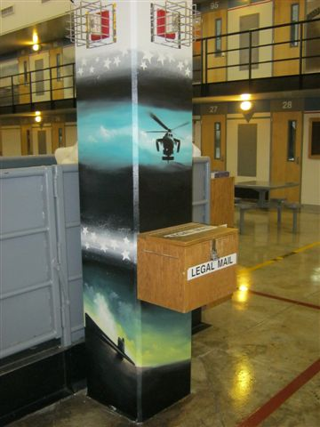
SCCC Veterans Pod

Slide 25
Eligibility Requirements
All incarcerated Veterans are eligible to be housed in the Veterans Unit that meet the below requirements-
MI3 (minimum) custody or lower,
Volunteer to participate in the program,
6 months infraction free and remain infraction free,
Agree to abide by unit rules and conduct expectations,
Not be dishonorably discharged.

Slide 26
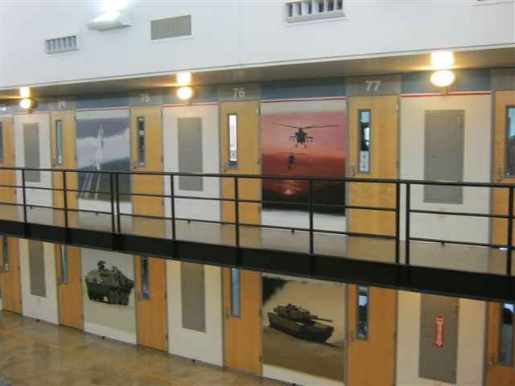
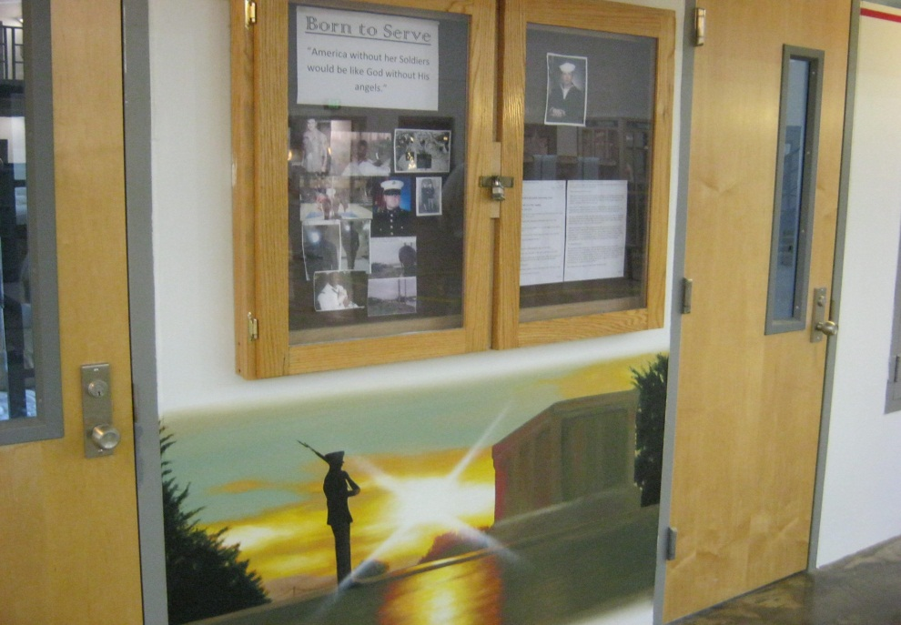
A POD

Slide 27
CORE Values…
HONOR: A code of personal integrity, honor guides those who do the right thing when no one is looking. It is not only a duty, but also a distinction, as those who possess honor are held in honor. It's found in one's beliefs, but exhibited through one's actions.
INTEGRITY: Do what’s right, legally and morally. Integrity is a quality you develop by adhering to moral principles. It requires that you do and say nothing that deceives others. As your integrity grows, so does the trust others place in you. The more choices you make based on integrity, the more this highly prized value will affect your relationships with family and friends, and, finally, the fundamental acceptance of yourself.
SERVICE: Put the welfare of others before your own. Service is larger than just one person. In serving others you are doing your duty loyally without thought of recognition or gain. The basic building block of service is the commitment of each person to go a little further, endure a little longer, and look a little closer to see how he can add to the effort his community.
RESPECT: Treat others with dignity, while expecting others to do the same. Respect is what allows us to appreciate the best in other people. Allow others to be themselves without judgment or influence. Self-respect is a vital ingredient with in the value of respect, which results from keeping oneself healthy, constantly striving for personal betterment, and knowing you have put forth your best effort.
PERSONAL INIITATIVE: Accomplish goals through problem ownership, a thrilling response to challenge, and acceptance of responsibility.

Slide 28
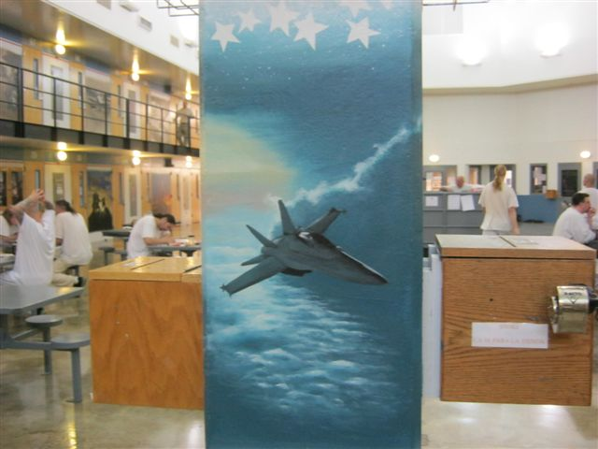
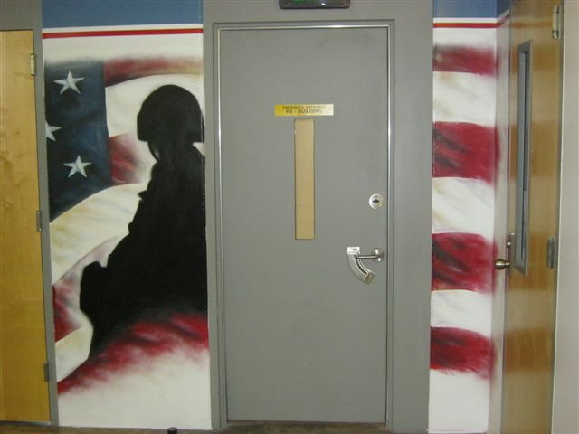
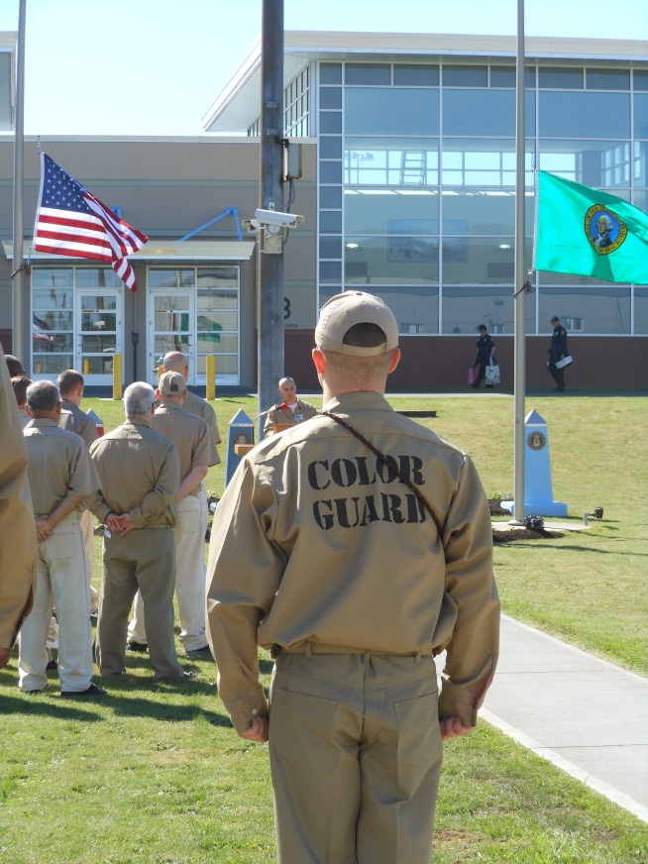
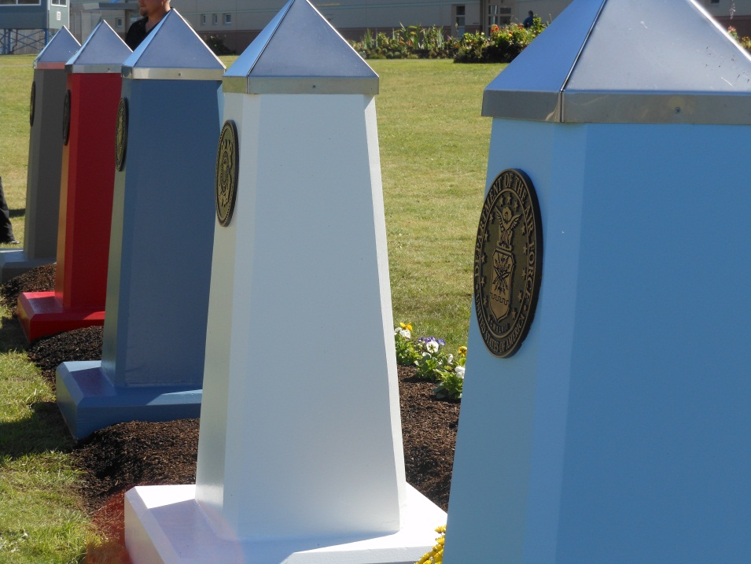

Slide 29
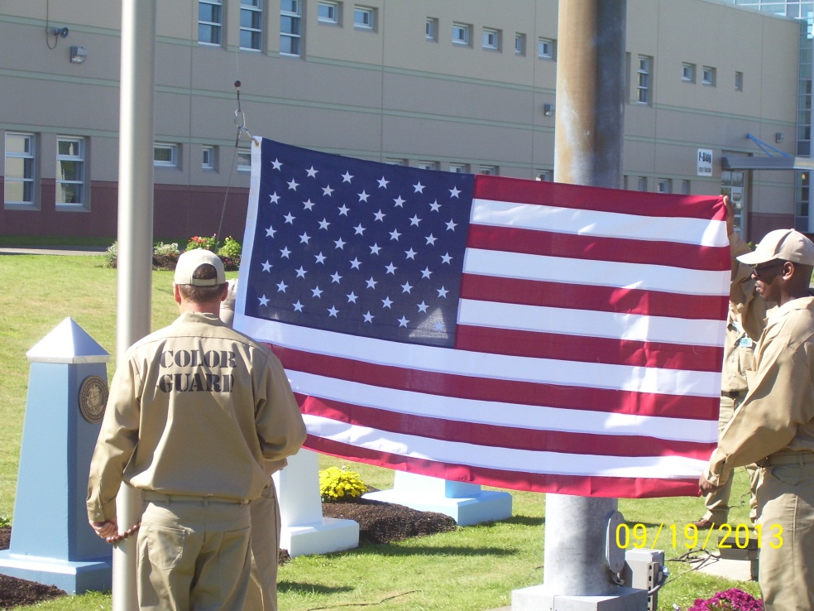
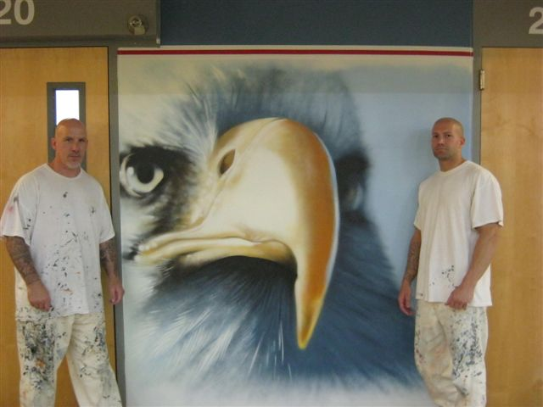
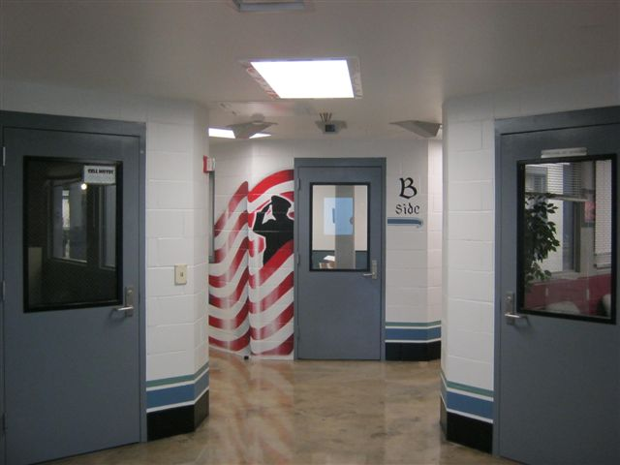
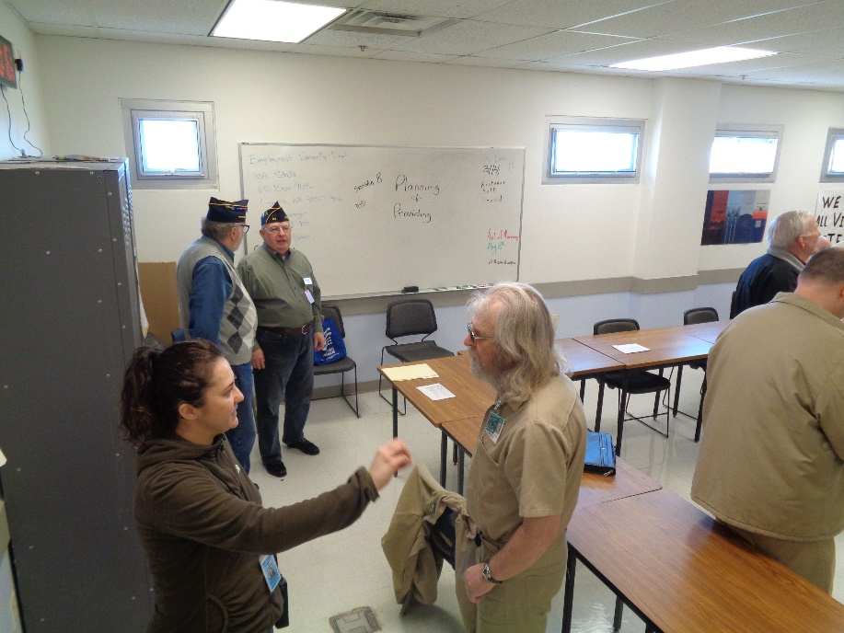

Slide 30
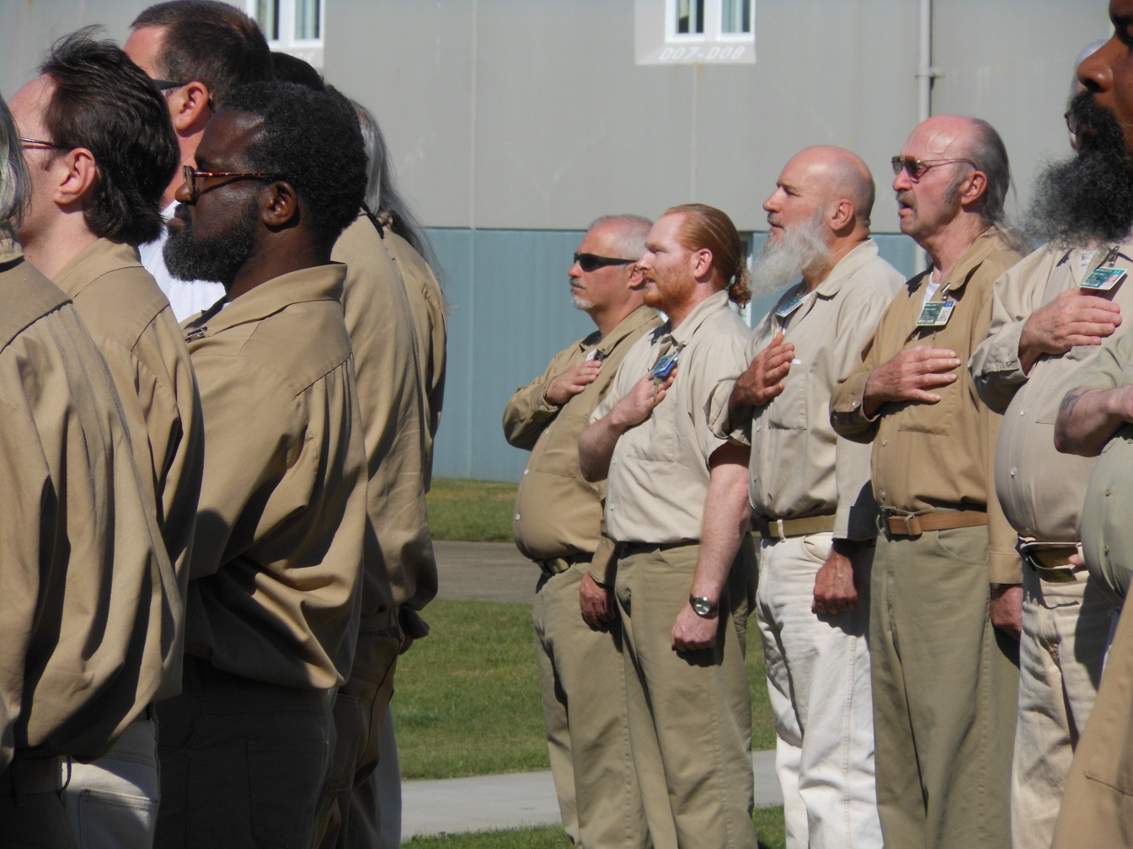
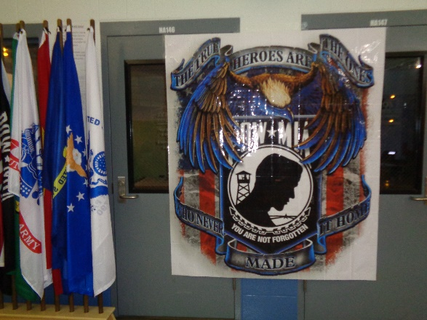
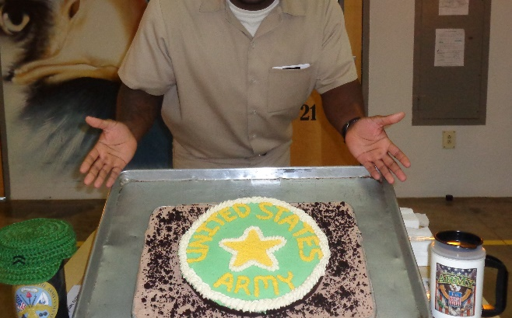
STAFFORD CREEK VETERAN PROGRAMS

Slide 31
Veteran Programs…
PT exercise class for all ages and abilities
Yoga for Veterans
PTSD Monthly Workshops
Claims & Benefits Triage Clinics
Redemption - Self Awareness Classes for Veterans
Honor Guard, Color Guard & Flag Raisings
Vocal Ensemble Group
Band Ensemble Group
Yarn Group
Brigadoon Service Dog Training
Service Garden
Branch Birthday Parties
American Legion Post
Yearly Stand Down

Slide 32
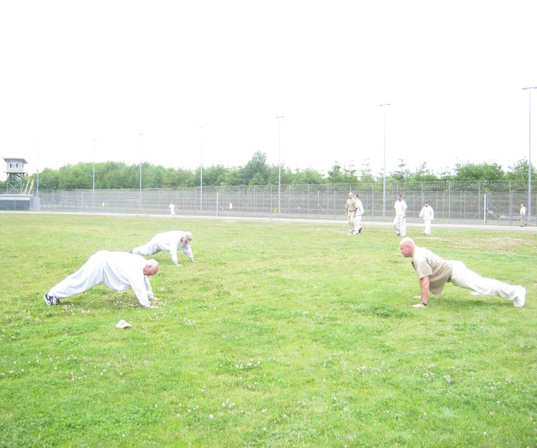
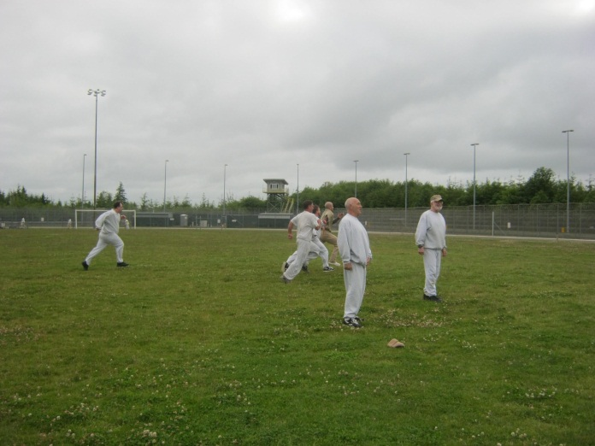
PT Program
3 times a week.
Calisthenics program designed for all levels of ability.
Exercises based on the Army PT Field Manual.
Designed to improve awareness of healthy living and improve physical fitness.

Slide 33
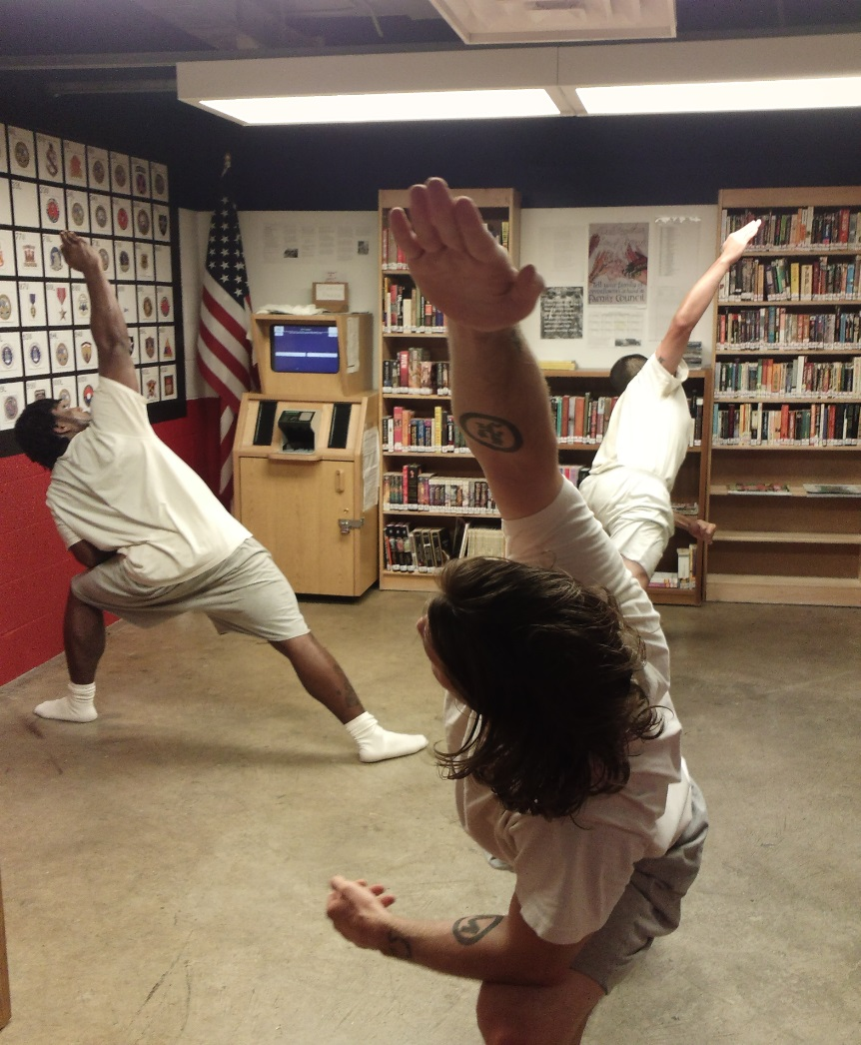
Vet Yoga
Healthy body and mind.
Therapeutic Yoga
Intro to Yoga
Ashtanga Yoga

Slide 34
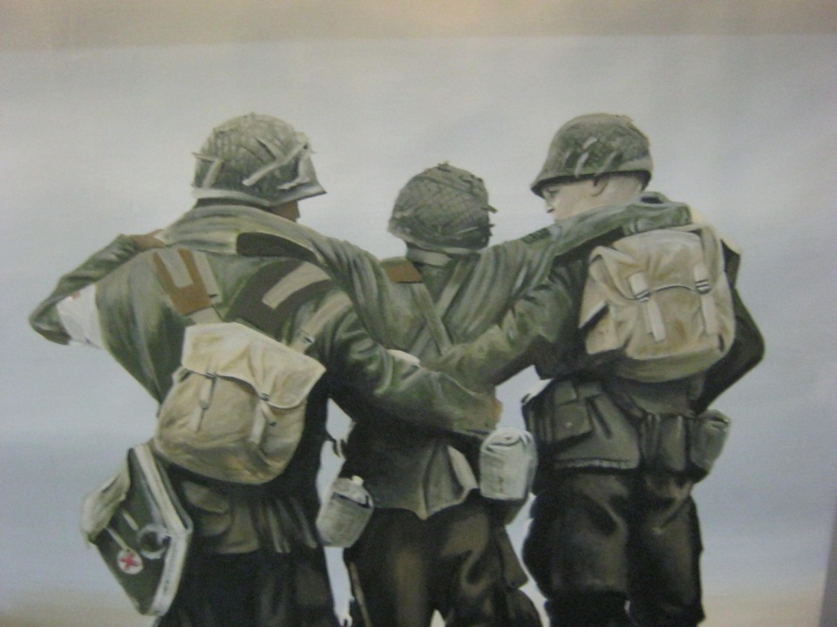
Veteran Counseling
An affective approach to addressing military and wartime related trauma is group and individual counseling. The WDVA has been working with the SCCC Vets to provide support groups.

Slide 35
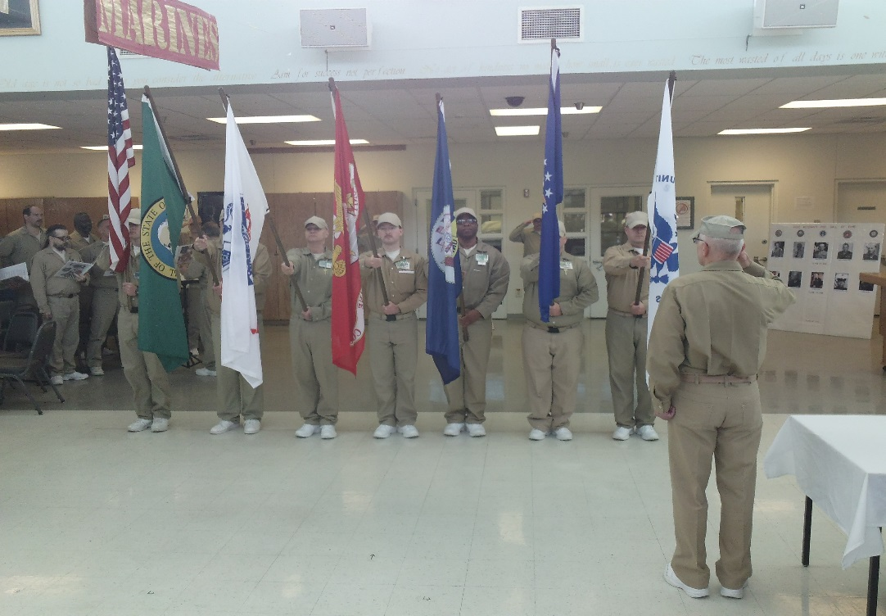
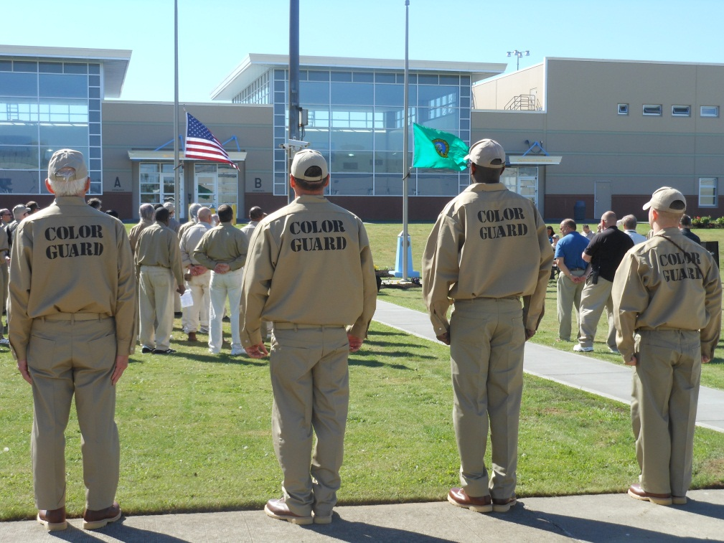
Color Guard & Honor Guard
A select group of Veteran offenders are charged with raising and lowering the colors daily and presenting the flags at important facility events.

Slide 36
Flag Detail

Slide 37
Peer and Resource Guides
Incarcerated Veterans helping each other get through the struggles of daily life and guides to help Veterans familiarize themselves with their military resources and benefits.

Slide 38
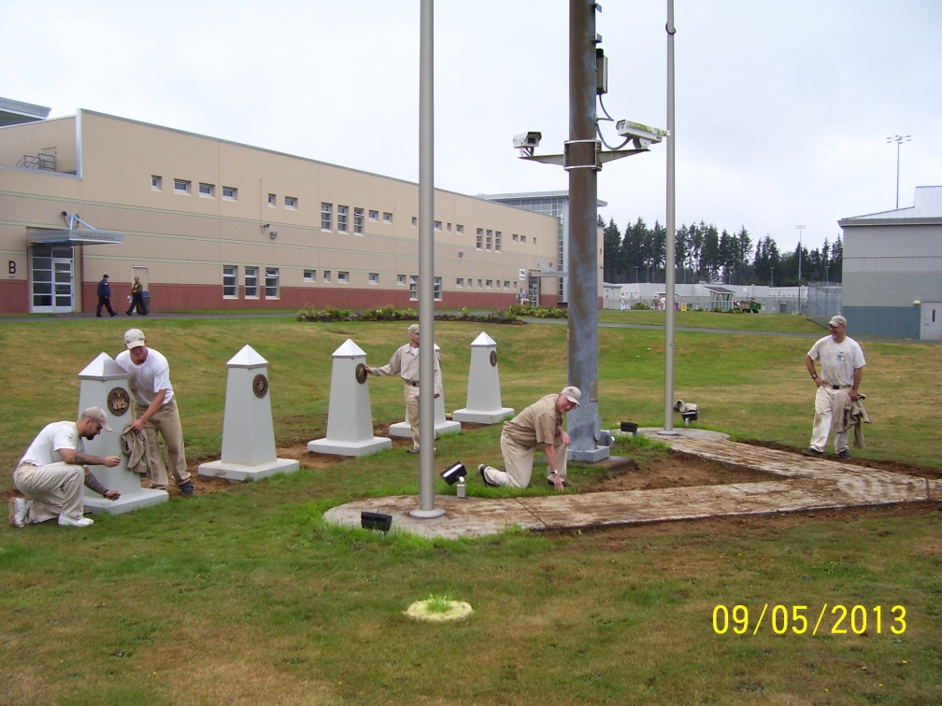
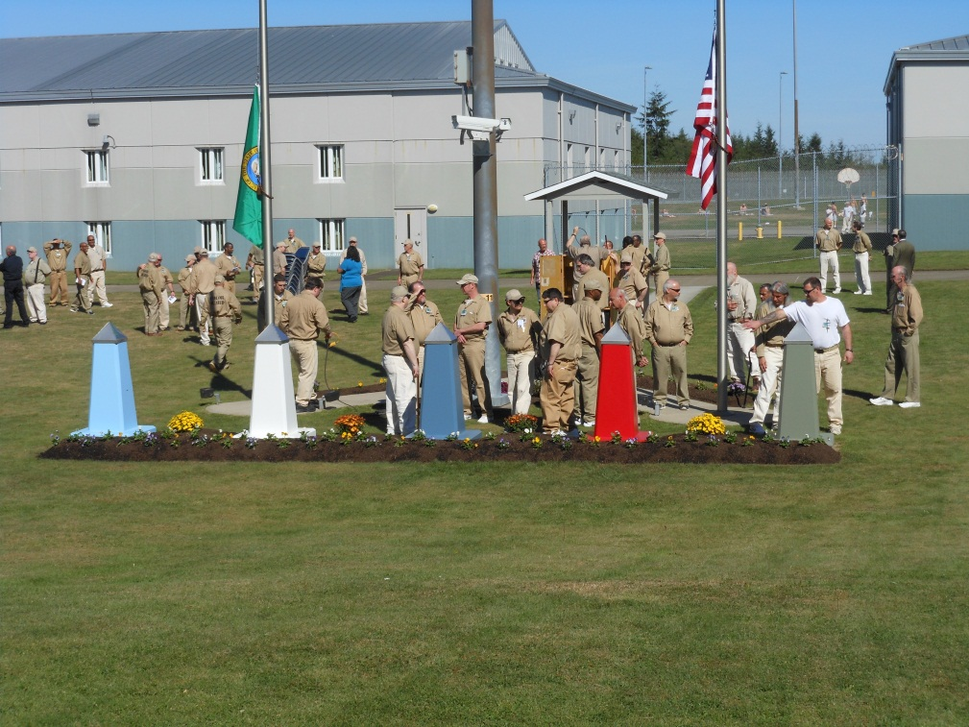
Service Garden
Gardens around the flag pole are kept by Veteran Pod gardeners with the assistance of Veteran Pod volunteers.

Slide 39
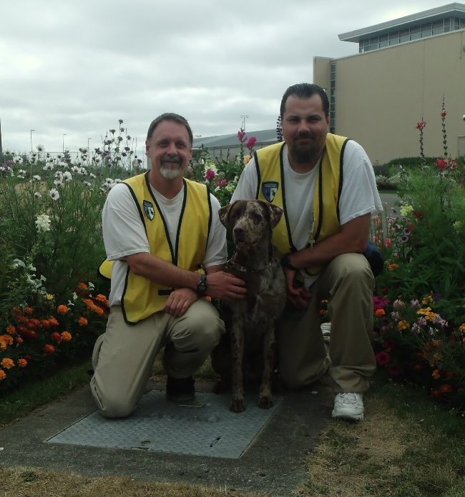
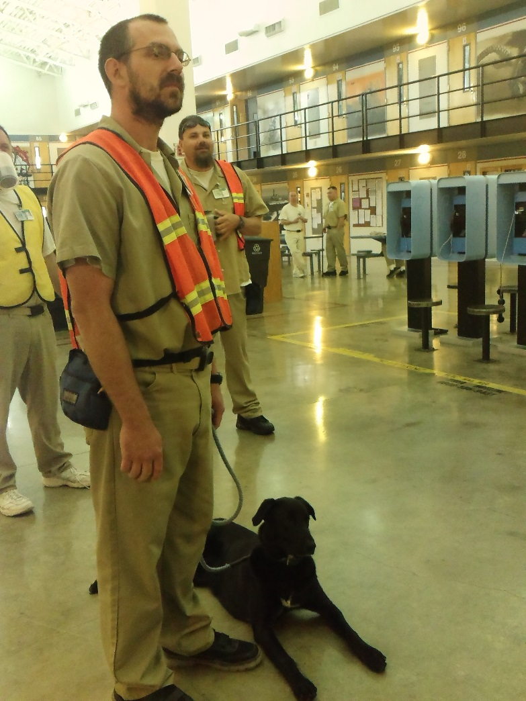
Brigadoon Service Dog Program

Slide 40
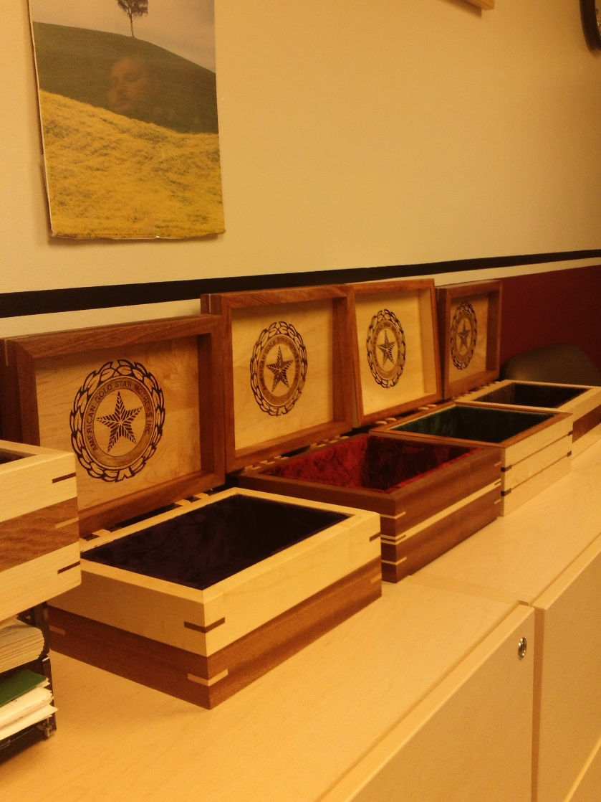
American Gold Star Mothers Outreach

Slide 41
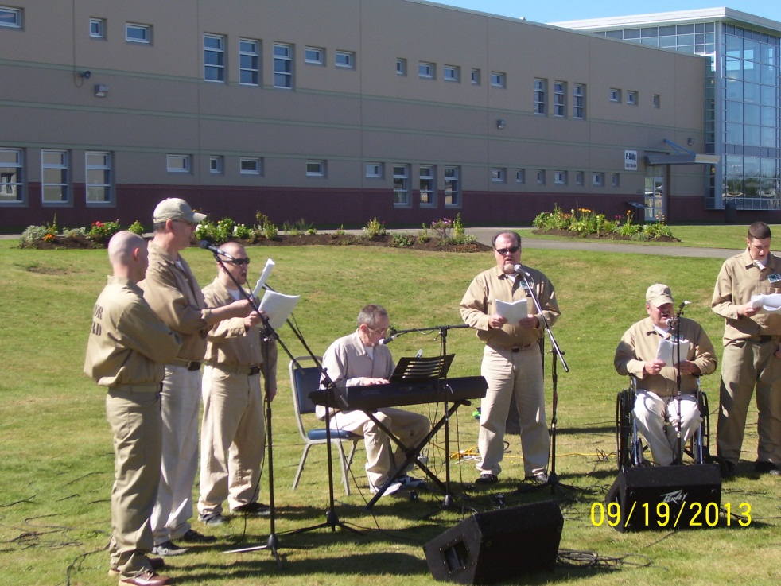
Veteran Ensembles
Choir & Band that performs patriotic songs at facility events.

Slide 42
AMERICAN LEGION POST 23

Slide 43
YEARLY STAND DOWN

Slide 44
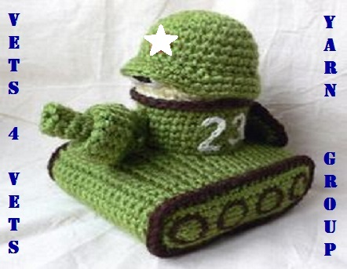
Flag Detail
SCCC VETERANS UNIT PROGRAM DOOR IDENTIFIERS

Slide 45
Inferences from the statistics shown…
Higher number of middle aged Vets in prison (45-54yrs)- 22% higher than average prison population are middle aged, 24% lower than the prison average are 25-34, 16% lower than prison average is 24 or younger.
IVO commit more violent crimes- 10% higher than prison average
IVO commit less drug crimes- 7% lower than prison average
Veterans serve longer sentences (20+ yrs)- 12.5% higher than average prison population.
Higher number of Caucasians in IVO population- 21% higher average than non-Vet population.
Incarcerated Vets are more educated than non-Vets- 31% above prison average have above a high school grade level, 23% above prison average have some college or more).
IVO’s are more likely to have family issues. They are more often married and significantly more often divorced- 6% above prison average married & 26% above the prison average divorced,

Slide 46
Thank you for your time.
June 2019

