Slide 1
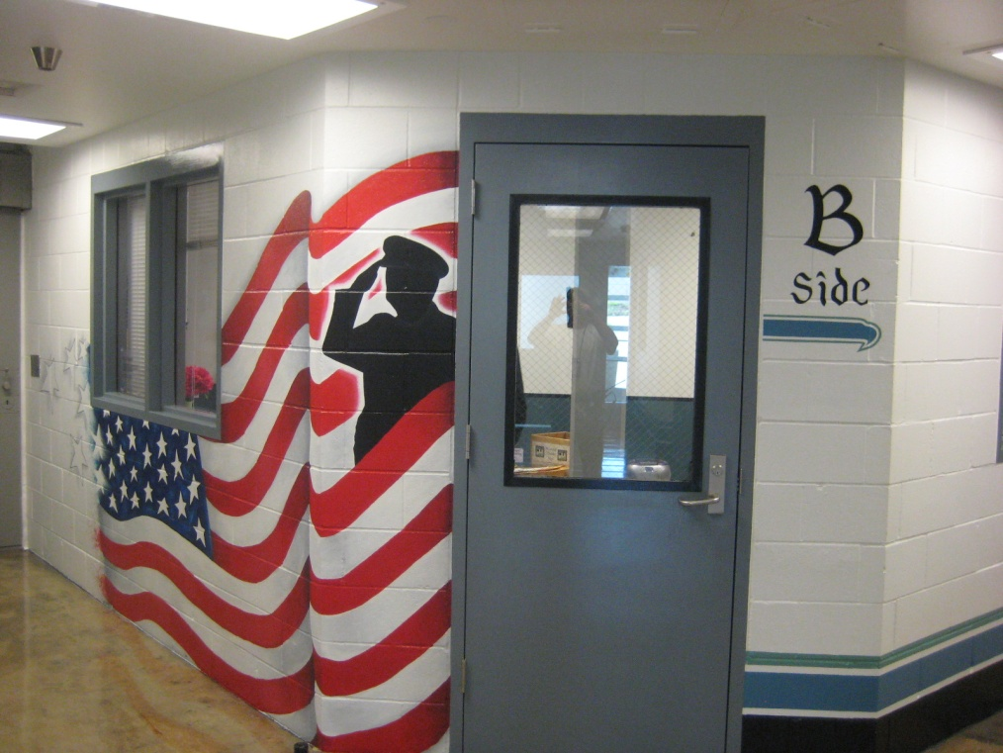
SCCC VETERANS UNIT Together we serve.

Slide 2
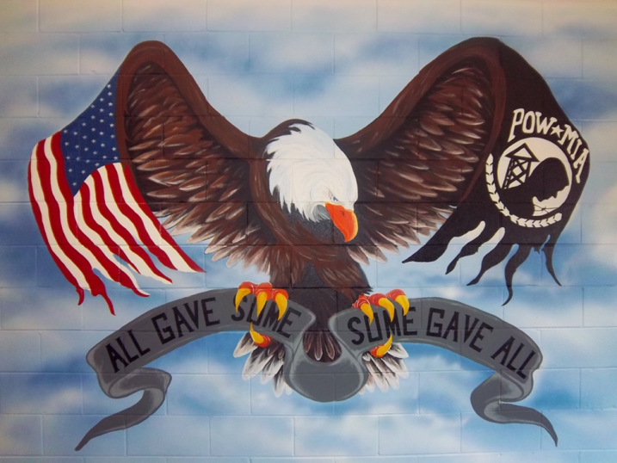
Where did the idea come from?
The idea of SCCC Veteran offenders planted the seed…
Belief that military veterans have special needs and should be taken care of.
Florida DOC: SCCC H5 Veterans Unit is molded after the very successful Veteran’s Dormitory Program at the Gulf Correctional Institution in Florida. This veterans program is a Re-Entry Initiative designed to assist former military Veterans who will be returning to society in the near future. The Veterans’ Dormitory Program also provides a stable and structured environment designed to facilitate the learning process that our courses offer as well as providing for positive social interaction between veterans.

Slide 3
WA DOC Established Veteran Units
Stafford Creek Corrections Center – Aberdeen, WA (Minimum Custody)
Coyote Ridge Corrections Center – Connell, WA (Minimum & Medium custody

Slide 4
Program’s Moto & Mission…
MOTO: Together We Serve.
MISSION STATEMENT: The SCCC Veterans Unit strives to enhance the wellbeing of incarcerated Veterans and increase their chance at successful community reentry by providing an opportunity to closely associate with like-experienced individuals, making resources available to address their special needs, and helping them to establish a dedication to positive living.

Slide 5
Program Goals:
Enhance Veteran offenders’ overall prison behavior and personal wellbeing by giving them an opportunity to closely associate with like-experienced individuals.
Establish a group of staff that are familiar working with the complex Veterans services systems and the special nature of Veterans.
Make available support resources and programs to cater to the special needs of Veterans.
Reduce the financial burden on DOC and Washington State by assisting incarcerated Veterans in accessing their Federal resources and benefits; specifically in areas of transition/release, health/wellbeing, establishing healthy community ties, and job readiness.

Slide 6
H5 is dedicated to house military Veterans.

Slide 7
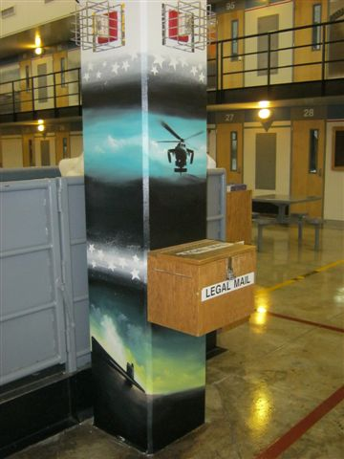
H5 - A POD

Slide 8
Eligibility Requirements
All incarcerated Veterans are eligible to be housed in the Veterans Unit that meet the below requirements-
MI3 (minimum) custody or lower,
Volunteer to participate in the program,
6 months infraction free and remain infraction free,
Agree to abide by unit rules and conduct expectations,
Not be dishonorably discharged.

Slide 9
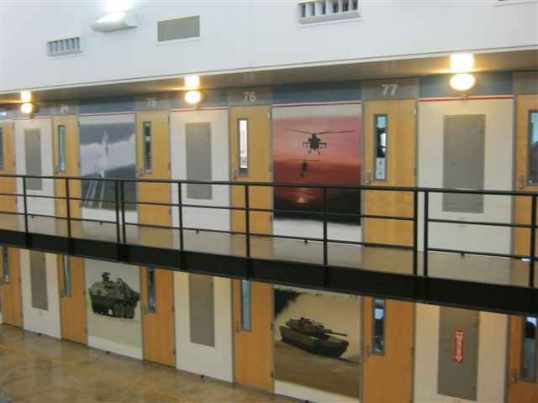
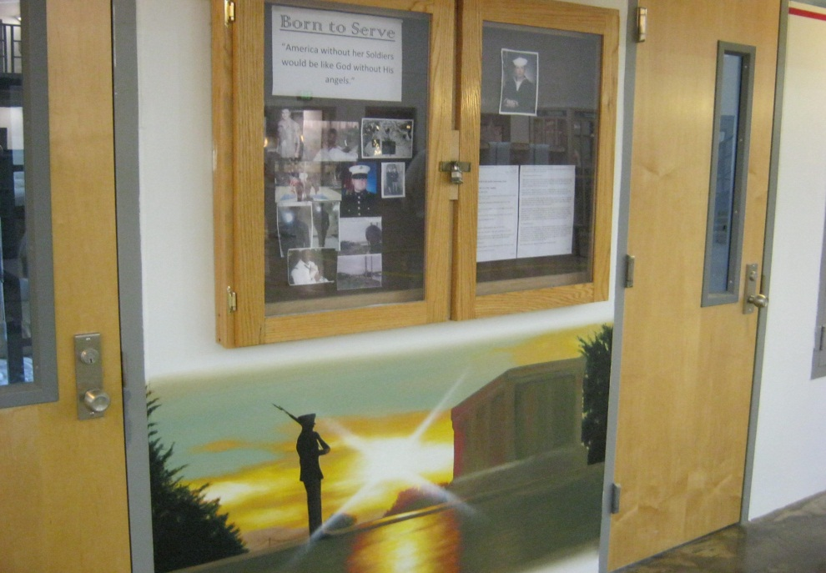
A POD

Slide 10
CORE Values…
HONOR: A code of personal integrity, honor guides those who do the right thing when no one is looking. It is not only a duty, but also a distinction, as those who possess honor are held in honor. It's found in one's beliefs, but exhibited through one's actions.
INTEGRITY: Do what’s right, legally and morally. Integrity is a quality you develop by adhering to moral principles. It requires that you do and say nothing that deceives others. As your integrity grows, so does the trust others place in you. The more choices you make based on integrity, the more this highly prized value will affect your relationships with family and friends, and, finally, the fundamental acceptance of yourself.
SERVICE: Put the welfare of others before your own. Service is larger than just one person. In serving others you are doing your duty loyally without thought of recognition or gain. The basic building block of service is the commitment of each person to go a little further, endure a little longer, and look a little closer to see how he can add to the effort his community.
RESPECT: Treat others with dignity, while expecting others to do the same. Respect is what allows us to appreciate the best in other people. Allow others to be themselves without judgment or influence. Self-respect is a vital ingredient with in the value of respect, which results from keeping oneself healthy, constantly striving for personal betterment, and knowing you have put forth your best effort.
PERSONAL INIITATIVE: Accomplish goals through problem ownership, a thrilling response to challenge, and acceptance of responsibility.

Slide 11
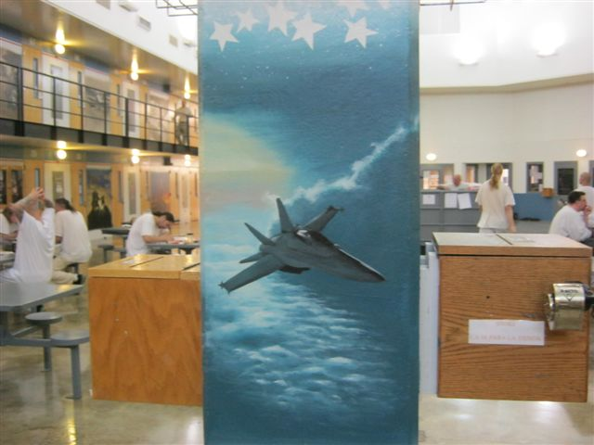
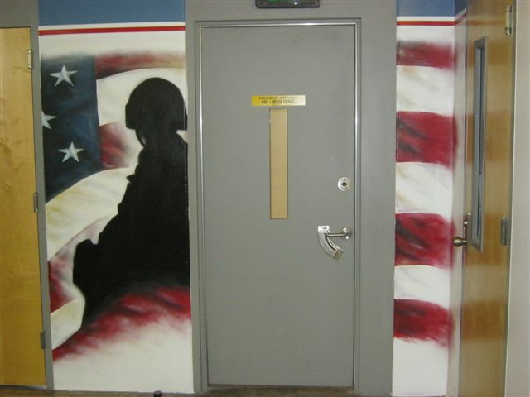
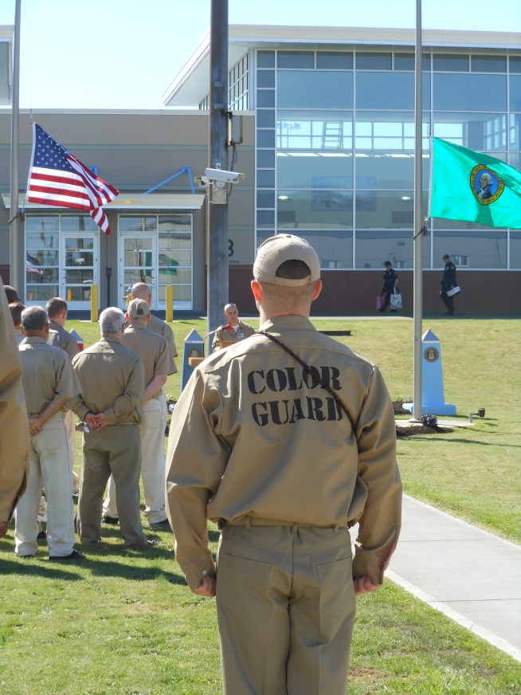
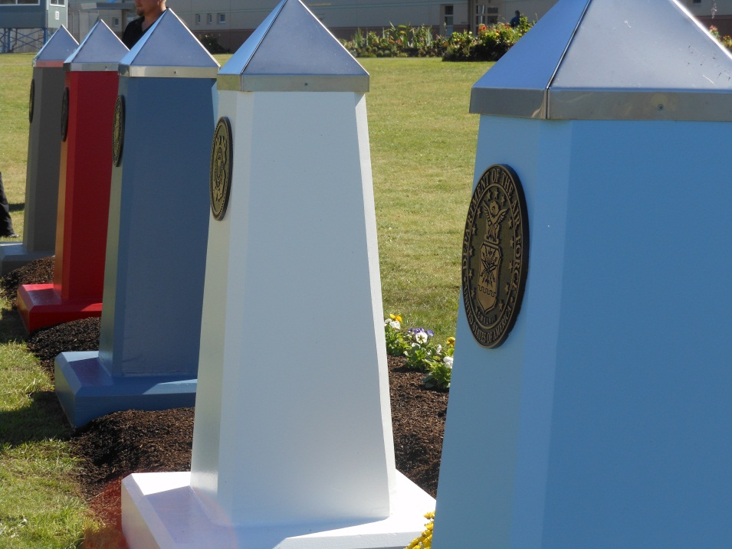

Slide 12
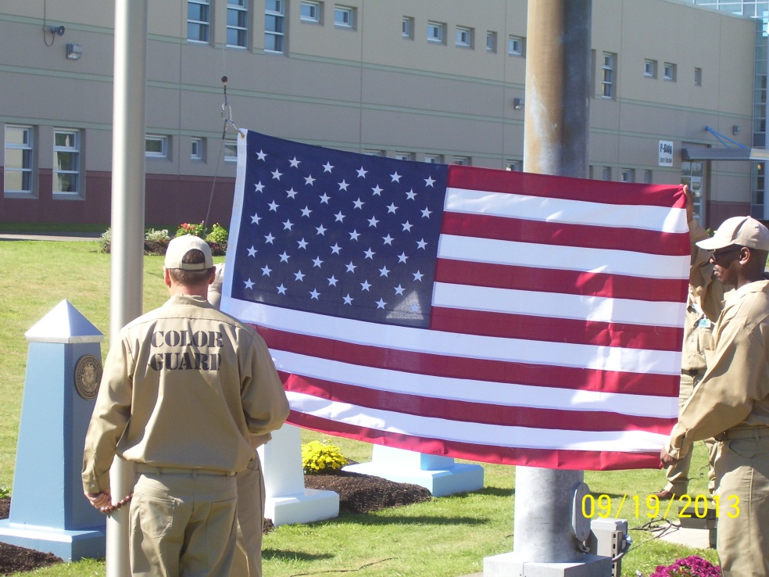
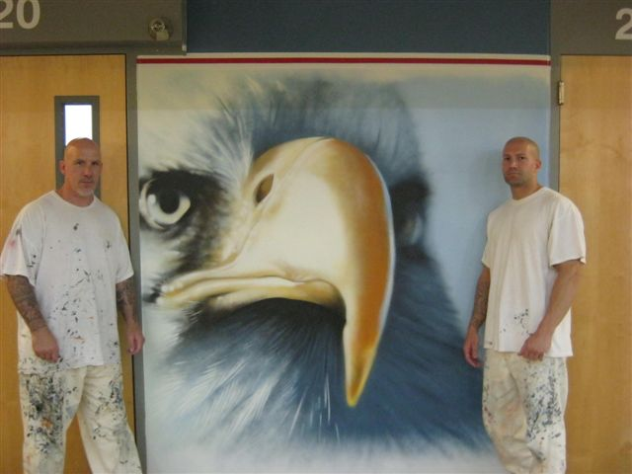
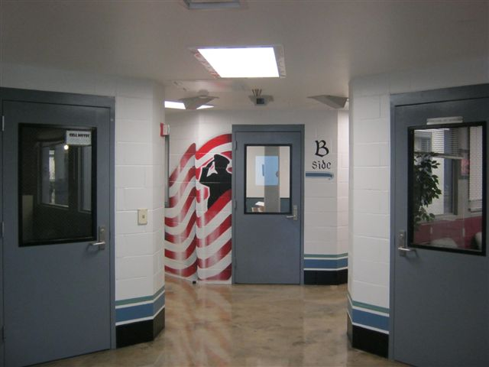
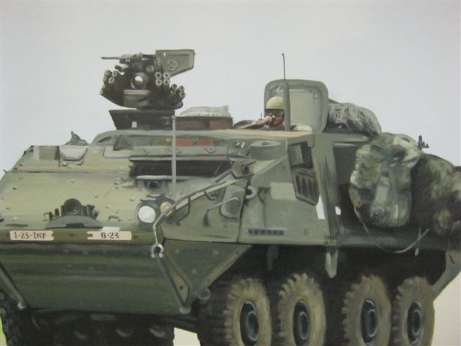

Slide 13
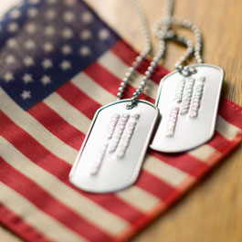
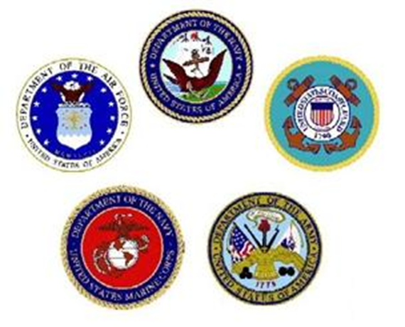
What the program is about…
Veterans helping Veterans.
Quiet, clean living environment.
Access to Veterans programs.
Links to Veteran resources.

Slide 14
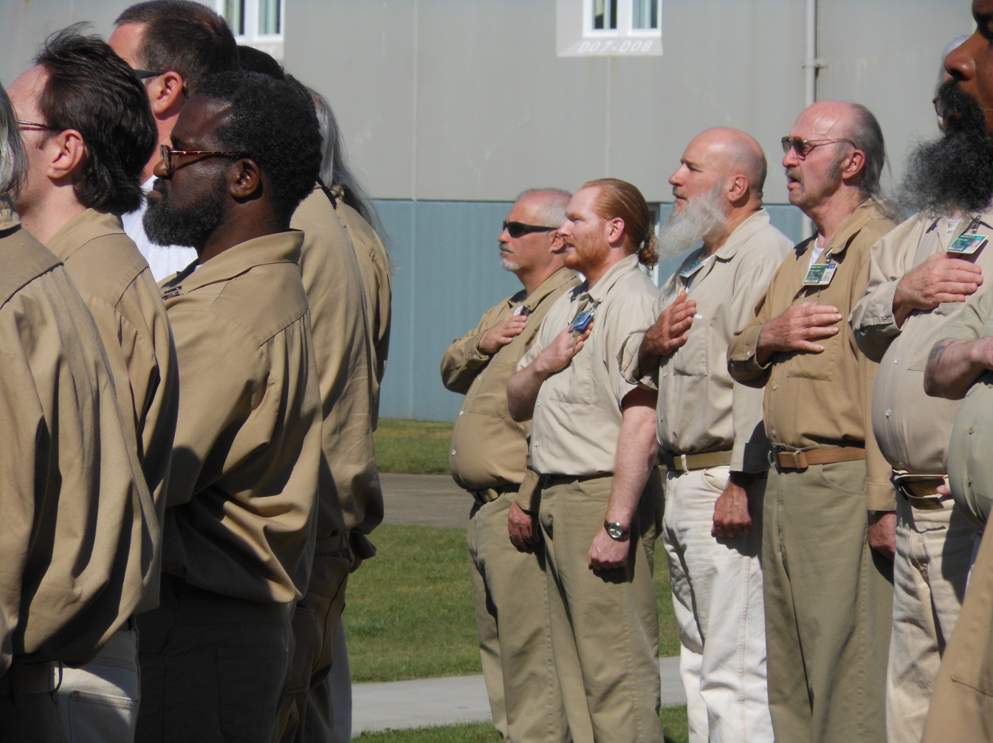
SCCC VETERAN PROGRAMS

Slide 15
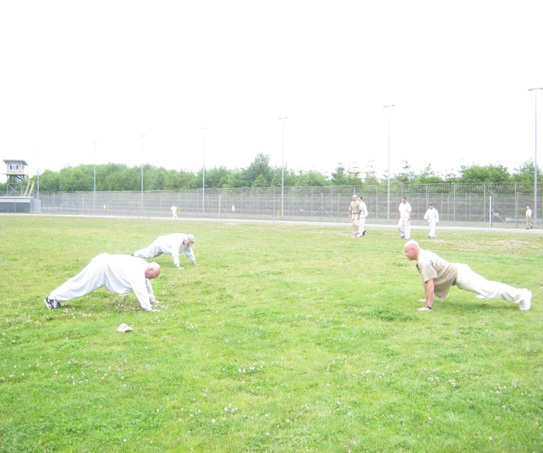
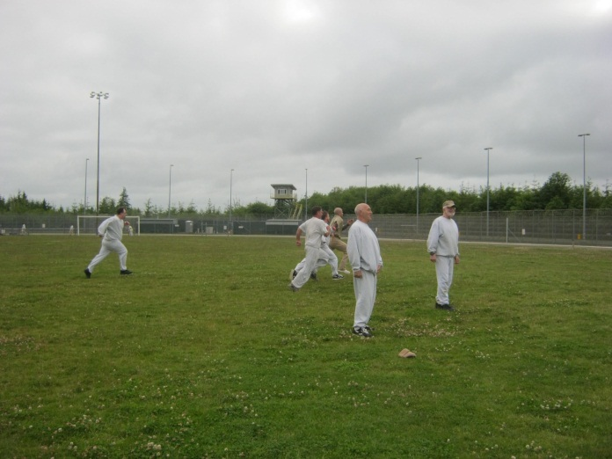
PT Program
3 times a week.
Calisthenics program designed for all levels of ability.
Exercises based on the Army PT Field Manual.
Designed to improve awareness of healthy living and improve physical fitness.

Slide 16
Yoga for Veterans

Slide 17
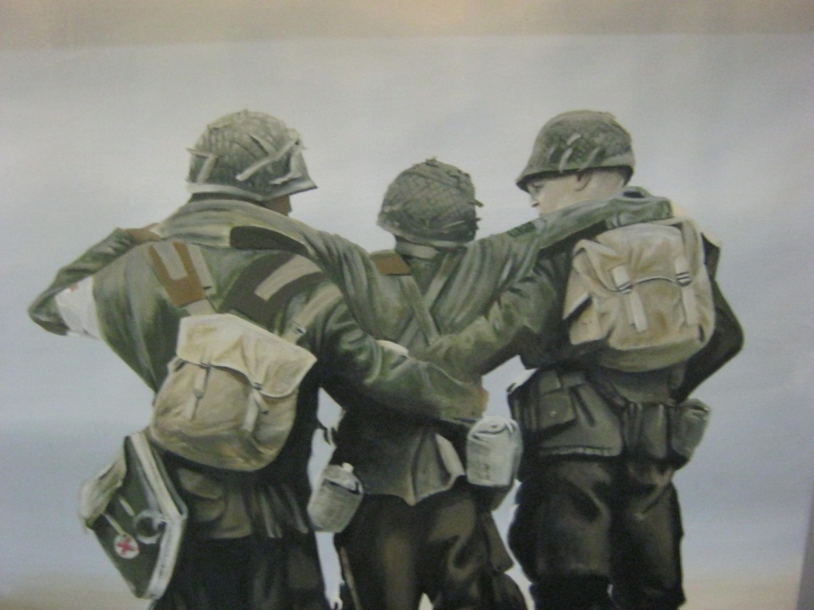
Veteran Counseling
An affective approach to addressing military and wartime related trauma is group and individual counseling. The WDVA has been working with the SCCC Vets to provide support groupS.

Slide 18
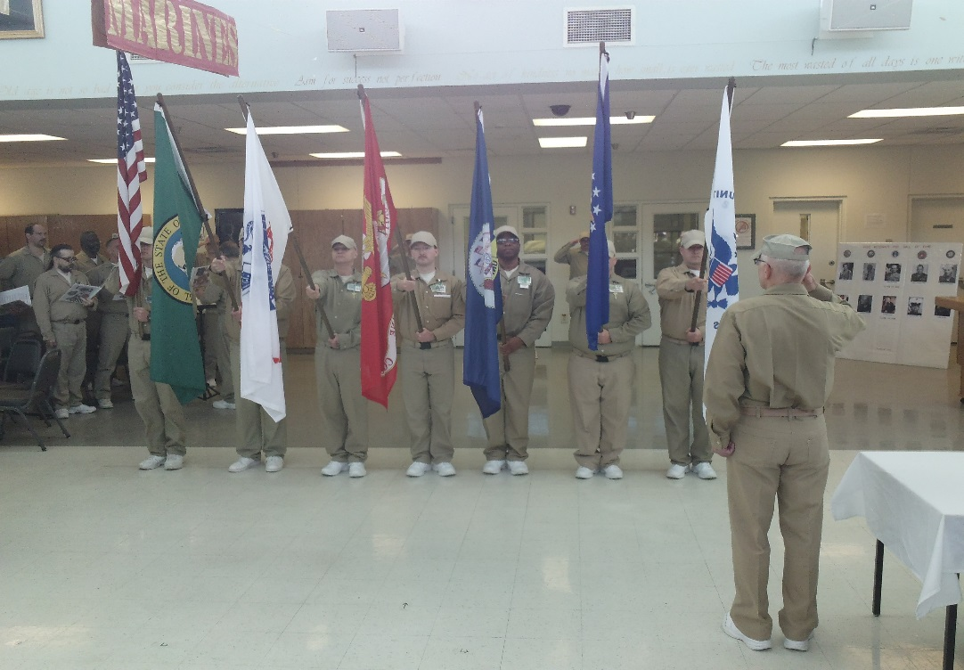
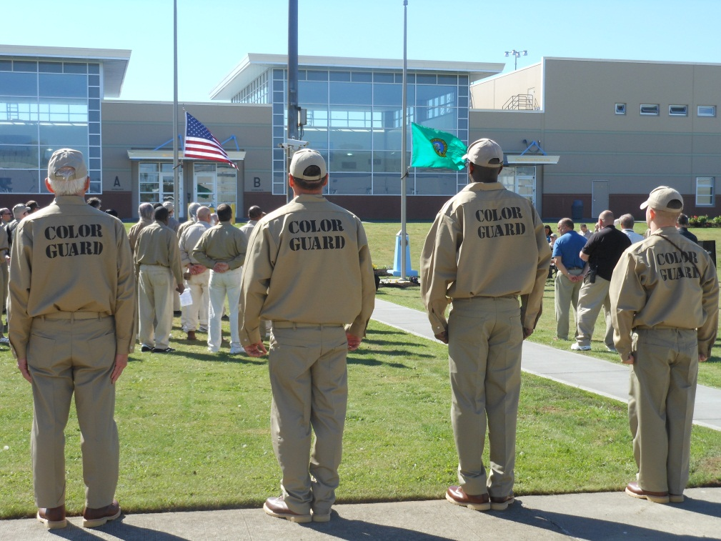
Color Guard & Honor Guard
A select group of Veteran offenders are charged with raising and lowering the colors daily and presenting the flags at important facility events.

Slide 19
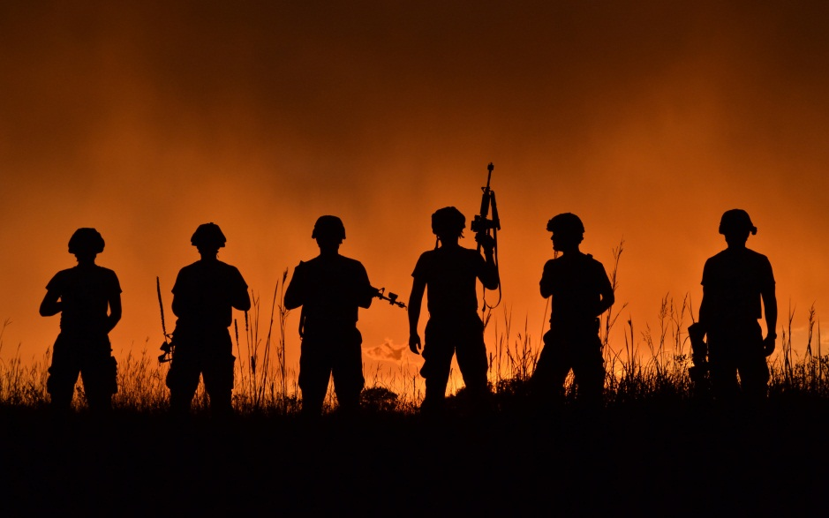
Peer and Resource Guides
Incarcerated Veterans helping each other get through the struggles of daily life and guides to help Veterans familiarize themselves with their military resources and benefits.

Slide 20
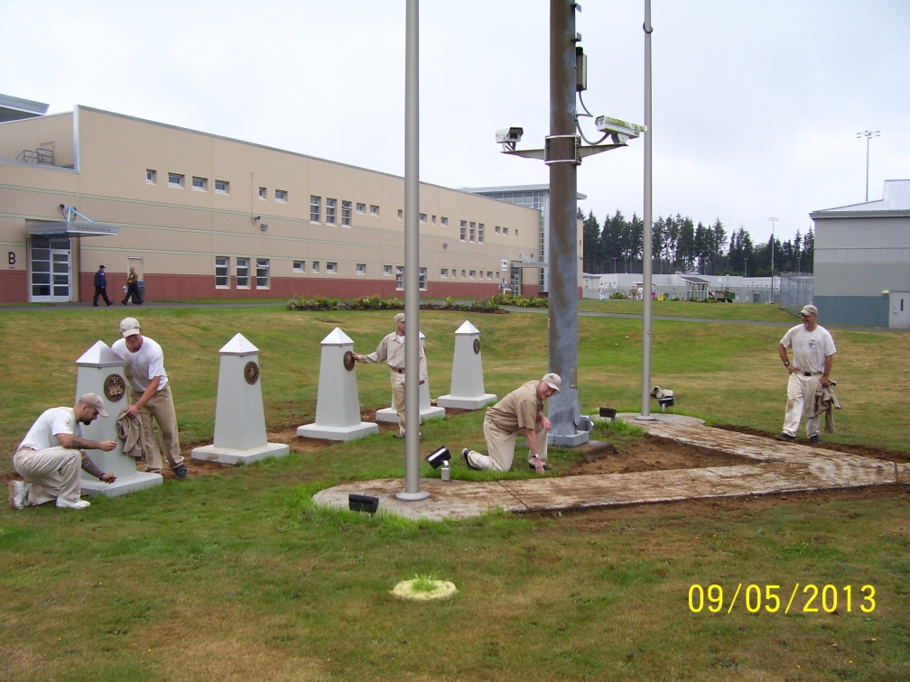
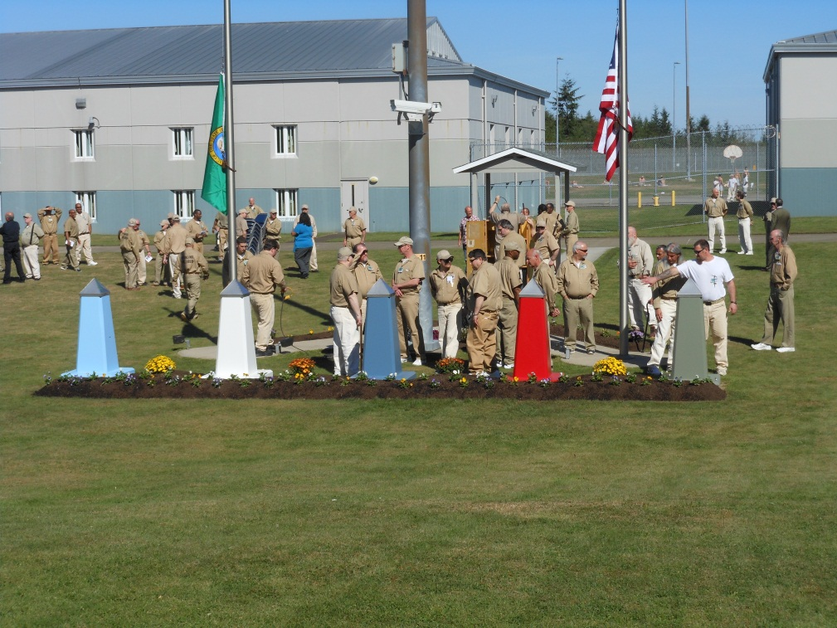
Service Garden
Gardens around the flag pole are kept by 2 Veteran Unit gardeners with the assistance of Veteran Unit volunteers.

Slide 21
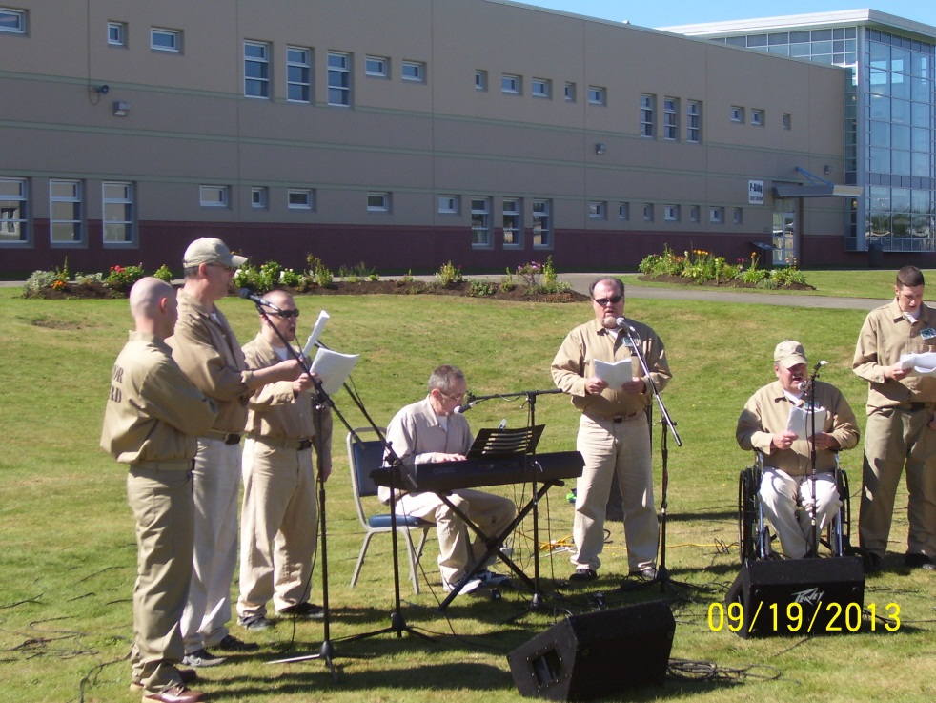
Veteran Ensembles
Choir & Band that performs patriotic songs at facility events.

Slide 22
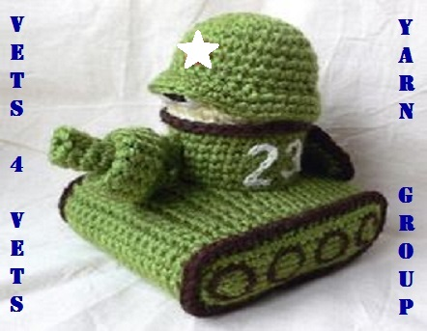
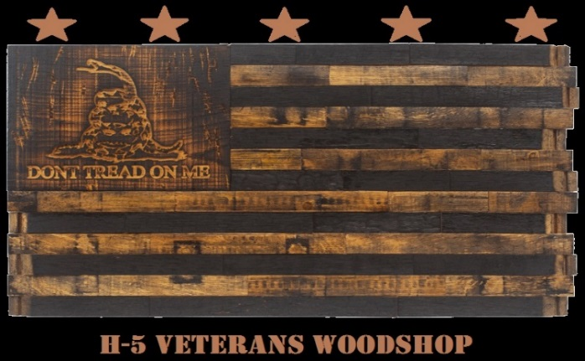
Flag Detail
SCCC VETERANS UNIT PROGRAM DOOR IDENTIFIERS

Slide 23
Priority needs…
Transition resources and connections for releasing Veterans.
Scheduled outreach, education and technical services regarding VA benefits and service officers.
Medical and health care support.
Periodic visits from Veteran community members and groups (motivational & connections).
Training for staff.
Volunteers to support groups (Color Guard, Ensemble, etc.)

Slide 24
Thank you for your time.

