Slide 1



Veterans in Agriculture, Rural Veterans Outreach
Jason Alves M.P.A., Program Manager,
Veterans Conservation Corps and Vet Corps, WDVA
JasonA@dva.wa.gov, 360-725-2224

Slide 2
Objectives
Introduce you to some of the statistics around rural veterans
Introduce you to some of the statistics around those in Agriculture, including veterans.
Describe programs, organizations and initiatives statewide that support veterans in Agriculture.

Slide 3



Rural Veterans
113,00 rural veterans in wA*
44% of all military recruits are from rural areas*
22,000 with a service connected disability*
*American Community Survey 2017 & Carsey Institute 2004

Slide 4
Veteran Unemployment
Rural
Urban
5.5%
3.8%
Unemployed
Unemployed
31.2%
22.5%
Unemployed & Not Seeking Employment
Unemployed & Not Seeking Employment

Slide 5

Total Veterans and Farmer Populations*
*VA Vet Pop & 2017 Ag Census

Slide 6
Counties where veterans make up 15% or more of Farmers*
*VA Vet Pop & 2017 Ag Census

Slide 7
Wahkiakum County total county population 3,824 *
*VA Vet Pop & 2017 Ag Census

Slide 8



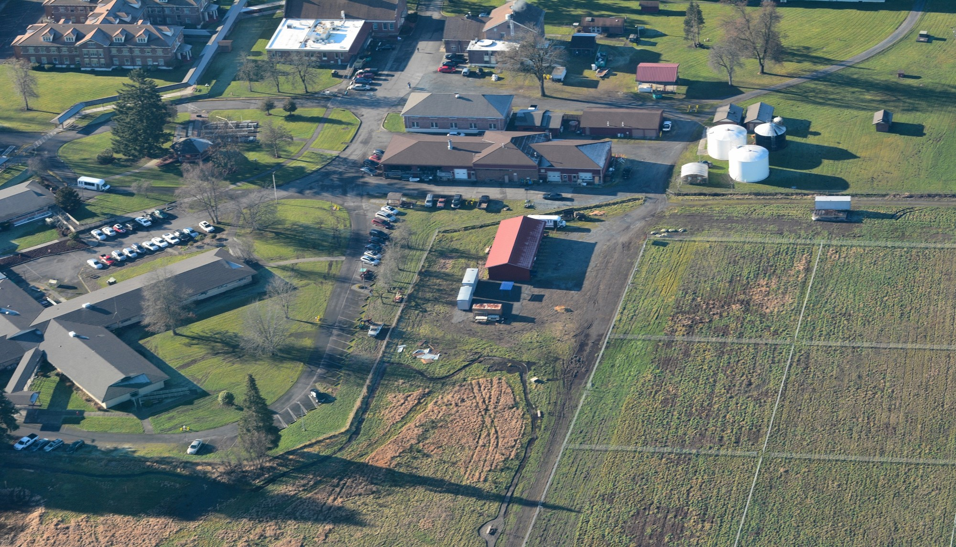

Rural Veterans and Agriculture
Agriculture in WA employs 160,000 workers Annually *
Agriculture contributes 13% of the state’s economy.*
Agriculture jobs include those beyond the field
2017 Ag Census*

Slide 9
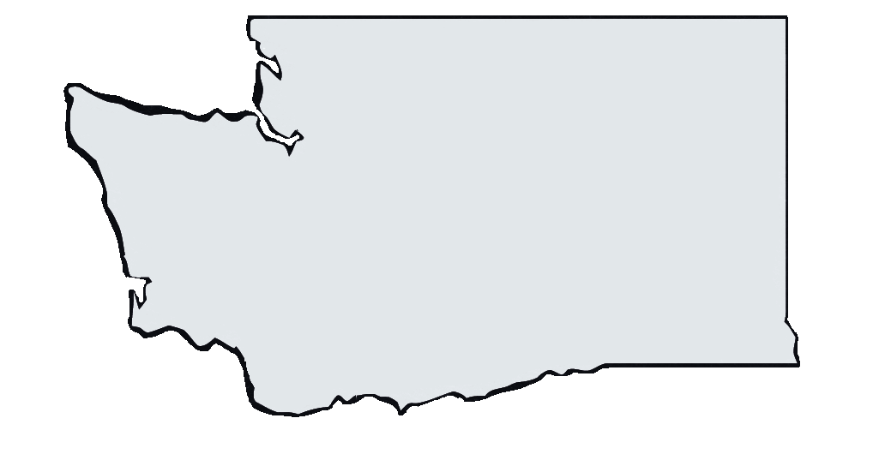

Initiatives and Partners for Veterans in Agriculture
Growing Veterans growingveterans.org
360-445-2399 staff@growingveterans.org
Notes:
Growing Veterans has a certified organic farm in Whatcom County Washington where veterans and civilians come together to grow food, community and each other. In the fields interns and volunteers learn and practice sustainable agriculture where informal "Dirt Therapy" organically happens. In addition, they offer a 3-day peer support training workshop accredited for 20.5 CEU credits through Washington Mental Health Counselors Association. Growing Veterans mission is to cultivate belonging and purpose through farming and peer support with the vision of creating a culture of honor, truth, and understanding, where we connect and strengthen the roots of humanity.

Slide 10
Initiatives and Partners for Veterans in Agriculture
Growing Veterans growingveterans.org
360-445-2399 staff@growingveterans.org
GRuB Victory Farm
goodgrub.org/victory-farm
360-753-5522 vgp@goodgrub.org
Notes:
The Victory Farm in Thurston County offers hands-on opportunities for veterans to develop their skills in sustainable small-scale urban agriculture and food production. Its mission is to empower veterans, active duty service members and their families to establish strong roots in their community by providing opportunities to connect with community and others who have served or are currently serving; helping to break down the barriers of isolation while creating a

Slide 11
Initiatives and Partners for Veterans in Agriculture
Growing Veterans growingveterans.org
360-445-2399 staff@growingveterans.org
GRuB Victory Farm
goodgrub.org/victory-farm
360-753-5522 vgp@goodgrub.org
VETS_CAFE
vetscafeolywa@gmail.com
https://www.vets-cafe.org/
Notes:
The Victory Farm in Thurston County offers hands-on opportunities for veterans to develop their skills in sustainable small-scale urban agriculture and food production. Its mission is to empower veterans, active duty service members and their families to establish strong roots in their community by providing opportunities to connect with community and others who have served or are currently serving; helping to break down the barriers of isolation while creating a

Slide 12
Initiatives and Partners for Veterans in Agriculture
Growing Veterans growingveterans.org
360-445-2399 staff@growingveterans.org
GRuB Victory Farm
goodgrub.org/victory-farm
360-753-5522 vgp@goodgrub.org
VETS_CAFE
vetscafeolywa@gmail.com
https://www.vets-cafe.org/
Vets on the Farm
htttp://sccd.org/votf
Notes:
Vets on the Farm is a program of the Spokane Conservation District that has expanded into other counties with support from the Conservation Commission. The program is designed for veterans seeking a new mission and a way to transition back into civilian life through careers in agriculture, farming, ranching or other conservation based industries. Spokane Vets on the Farm operates an incubator farm and farm stand and offers transition resources including education opportunities with WSU Extension and Spokane Community Colleges, community networking, and employment support.

Slide 13
Initiatives and Partners for Veterans in Agriculture
Growing Veterans growingveterans.org
360-445-2399 staff@growingveterans.org
GRuB Victory Farm
goodgrub.org/victory-farm
360-753-5522 vgp@goodgrub.org
VETS_CAFE
vetscafeolywa@gmail.com
https://www.vets-cafe.org/
Vets on the Farm
htttp://sccd.org/votf
Farmer Veteran Coalition WA state Chapter
Washington@farmvetco.org
Notes:
-Home grown by heroes
Farmer fellowship funds
Scholarships
Land access

Slide 14
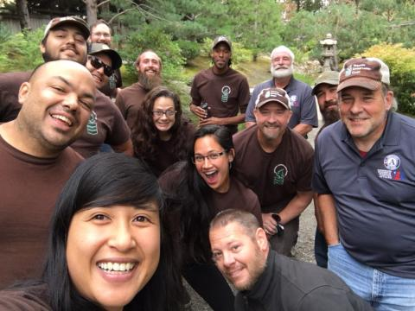
WDVA programming
Veterans Conservation Corps
Veterans Farm at Orting
VA rural health VA Farms Grant
2017 Ag Census*

Slide 15
Making the connection for Rural Veterans
work is associated with decreased intensity of depression *
Veterans with mental health conditions often experience occupational impairment *
Agriculture provides advantages to Veterans by providing employment that where the Veteran lives
* Kukla, Rattray, & Salyers, 2015; Sripada et al., 2018

Slide 16
Objectives
Introduce you to some of the statistics around rural veterans
Introduce you to some of the statistics around those in Agriculture, including veterans.
Describe programs, organizations and initiatives statewide that support veterans in Agriculture.

Slide 17
Thank you
Jason Alves M.P.A., Program Manager,
Veterans Conservation Corps and Vet Corps, WDVA
JasonA@dva.wa.gov, 360-725-2224

