Slide 1
Budget Update
Mike Kashmar Chief Financial Officer
September 20, 2018

Slide 2
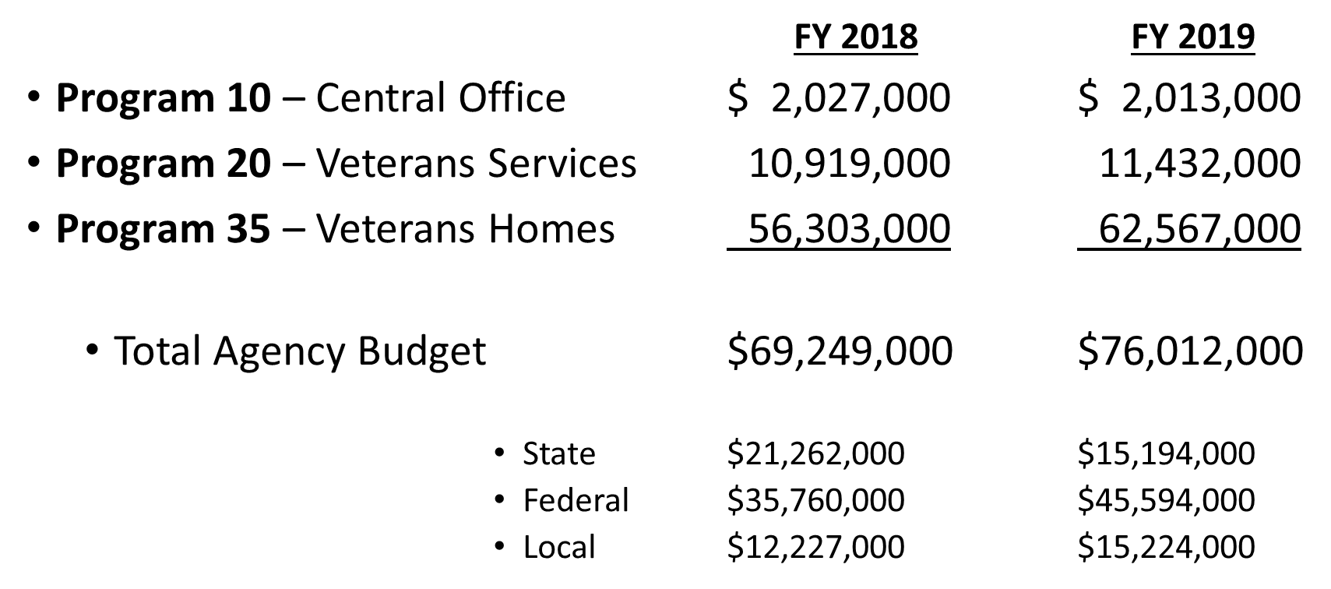
2017-19 Biennium Budget– By Program

Slide 3
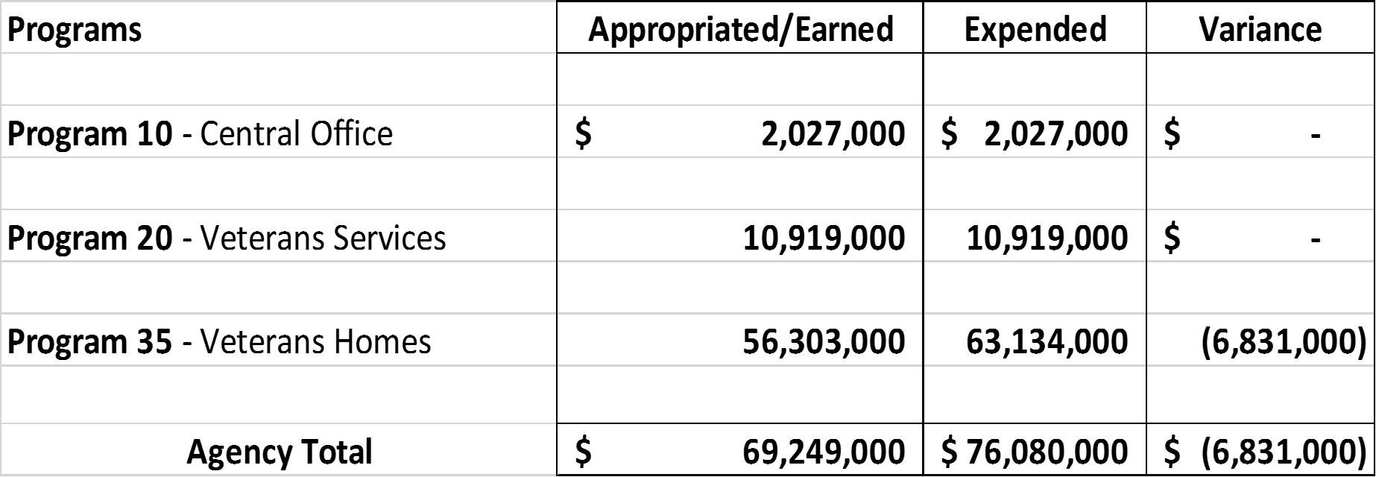
FY 2018 – Post Closing

Slide 4
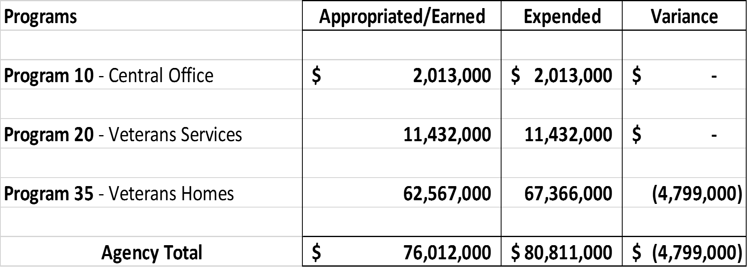
FY 2019 – Projected Budget/Expenditures

Slide 5
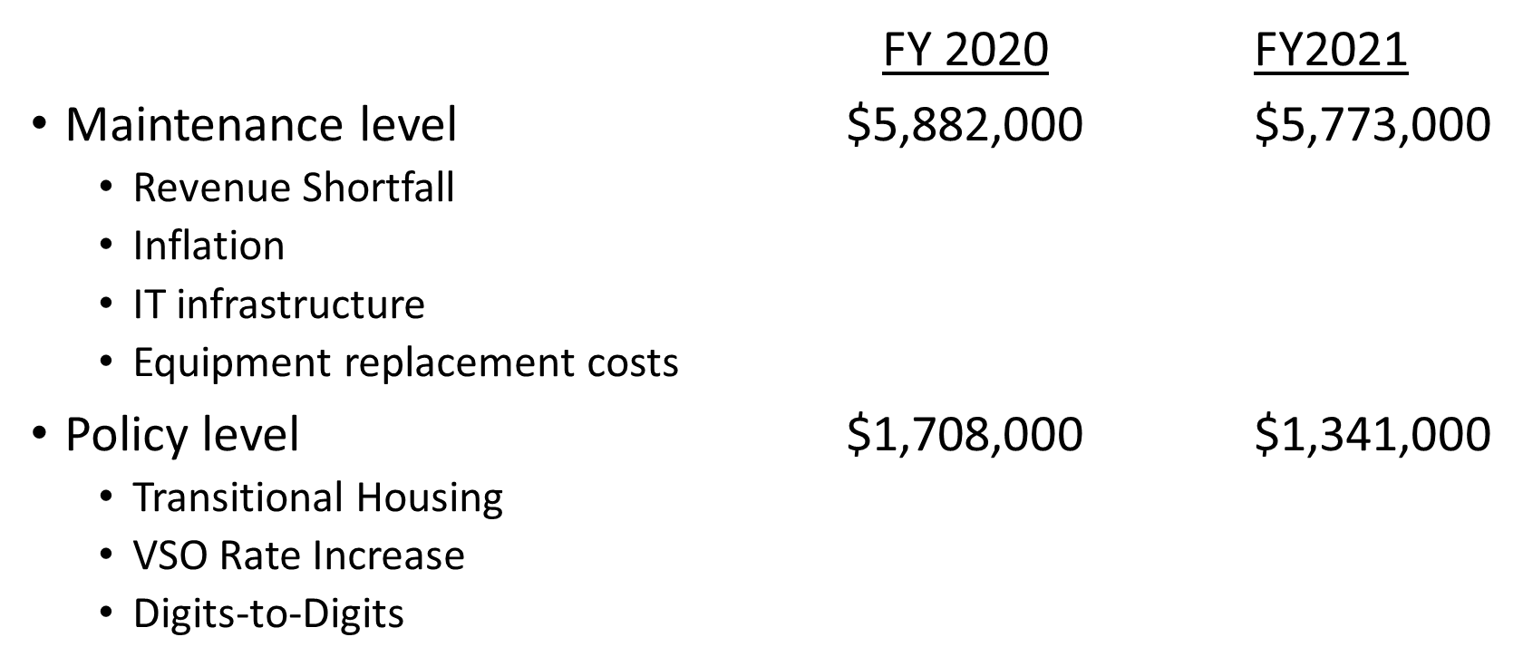
2019-21 Biennium Operating Budget Request

Slide 6
Questions?
Thank you!

