Slide 1
Commander’s Call - VAROBriefing
September 2018

Slide 2
VBA - Beneficiaries Served
Education
Paid nearly $74B in Post-9/11 GI Bill benefits to over 1.74M individuals to date since program inception in 2009
Forever GI Bill implemented on August 16, 2017.
Compensation
Paid $74B to 4.66M beneficiaries
Completed 1.3M claims & 5.76M issues – met & maintaining goal to complete claims in average of 125 days
Life Insurance
Provides over $1.2T in coverage for service members, Veterans and their families
Paid $2B to insure 6.1M lives, including 114.5K death claim payments
Home Loan Guaranty
Over 2.75M VA home loans on the books
Guaranteed a record 705K loans in FY16 (12% more than FY15) totaling $179B
Helped a record 97K Veterans avoid foreclosure in FY16 (7% more than FY15)
Approved a record 1,914 Specially Adapted Housing grants exceeding $100M in FY16 (6% more than FY15)
Vocational Rehabilitation & Employment
Over 14K Veterans achieved positive outcomes in VR&E program in FY16 – 6.5% more than FY15
VR&E participants grew 3.1% from FY15 to more than 135K in FY16
“ To care for him who shall have borne the battle and for his widow, and his orphan.”
Benefits Assistance
Over 6M registered eBenefits users – 1M more than FY15
Provided 14K VA Benefits briefings to estimated 378K transitioning Servicemembers & family through the Transition Assistance Program
Pension & Fiduciary
Paid $5.45B in Pension benefits to nearly 500K beneficiaries in FY16
Served 198K Fiduciary beneficiaries in FY16 – 8% more than FY15

Slide 3
VA - 5 Priorities
Greater Choice for Veterans
Redesign the 40/30 Rule
Build a High Performing Integrated Network of Care
Empower Veterans through transparency of information
Modernize our System
Infrastructure Improvements and Streamlining
EMR Interoperability and IT Modernization
Focus Resources More Efficiently
Strengthening of Foundational Services in VA
VA/DOD/Community Coordination
Deliver on Accountability and Effective Management Practices
Improve Timeliness of Services
Access to Care and Wait Times
Decisions on Appeals
Performance on Disability Claims
Suicide Prevention
Getting to Zero

Slide 4
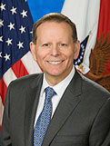
Paul R. Lawrence, Ph.D. Under Secretary for Benefits
Paul R. Lawrence, Ph.D.
Under Secretary for Benefits
Paul R. Lawrence, Ph.D. was nominated by President Donald J. Trump to serve as the 7th Under Secretary for Benefits and was confirmed by the United States Senate on April 26, 2018.
As Under Secretary, he leads more than 20,000 employees in the Veterans Benefits Administration (VBA) in the delivery of benefits programs for Veterans, including disability compensation, pension and fiduciary, education, home loan guaranty, vocational rehabilitation and employment, life insurance, and the Transition Assistance Program. Through a nationwide network of 56 regional offices, special processing centers, and VBA headquarters, he oversees the execution of over $104B in direct benefits to Veterans and their dependents.
Prior to his confirmation, Dr. Lawrence served as Vice President at Kaiser Associates. He has 30 years of experience working closely with federal leaders as a senior management consultant, serving in leadership positions at such organizations as Ernst & Young, Accenture, the MITRE Corporation, IBM Business Consulting Services, and PricewaterhouseCoopers. He has researched and written extensively on management and government. He is the co-author of Succeeding as a Political Executive: 50 Insights from Experience; What Government Does: How Political Executives Manage; and Paths to Making a Difference: Leading in Government. He is the co-editor of Transforming Organizations and Learning the Ropes: Insights for Political Appointees. He served on the Board of Advisors to the Economic Program at the University of Massachusetts and has served on the Board of Advisors of the Thomas Jefferson Public Policy Program at The College of William and Mary. He was twice selected by Federal Computer Week as one of the top 100 public service business leaders. Dr. Lawrence served in the U.S. Army attaining the rank of Captain. He graduated from the Army's Airborne School and was awarded the Meritorious Service Medal. He earned a Master of Arts and Ph.D. in Economics from Virginia Tech and a Bachelor of Arts in Economics from the University of Massachusetts, Amherst.

Slide 5
USB Three Areas of Focus
Customer Service
Financial Stewardship
Culture of Collaboration

Slide 6
Where We’re Going: VBA Priorities 2018 & Beyond
DIGITIZATION and AUTOMATION
Centralized Intake of Claims Material
Paper Extraction & Digitization of Inactive Claim Files
Decision Ready Claims
Exam Management System
Quality Management System
EFFICIENCY and SERVICE
Update Performance Standards
Expand Access to VA Systems
Modernize the Appeals Process
Continue to improve customer service at National Call Centers
Improve Dependency Claims Processing
Update the VA Schedule for Rating Disabilities (VASRD)
STRATEGIC PARTNERSHIPS
Warrior Training Advancement Course (WARTAC)
6

Slide 7
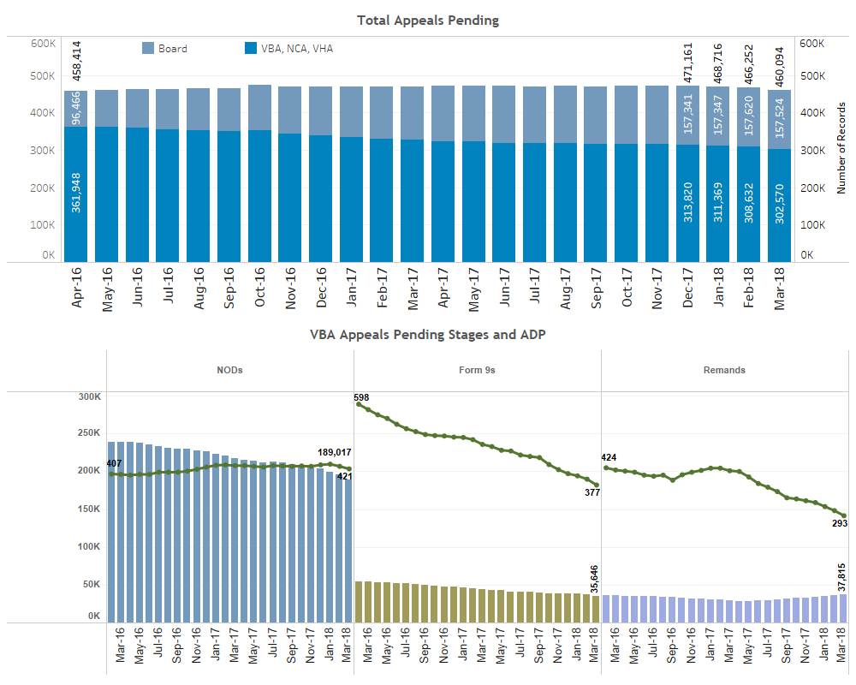
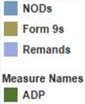
VA Appeals Inventory
Board C&P 154,642
VBA C&P 298,180

Slide 8
VA Appeals Process Today

Slide 9
New Decision Review Process
Veterans Benefits Administration
Board of Veterans’ Appeals
The Claim
(Establishes Effective Date)
VBA Decision
(Improved Notice)
Higher-Level Review
Same Evidence
125-Day Avg. Goal
Supplemental Claim
New Evidence
125-Day Avg. Goal
Appeal (NOD)
3 Options
365-Day Avg. Direct Docket Goal
120 Days
Except for appeals to the Court,
all filing deadlines are one year.
Court of Appeals for Veterans Claims
9

Slide 10
New Process – VBA Lanes
Supplemental Claim Lane
Higher-Level Review Lane
VA will readjudicate a claim if “new and relevant” evidence is presented or identified with a supplemental claim (open record)
VA will assist in gathering new and relevant evidence (duty to assist).
Effective date for benefits always protected (submitted within 1 year of decision)
Replaces “reopening” claims with “new and material” evidence
More experienced VA employee takes a second look at the same evidence (closed record and no duty to assist)
Option for a one-time telephonic informal conference with the higher-level reviewer to discuss the error in the prior decision
De novo review with full difference of opinion authority
Duty to assist errors returned to lower-level for correction (quality feedback)
10

Slide 11
New Process – Appeal Lane
Evidence Only Docket
VBA Decision
Hearing Docket
When this option is selected on the NOD, the appellant will be scheduled for a Board hearing. Additionally, the appellant may submit evidence within the 90 day window following the scheduled hearing. The Board does not have a duty to assist and the record is otherwise closed.
When this option is selected on the NOD, the appellant may submit evidence within the 90 day window following submission of the NOD. The Board does not have a duty to assist and the record is otherwise closed.
NOD
Evidence Docket
Direct Docket
Hearing Docket
Direct Docket
When this option is selected on the NOD, the appellant receives direct review by the Board of the evidence that was before VBA in the decision on appeal. The Board has a 365-day timeliness goal for this docket. Quality feedback loop for VBA.
Additional evidence submitted within 90 days following NOD
Closed record and 365 days timeliness goal
Board hearing and additional evidence submitted within 90 days following hearing
Supplemental Claim
Board Decision
Appeal to CAVC
11

