Slide 1
From soldier to veteran: How the va & dod work together to ensure a seamless & successful transition
Jessica N. Thomas, licsw
va liaison for healthcare, warrior transition battalion, jblm

Slide 2
Dod & va transition programs:
1. DOD programs that are specific to ALL transitioning Soldiers:
Soldier For Life-Transition Assistance Program- redesigned due to increased concern around Soldier transition
2. Collaborations between DOD, VHA and the VBA:
VA Liaison for Healthcare, VBA on site and conducting trainings, IDES (MEB)
3. New programs & policies for historically underserved populations:
Mental Health Executive Order, Military Sexual Trauma (MST) eligibility, Women Veterans,
LGBT-Q population

Slide 4
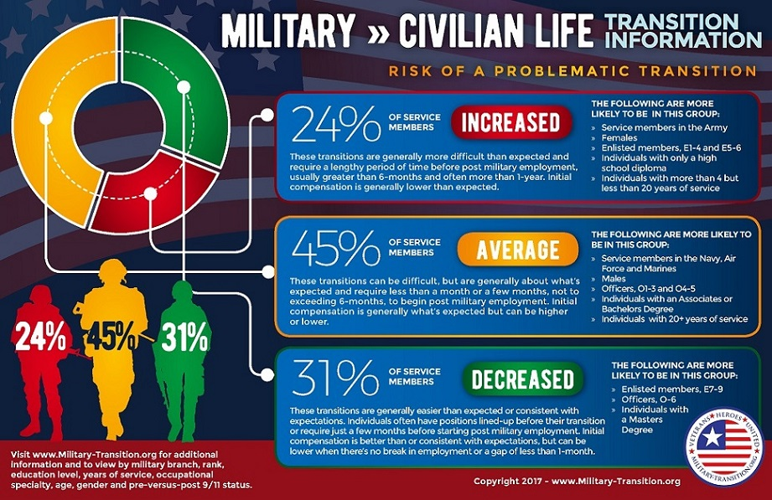

Slide 5
Soldier for life-transition assistance program
The Soldier for Life — Transition Assistance Program (SFL-TAP) is a centrally funded commanders program that provides transition assistance services to eligible Soldiers. Commanders are responsible for ensuring each Soldier has time to attend this training.
SFL-TAP consists of a two-hour preparation counseling session, attendance at a 3 day Department of Labor Employment Workshop (DOLEW), 6 hrs of VA Healthcare and Veteran Benefits briefs, including in enrolling in e-Benefits, my HealtheVet and VA healthcare online. (SMs are able to enroll in VHA 180 days prior to d/c)
Soldiers who are retiring can participate in SFL-TAP within 24 months of retirement, and 12-18 months for all other Soldiers.
At the conclusion of SFL-TAP Servicemembers will have received an average of 40 hours of classes/trainings including completion of 8 online courses in order to successfully complete SFL-TAP program.

Slide 6
Collaborations between DOD & VHA
Collaboration #1: VA Liaison for Healthcare (Transition & Care Management Program)
VA Liaisons stationed at Military Treatment Facilities (MTFs) or Warrior Transition Battalion support the transfer of service members who need continued medical care. They coordinate care and provide consultation about VA resources and treatment options. Liaisons will contact the service member's local VA Medical Center and Transition Care Management (TCM) Team to ensure that appointments and care plans are in place before the service member leaves the MTF.
VA Liaisons at the WTB & MTF are apart of the Soldiers multi-disciplinary team, but work closely with providers across post to ensure any Soldier is afforded the ability to be connected to their local VA, TCM Team and potentially assigned a case manager for 90 days.
Priority: SI/I, Vulnerable (SA/SI, pregnant, at risk of homelessness, MH), Chapters, Combat Veterans

Slide 7
Collaborations between DOD & VBA
Collaboration #2: Veteran Benefit Administration :
Every post has VBA reps and Veteran Service Officers who work with the TAP in order to assist Soldiers who will be transitioning out of the Service to apply for a Service Connected Disability. Soldiers are encouraged to participate in the Benefits Delivery at Discharged (BDD) program.
BDD:
180 days
ETS physical
Medical Records
Attend evaluations for claims while on AD
**If granted a service connected disability from the VA, Soldiers should receive their benefits within 2-3 months after discharge.

Slide 8
Collaborations between DOD & VHA & VBA
Collaboration #3: IDES
When a SM is wounded, injured or fall ill while on AD and they are no longer able to perform their duties, they will be referred to the Integrated Disability Evaluation System (IDES). Through this collaborative the VA & DOD work together to make disability evaluation simple, fast and fair. If the SM is found to be medically unfit for duty, IDES will give them a proposed VA disability rating before they leave the service.
During the Medical Evaluation Board Soldiers are assigned the following personnel to assist them with their transition:
Physical Evaluation Board Liaison Officer (PEBLO) which guides SMs through IDES process & assists with DOD Benefits
Military Service Coordinator (MSC) who will assist them with VA compensation claims/benefits with in IDES
Vocational Rehabilitation Counselor (VRC) to assist them with Vocational Rehabilitation & Employment services to prepare them for transition
VA Liaison for Healthcare to complete the VA Referral, obtaining an initial VA appointment and connecting the SM to the TCM team to prior to leaving JBLM.

Slide 9
New policies: Mental health executive order
Mental Health Executive Order – “Supporting our Veterans during their transition from Uniformed Service to Civilian Life” Jan 2019 President Trump
Directs the U.S. Department of Veteran Affairs, DOD, and DHS to work together to ensure newly discharged Service members and Veterans have access to any needed mental health care for at least 1 year following their discharge from military service.
Service members with an OTH discharge may receive emergent mental health care from VA, and servicemembers who have an OTH can receive mental health care for conditions incurred or aggravated during active duty service.
How:
Servicemembers will be offered VA Healthcare registration pre-transition (via e-Benefits & VA Liaison’s) by modifying the Transition Assistance Program (TAP) guidelines and increasing VSO involvement.

Slide 10
New programs: Military sexual trauma & VA eligibility
Military Sexual Trauma (MST) and Mental Health Eligibility- May 2016, Updated 2018
The Department of Veteran Affairs has a wide range of outpatient, inpatient and residential services available to assist Veterans in their recovery from MST. All treatment for mental and physical health conditions related to MST is provided free of cost. Veterans do NOT need to be service connected and eligibility for MST related health care is independent of receipt of other VA Benefits.
No income limit, no reporting or documentation required, no length of service
MST Coordinator- Every VA facility must have one
Relaxed standards in filing for VA compensation for MST related issues.

Slide 11
New programs: LGBT & Related Identities
“LGBT and Related Identities” –Veterans may have other ways of describing themselves so the term is an inclusive term for sexual and gender minorities.
Veterans Care Coordinator at every facility to assist Veterans in receiving the specialized care needed. VA Healthcare includes:
Hormone Treatment
Substance use/alcohol treatment
Tobacco use treatment
Treatment and prevention of STIs /PrEP
Intimate partner violence reduction and counseling
Heart health
Cancer screening, prevention and treatment
Consults for counseling to discuss transitioning or an evaluation for hormone therapy

Slide 12
Transition & VA Information
www.va.gov ← Department of Veteran Affairs
www.ebenefits.gov ← Apply for Healthcare & Compensation Benefits
www.benefits.va.gov ← VA Transition Assistance Program (TAP)
www.oefoif.va.gov ← VA Liaison for Healthcare & Transition and Care Management Program

