Slide 1
VA MISSION Act Overview Presented by Dallas Marcus
Start date 6-6-2019

Slide 2
Today’s Agenda
What the MISSION Act is and isn’t
New Community Care Eligibility Criteria
New Benefit: Urgent Care
Copayment Rates at a Glance
Resources for Veterans
What does the Veteran need to do?
Questions
2

Slide 3
What the MISSION Act is and isn’t
The MISSION Act does:
Replaces the Choice Program
Opens the opportunities for more veterans to be seen in the community
The MISSION Act doesn’t:
Promise or guarantee that the veteran will be seen sooner out in the community
Force the Veteran to use Community Care System
3

Slide 4
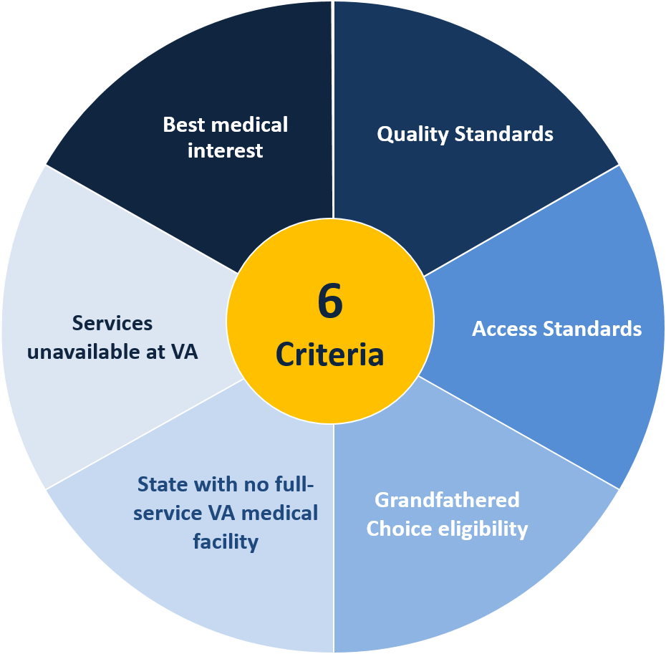
New Community Care Eligibility Criteria
Services unavailable at VA
Best medical interest
Quality Standards
Access Standards
Grandfathered Choice eligibility
State with no full-service VA medical facility

Slide 5
1. Services Unavailable at VA
Services unavailable at VA (ex: maternity care, IVF)
In this situation, a Veteran needs a specific type of care or service that VA does not provide in-house at any of its medical facilities.

Slide 6
2. Best Medical Interest
Best Medical Interest
In this situation, a Veteran may be referred to a community provider if it’s in the Veteran’s best medical interest as determined by a VA provider in discussion with the Veteran.
This is a conversation between veteran and VA provider.

Slide 7
3. Quality Standards
Quality Standards (implemented after June 2019)
In this scenario, if VA has identified a medical service line is not meeting VA’s standards for quality based on specific conditions, Veterans can elect to receive care from a community provider under certain limitations.

Slide 8
4. Access Standards
VA cannot furnish care within certain designated access standards
To be eligible under this criterion, VA would have to be unable to schedule a VA appointment for a Veteran at a facility that can provide the requested service within the designated average drive time and within the designated number of days (wait time).

Slide 9
4. Access Standards continued (Wait Time)

Slide 10
5. Grandfathered Choice Eligibility (ends June 6, 2020)
Grandfathered Choice Eligibility
Veteran was eligible under the distance criteria (continue to meet the distance criteria) for the Veterans Choice Program on June 5, 2018
AND
They live in one of the five U.S. states with the lowest populations (North Dakota, South Dakota, Montana, Alaska, and Wyoming) or
Veteran received care in the year prior to enactment the VA MISSION Act of 2018 AND requires care before June 6, 2020

Slide 11
6. State with No Full-Service VA Medical Facility
Residence in a State without a full-service VA medical facility
Specifically, this applies to Veterans living in Alaska, Hawaii, New Hampshire, and the U.S. territories of Guam, American Samoa, Northern Mariana Islands, and Virgin Islands.

Slide 12
Urgent Care Overview
Establishes a new benefit for urgent (walk-in) care
Must meet specific eligibility requirements
Enrolled in VA healthcare
Received care through the VA in the last 24 months prior to the visit
Provides Veterans with access to urgent, non-emergency care (e.g. non-life threatening conditions) through the VA contracted network of community providers (Tri-West or CCN contractor)
Includes services such as: flu shot, ear infections, strep throat, pink eye
More information on Flyer for Urgent Care
12

Slide 13
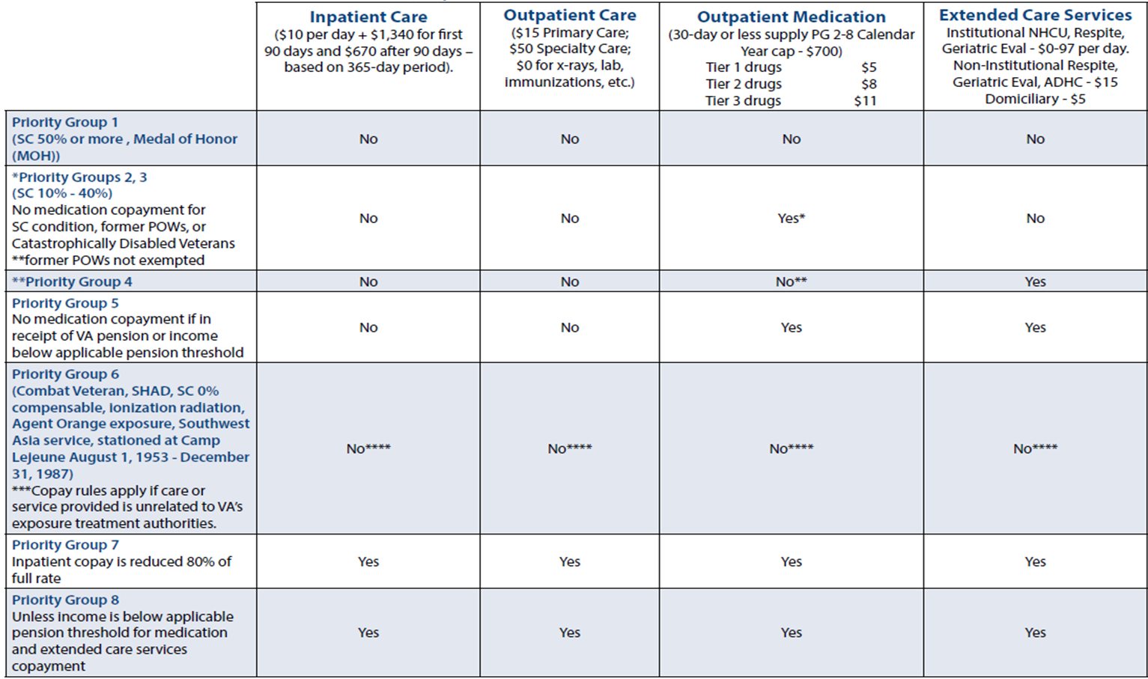
COPAYMENT RATES AT A GLANCE: Copayment Rates will not change under MISSION Act
13

Slide 14
Resources
Contact Numbers:
Office of Community Care (OCC): 509-484-7969
Primary Care: 509-434-7026
Spokane Eligibility: 509-434-7009
Spokane VA main number: 509-434-7000
Web pages:
https://www.va.gov/communitycare/
https://www.va.gov/communitycare/about_us/contacts.asp
https://joinournetwork.triwest.com/Forms/AddProvider.aspx
14

Slide 15
What does the Veteran need to do?
Step 1: Make sure you are enrolled at local VA Hospital
Step 2: Make sure that Eligibility has updated information.
Step 3: Reach out to Your Primary Care Doctor or Team
Step 3a (Choice 40): If Veteran qualifies for grandfathered Choice 40, Veteran can call OCC (Office of Community Care) for the following 3 types of consults:
Primary Care, Audiology or Optometry
15

Slide 16
Questions
16

