Slide 1
Working with Congressional & State Legislative Offices

Slide 2
Hello! Who We Are:
Val Hamann - Office of U.S. Senator Patty Murray, Eastern Washington Representative
Chelsea Clayton - Office of U.S. Senator Patty Murray, King County Director of Veterans Affairs
Charlie Duranona - Congresswoman Cathy McMorris Rodgers (WA-05), Veterans Liaison and Military Outreach
Benjamin Studley - Congresswoman Suzan DelBene (WA-01), Veteran Constituent Services Representative
Reni Michael - Washington State Senator Sharon Brown (District 8), Senior Legislative Assistant

Slide 3
What Happens in Congressional Offices?
Washington D.C. Staff, both those who work in the member’s personal office or as part of their committee staff:
Plan, develop and oversee legislation and the legislative process, usually within a specific issue-area.
Prepare draft responses to communications from constituents.
Prepare briefings for the member; provides expertise, background and analysis within their issue area.
Staff in Washington State offices:
Connect with State, county, and municipal government agencies as well as private organizations to provide feedback to the member on what is happening in the State and to look for ways to collaborate and support the work they are doing.
Work with individual constituents to help resolve problems they are having, usually with a federal government agency.

Slide 4
What is ‘Casework’?
Many people turn to the offices of their elected officials when they encounter a problem with a government agency, or are having difficulty obtaining clear answers or directions. Most offices have staff members whose jobs include looking for answers or solutions to these problems, and collectively that is often referred to as ‘Casework’. Some of these problems or questions are simple and relatively easy to resolve, while some can be long and ongoing processes.
Staffers that work with constituents on these issues are non-partisan government employees and are not concerned with your voting record or political affiliation – we are here to serve all of the constituents we represent.
House offices as well as State Legislative offices typically work only with constituents who live inside their particular district, and will refer constituents from other districts to their elected representatives.
Each individual elected official determines the scope of the kinds of issues their office can address.

Slide 5
Legislation & Policy vs. Casework
Typically, Casework is concerned with a specific problem involving a specific individual, and does not require changes to existing laws or agency policy.
Legislation, on the other hand, involves changing or clarifying laws and regulations for all citizens. The process of creating, introducing, and passing a new piece of legislation is a collaborative process that involves work from many different members of Congress in both the House and the Senate, and very often takes years of sustained effort.
In some instances, casework can help to drive larger legislative change. However, this is a LONG process and normally comes after a trend in numerous cases surrounding the same issue.
Not each case can and will prompt for legislature changes.
Those who are comfortable may be asked by staff if they would allow for the congressional office/member to use their story on the Senate or House floor while the member is discussing legislation.

Slide 6
What Kinds of Assistance Can Congressional Offices Provide?
Obtaining updates from Federal Agencies on applications or appeals.
Obtaining clarification on specific points, or answers to specific questions.
Help resolving errors or mistakes.
Obtaining responses to a concern, or assurances regarding potential future events.
Requesting expedited consideration under certain circumstances, such as homelessness, terminal illness, and extreme financial hardship (foreclosure, eviction, utilities shut off)
In some instances, Staff may be able to connect you with potentially useful resources both through Federal agencies, as well as through State and municipal agencies and private non-profit organizations.

Slide 7
What Kinds of Assistance Can Legislative Offices Provide?
The Washington State Legislature – House and Senate work with Legislative Liaison’s from the various agencies to assist constituents.
Our office requests an email with specific and pertinent information relating to the case. Sticking to specifics and providing all necessary information helps us to serve you better.
In the event of a constituent request for support in an ongoing case with L&I, DSHS or DCYF, we request that the constituent work with their caseworker to submit a release authorizing our office access to their case. Unlike the federal member offices, we do not have a standard legislative release form.
We are able to supply assistance and support with the various agencies within Washington State. A few examples:
Labor & Industries
Dept. of Licensing
Dept. of Transportation
Dept. of Children, Youth & Families
Dept. of Social & Health Services

Slide 8
What Kinds of Issues Can Congressional Offices Not Assist With?
Tell an agency what they should do, including reversing an outcome that has already occurred or dictating what their decision should be.
Conduct an investigation, including demanding they provide copies of internal documents or interview specific individuals.
Change or circumvent existing agency rules, policies or procedures.
Demand an agency advance a particular item in their queue without exceptional circumstances.
Complete government forms or applications, or provide the kind of active representation that a Veteran Service Officer or attorney provides.
Offer legal advice or representation, or interfere in matters being addressed by the judicial branch of government.
Offer a medical diagnosis or opinion, or question the diagnosis or opinion of a healthcare professional.

Slide 9
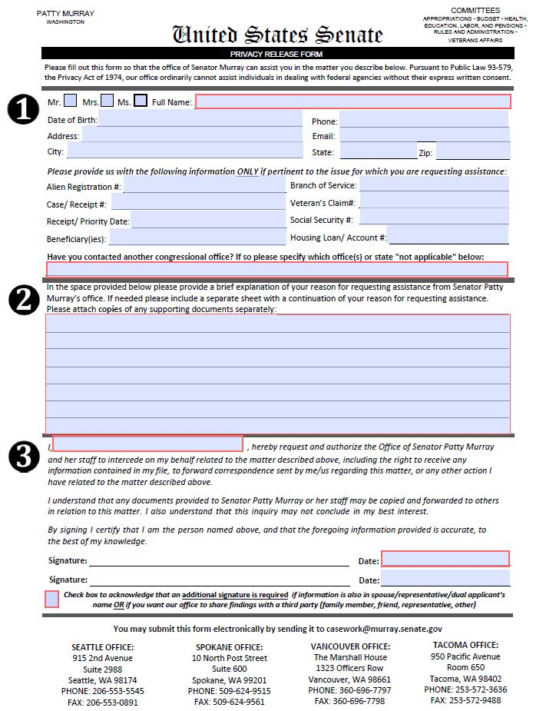
How Do I Start an Inquiry?
All Congressional inquiries begin with a completed Privacy Release Form. Forms can be picked up at our offices, mailed or emailed by request, or in some cases downloaded from the member’s website.
Completed forms should included your full name, address, telephone numbers, social security number, and preferred email address.
Give a short, complete summary of the situation you’re looking for help with, and feel free to attach any relevant documents.
All forms have to be hand-signed with pen. If you want staff to be able to speak to anyone else about your case, such as a spouse or VSO, they also will need to sign.

Slide 10
What Happens Next?
The Office will send a letter of inquiry along with a copy of the Privacy Release Form that you have completed and any other documents provided. In most cases, this will be directed to our designated Congressional Liaison within that organization or agency.
The Congressional Liaison will review the letter and attached documents, and then prepare to respond. This often means reviewing files, speaking to specific individuals within the organization, reviewing laws and policy, and gathering other information.
The agency will respond. In some cases, this could involve reaching out directly to you or taking an action in response to your inquiry. In virtually all cases, they will also send a letter to our office responding to the questions or concerns.
In some instances, if you and the staff member feel the response does not full address the situation, does not answer all questions, or more information may be available in the future, the office can send a follow up inquiry.

Slide 11
Examples
VBA
Status of appeal can provide reassurance that the VA has your claim and working it from the national que. Additionally, our involvement can sometimes flag attention to mistakes that otherwise would not have been caught. We advocate and inquire on your behalf.
Inquiries into discrepancies in educational benefits can lead to correction of benefits.
VA home loan’s usually run into the problem of certified service. We can help inquire to get proof from the national Archives to obtain DD214’s or certification.
Working with Debt Management Center for erroneous debt or advocacy to help veteran.
VHA
Connecting with the patient advocates is a huge problem we can sometimes make the connection faster for veterans. (Appointments, pharmacy, complaints, ect.)
Erroneous bills from the VA or community providers. Authorizations are a bill issue right now leaving veterans with medical bills they shouldn’t be paying. (Emergency, community care and VA)

Slide 12
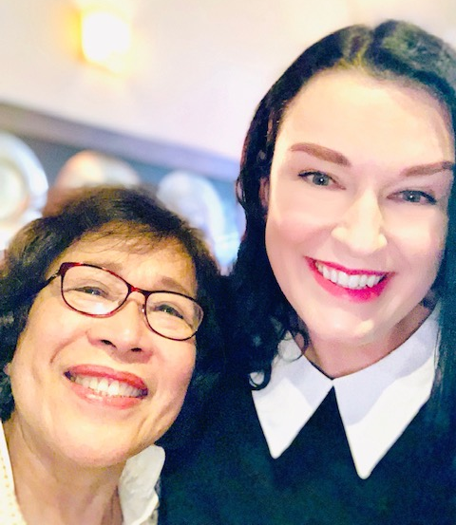
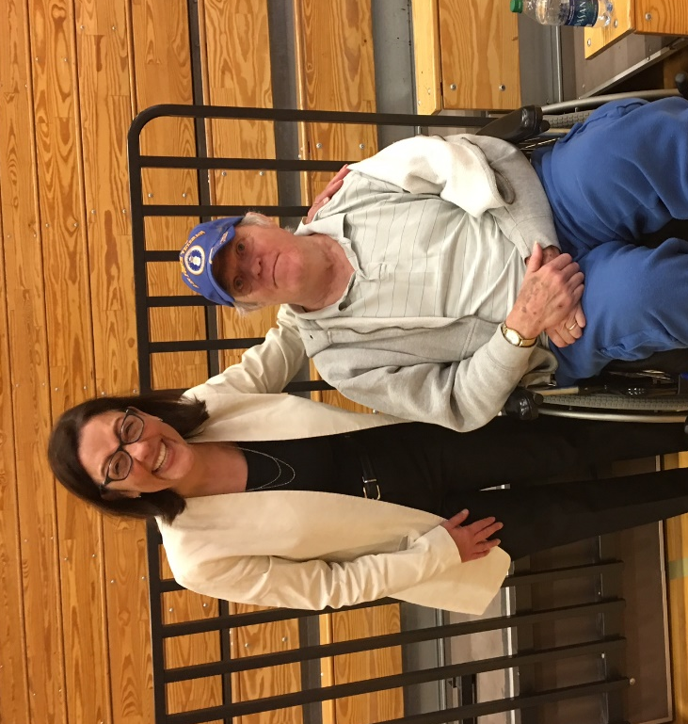
Casework Stories

Slide 13
Questions? Contact Information
Val Hamann
10 N. Post St.; Suite 600
Spokane, WA 99201
509-624-9515
Chelsea Clayton
2988 Jackson Federal Building
Seattle, WA 98174
206-559-5545
Charlie Duranona
10 N. Post St. Suite 625
Spokane, WA 99205
509-353-2374
Reni Michael
Irv Newhouse Building 202
P.O. Box 40408
Olympia, WA 98504
360-786-7614
Ben Studley
22121 17th Ave SE, Suite 220
Bothell, WA 98021
425-485-0085

