Slide 1
Engaging in the Second Mission
Kim Pham
Veterans Conservation Corps Program Specialist
Dan Overton
Traumatic Brain Injury Program Coordinator

Slide 2
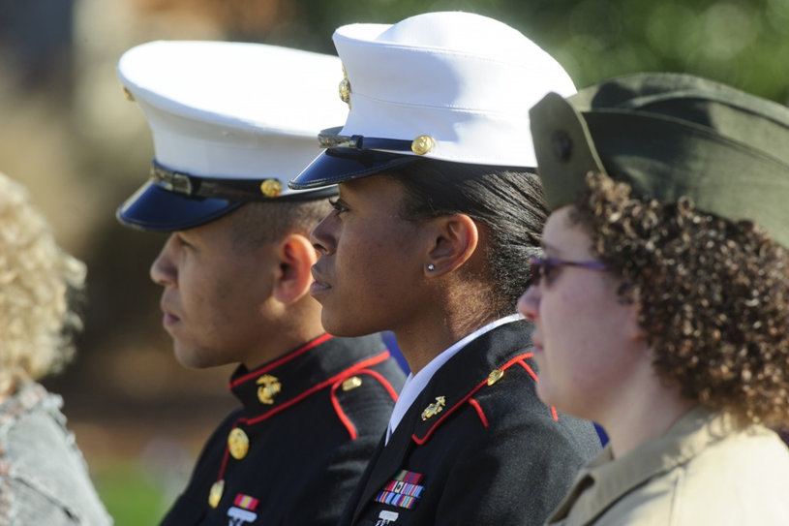
Before We Begin…
Notes:
Not all veterans’ experiences are the same.
Not all veterans are broken, angry or unstable.
One does not need to have been in combat to be a veteran.
Some of the information in this presentation may or may not apply to one’s respective situation.
Everybody in attendance today has a voice in this discussion.

Slide 3
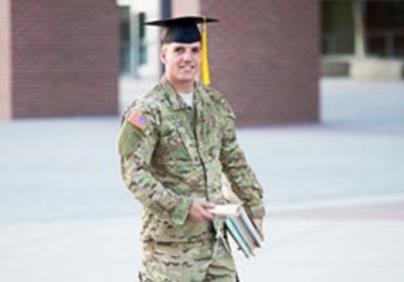
MILITARY CULTURE
What strengths, skills
and values are taught and learned in the military?

Slide 4
WHAT MILITARY VALUES AND SKILLS ARE VALUED?
Leadership and teamwork.
Character – trustworthy, dependable, drug free and strong work ethic.
Structure and discipline.
Job specific experiences and skills.
Decision making under rapidly changing circumstances.
Getting the job done.
Share company values.
Resiliency and working in difficult situations.
Loyalty to the employer.
Harrell & Berglass (2012). Employing America’s Veterans: Perspectives from Business

Slide 5
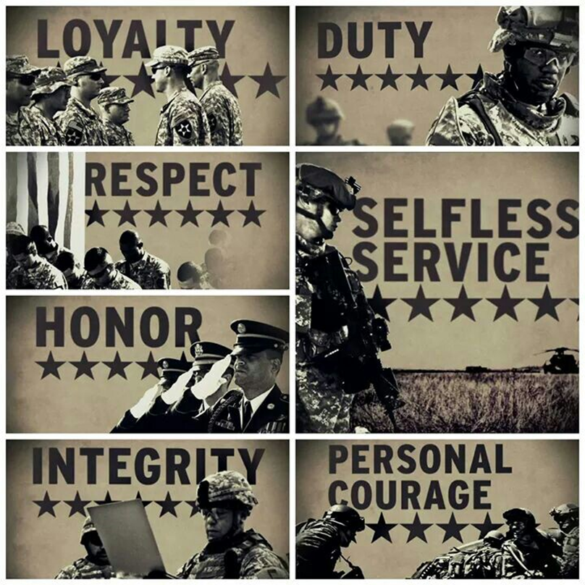
VETERANS AND MILITARY CULTURE…
Rifleman’s Creed:
This is my rifle.
There are many like it, but this one is mine.
It is my life.
I must master it as I master my life.
Without my rifle I am useless.
Soldier’s Creed:
I will always place the mission first.
I will never accept defeat.
I will never quit.
I will never leave a fallen comrade.

Slide 6
WARZONE SURVIVAL SKILLS AND EXPERIENCES
What skills and experiences are necessary to survive in a war zone?
How might these skills and experiences transfer to the civilian world?
Trust Buddies
Accountability/Control
Targeted Aggression
  Anger/adrenalin
Tactical Awareness
Quick decisions
Lethally Armed
Emotional Control
  Detachment
Individual Responsibility
Discipline, Order
Isolation/Avoidance
Details remain important
Quick reactions/frustration
Quick decisions/snapping reactions
World is about absolutes
  Grey area thinking?
Vigilance about surroundings
Anxious in crowds
Need for structure
Guilt/Loss
Control emotions
Inflexible Interactions

Slide 7
Combat experiences reported by soldiers and marines after deployment to Iraq (2002-2003)
Experience
Being attacked or ambushed
Receiving incoming rocket or mortar fire
Being shot at or receiving small arms fire
Being responsible for the death of a noncombatant
Seeing dead bodies or human remains
Handling or uncovering human remains
Seeing ill or injured women or children whom you were unable to help
Army -- Marines
89% 95%
86% 92%
93% 97%
14% 28%
95% 94%
50% 57%
69% 83%
Notes:
Combat experiences reported by soldiers and
marines after deployment to Iraq (2002-2003)
12
Experience Army Marines
Being attacked or ambushed 89% 95%
Receiving incoming rocket or mortar fire 86% 92%
Being shot at or receiving small arms fire 93% 97%
Being responsible for the death of a
noncombatant
14% 28%
Seeing dead bodies or human remains 95% 94%
Handling or uncovering human remains 50% 57%
Seeing ill or injured women or children
whom you were unable to help
69% 83%
Source: Hoge et al. July 2004, NEJM

Slide 8
WHAT CAN YOU FOCUS ON
As a result of training and experiences, what beliefs and values does a Veteran have?
I will never fail.
I will respect authority.
I live in selfless service.
Mission overall.
Success is a matter of life and death.
Quick decisions save lives.
You don’t understand me or my background.
I can never show weakness.
I cant ask for help.
No grey areas, no grey thinking.
I must contain emotion.
Every detail is important.
I must be in control.
Lethally armed, everyone is safe.

Slide 9
SECOND MISSION
What does it mean to find a second mission?
Will you, and the Veteran witness strengths, skills, talents, and values applied in a new way.
How AWARE are you or the veteran about the impact of military training and experiences on his/her life?
Post Deployment – 1-------------------------------------------10 Civilian Military
Notes:
Video if I can find on transition

Slide 10
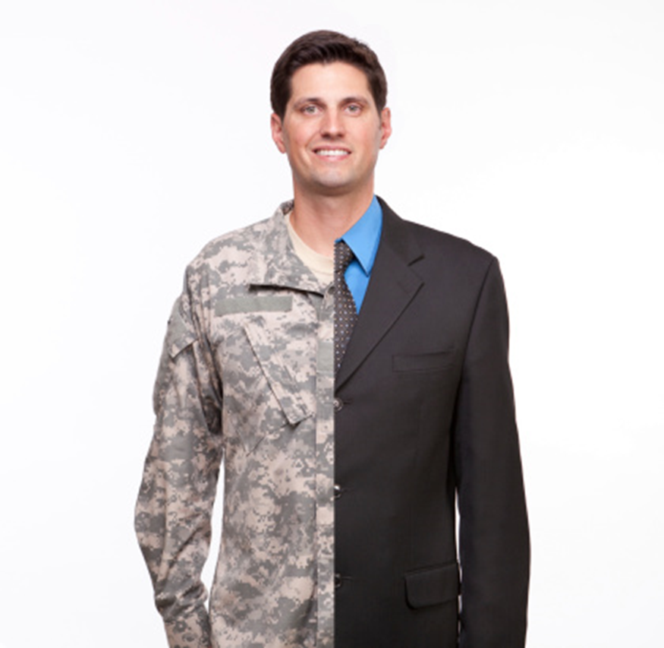
SECOND MISSION
What does it mean to find a second mission?
Notes:
It will be helpful to guide the veteran with the following: “What does it mean for me to become a civilian again?”
At some point there will be a need to learn which military characteristics to apply and not apply
How can you be a liaison and ambassador between military and civilian culture?

Slide 11
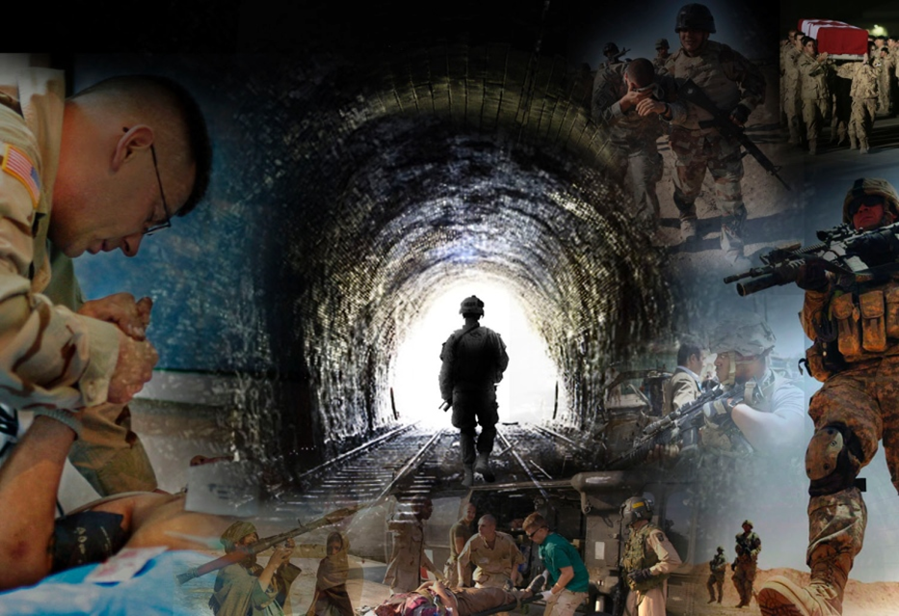
BEST PRACTICES for ENGAGEMENT
Notes:
What does it mean to be veteran supportive?
How competent are you, in working or engaging with military culture?
What would prevent a veteran from self-identifying in your organization and or programming?

Slide 12
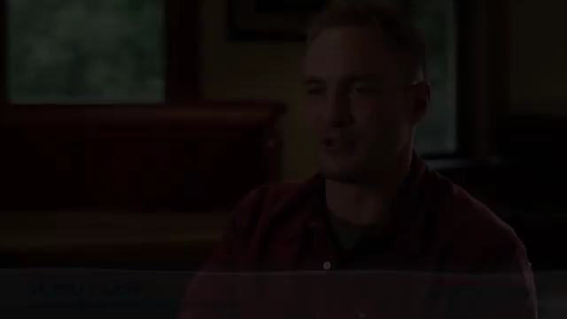

Slide 13

How Military Trauma can effect (successful) transition
PTSD (I)
Military Sexual Trauma (MST)
Traumatic Brain Injury
Suicide Prevention

Slide 14
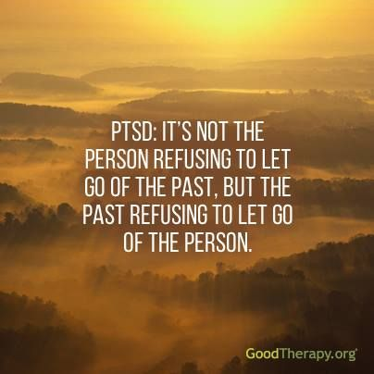
PTSD (I)
Notes:
The DSM-5 definition of trauma requires “actual or threatened death, serious injury, or sexual violence” [10] (p. 271). Stressful events not involving an immediate threat to life or physical injury such as psychosocial stressors [4] (e.g., divorce or job loss) are not considered trauma in this definition.
“trauma results from an event, series of events, or set of circumstances that is experienced by an individual as physically or emotionally harmful or threateningand that has lasting adverse effects on the individual’s functioning and physical, social, emotional, or spiritual well-being”

Slide 16
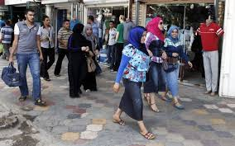

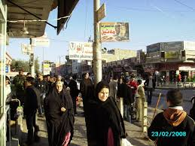

Notes:
To illustrate further, the pictures on the left are of market places in Iraq. What could pose a threat to one’s safety in these pictures? What could be an improvised explosive device or a shooter etc. The person carrying the bag? Could it be underneath one’s clothing? Buried in the sidewalk or in the doorway?
Now take a look at the pictures on the right. These locations are in Seattle. How are these places different than the ones in Iraq? For someone who has been deployed and experienced an explosion or trauma in this environment it could be the colors, sounds, smells, sensations etc, that get recorded to a traumatic event and anything similar to that experience will cause one to have similar reactions. Do you see similarities in both environments?

Slide 17
Notes:
Disorder vs “injury”

Slide 18
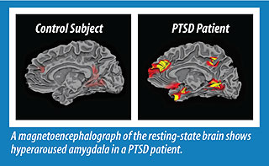
Notes:
Extensive neuroimaging studies on the brains of PTSD patients show that several regions differ structurally and functionally from those of healthy individuals.
The amygdala, the hippocampus, and the ventromedial prefrontal cortex play a role in triggering the typical symptoms of PTSD.
These regions collectively impact the stress response mechanism in humans, so that the PTSD victim, even long after their experience, continues to perceive and respond to stress differently than someone who is not suffering the aftermath of trauma.

Slide 19
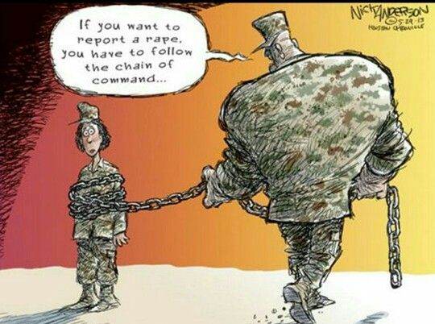
Notes:
1 in 4 women and 1 in 100 men report – many more that don’t. Only 13 percent of service men and 40 percent of service women who have experienced MST report
their military sexual assault.
A female in OEF/OIF is more likely to be raped by one of her comrades than injured in battle.
MST is an experience, not a diagnosis or a mental health condition,
Why is it not reported?
MILITARY REPORTING
Military reporting data is handled by the Department of Defense Sexual Assault Prevention and Response Office
(SAPR).
In 2014 there were 6,131 reported sexual assaults.
1 in 4 were "restricted reports," whereby the survivor reports the assault for purposes of receiving treatment but does not identify the perpetrator or pursue justice
for the crime. So the perpetrator is never censured, and continues to serve in the military in proximity of the survivor.
An unrestricted report does identify the perpetrator and triggers at least an initial investigation. However, commanders have discretion as to extant of the investigation and whether to pursue prosecution and/or
punishment. Commanders considered court-martial or other legal action for only half of the unrestricted
reported cases. Of those 2,625 cases:
✶ 628 were outright dismissed, and 477 were relegated to non-sexual assault-related offenses.
✶ Of the 1,550 perpetrators charged (38 percent of reported cases), commanders decided not to prefer court-martial charges for 552 (36 percent of those charged, 12 percent of reported cases), instead deciding 318 for non- judicial punishment, 111 for an administrative discharge, or 123 for other "adverse administrative actions.”
o Of the remaining 998 preferred by commanders for court-martial charges:
✶ 176 were dismissed by commanders prior to trial,
✶ 97 perpetrators were discharged in lieu of a court-martial, and
✶ 137 remained pending at the end of fiscal 2014.
o Of the 588 sexual assault cases that went to trial:
✶ 26 percent of alleged perpetrators were acquitted of all charges;
✶ 434 were convicted, although 117 received punishments other than jail time, (which most often include punitive discharges, reduction in rank, fines, restrictions or hard labor.)
▪ In the end, only 317 convicted service members were incarcerated on a sexual assault charge.

Slide 20
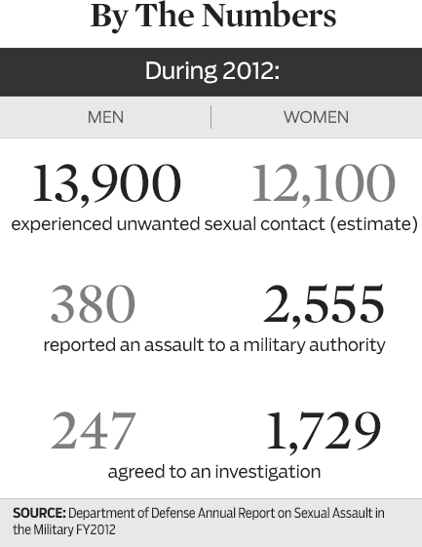
Notes:
REPORTING ABCS
Survivors of military sexual assault and harassment have two reporting options: restricted and unrestricted.
UNRESTRICTED REPORTING ABCS
a. Any report made through traditional reporting channels, i.e. victim’s chain-of-command, civilian
police
b. Access to medical care, counseling, and Victim Advocate support
c. Limited confidentiality: details of allegation will be provided only to those who have a legitimate
need-to-know
d. Full investigation enhances opportunity to hold perpetrator accountable
e. Victim may request expedited transfer, military protection order
f. Limitations: Cannot change to restricted reporting, may not be enough evidence to convict
perpetrator, investigation/court proceedings may be lengthy
RESTRICTED REPORTING ABCS
a. Enables military members to report sexual assault to specified personnel without triggering
investigation (SARC, VA, chaplain, medical).
b. Confidential protection of information; chain of command is NOT notified
c. Provides access to medical care, counseling, and Victim Advocate support
d. Intended to give victim additional time and increased control over release and management of
personal information
e. Empowers victim to gain valuable information and support needed to make informed decision about
participating in criminal prosecution
f. Limitations: Does not allow for expedited transfers, military protection orders, or ability to hold
perpetrator accountable; there are also limitations on holding evidence
g. If a sexual assault is reported through chain of command, restricted reporting is not an option!

Slide 21

Military cultural values ????
Loyalty
Respect
Selfless service
Mission
Honor and integrity
Excellence and commitment
Personal courage
Devotion to duty - Service members and veterans function as individuals, family members, community members, and citizens. They have a duty to operate responsively and appropriately.
Notes:
Look at how this type of PTSD? (MST) might be more difficult as there is a sense of betrayal and questioning of values.
AS with all sexual trauma it challenges worldviews beliefs about safety etc.
So will the same work? Why or why not.
The MST survivor will typically want nothing to do with their military history or identity.

Slide 22
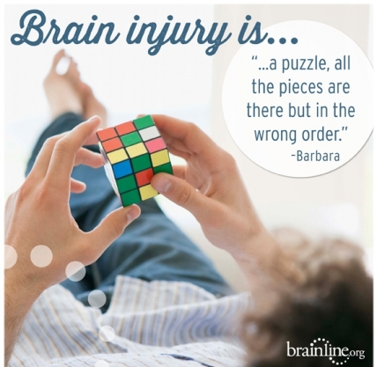
Trauma(tic) Brain Injury- TBI

Slide 23
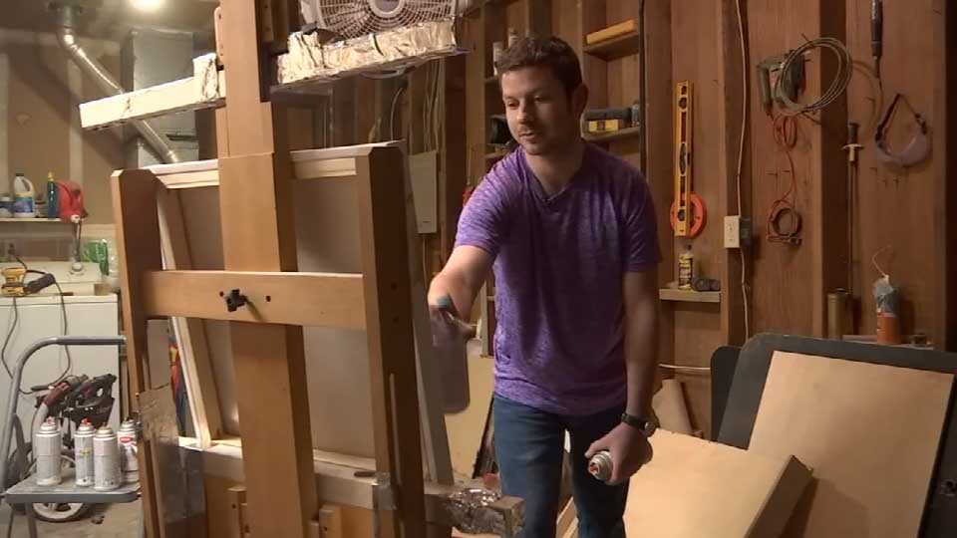

Notes:
How do you identify the person with TBI?
All three are veterans…which one is a vet with TBI
Trick question…all of them.
Shane Kohfield (top right) did two tours of duty in Iraq, the last of which left him with a traumatic brain injury.
Army Ranger Cory Remsburg was thrown like a rag doll into an Afghanistan canal Oct. 1 by the blast from a 500-pound roadside bomb, the right side of his head caved in by shrapnel.
Michelle Dyarman
Safe to say it is not always obvious.
Look for symptoms and history

Slide 24
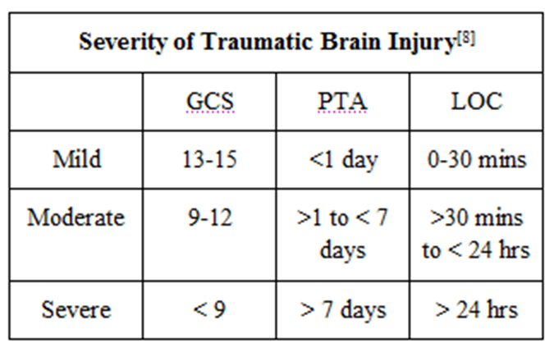

Slide 25
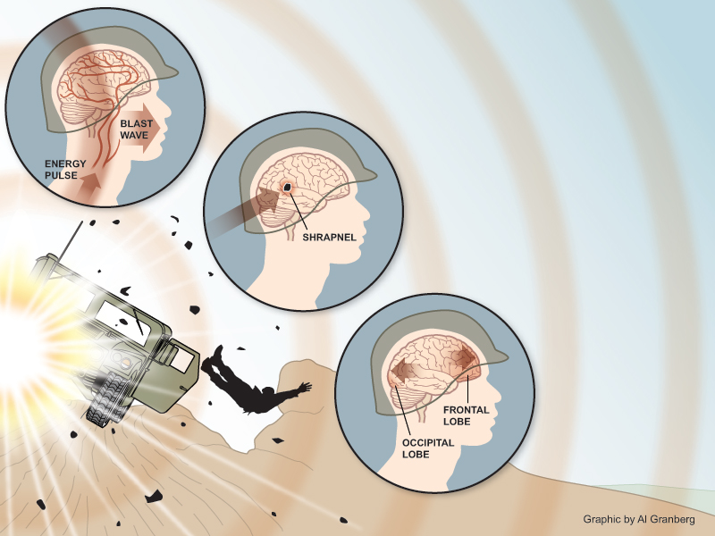
PRIMARY BLAST INJURY
.
SECONDARY BLAST INJURY
TERTIARY BLAST INJURY
Notes:
Three primary ways
The primary balst injury is considered the “signature injury from OIF/OIF.
Let me take just a moment to explain blast injuries.
Every blast creates a wave of pressure

Slide 26
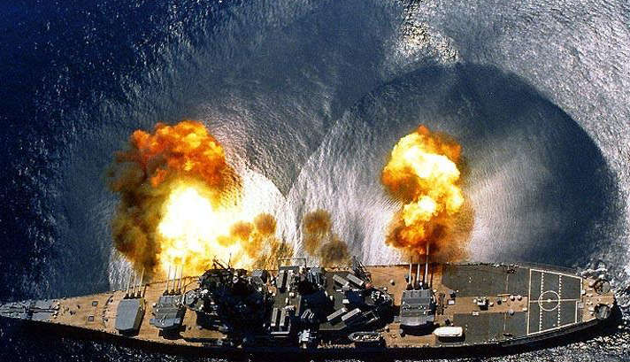

Slide 27
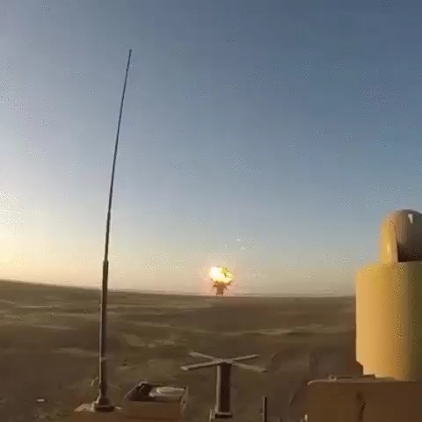
Notes:
How could Brock and the others receive a concussion from a blast.
The blast injury is the signature injury of OIF/OEF
Let me take a moment and explain.
This explosion seems far enough away right.
Roll vid
You can see the wave as it rolls across the desert and hits the soldier.
A blast injury feels like being hit by a wave and then being pulled back into the ocean — all in intensely rapid succession (Jeffrey Barth, PhD).
More scientifically, blast injuries result from the complex pressure wave generated by an explosion, an instantaneous rise in atmospheric pressure that is much higher than normal for humans to withstand.
This is called a blast over-pressurization wave which is an atmospheric pressure wave that hits the individual and pushes on all of the organs of the body.
The blast over-pressurization wave, generated by the explosion, travels at a high velocity and is affected by the surrounding environment; for example, the effects of the blast wave may be increased in a closed environment such as a vehicle. Air-filled organs such as the ear, lung, and gastrointestinal tract as well as organs surrounded by fluid-filled cavities such as the brain and spinal cord are especially susceptible to primary blast injury (Elsayed, 1997; Mayorga, 1997).

Slide 28
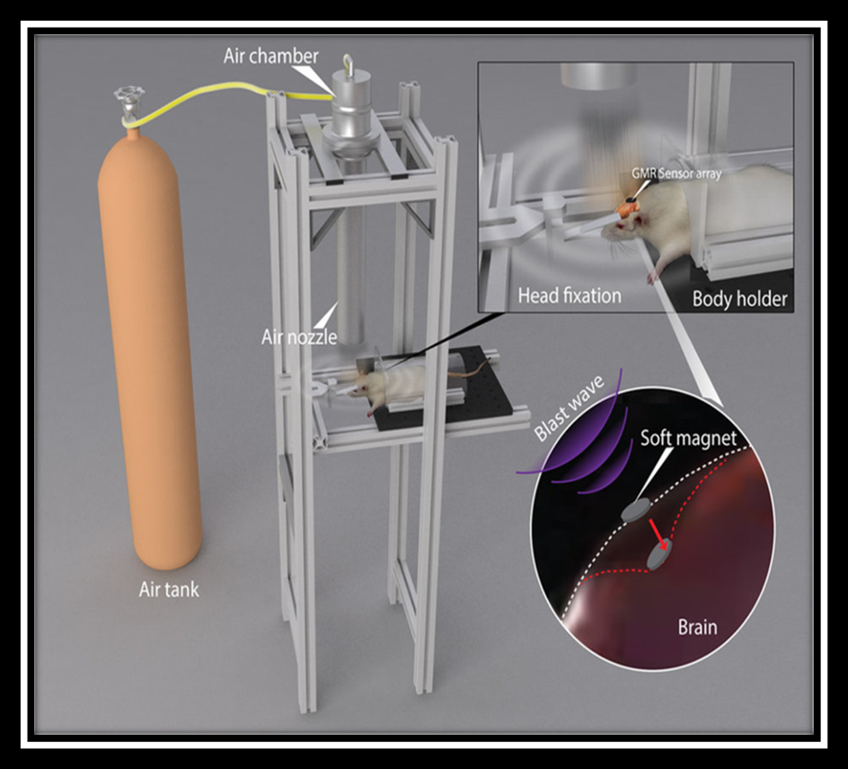
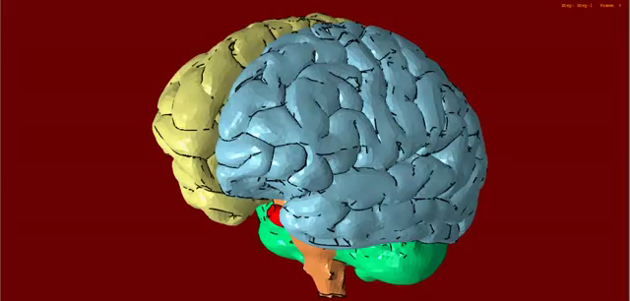

Slide 29


Slide 30
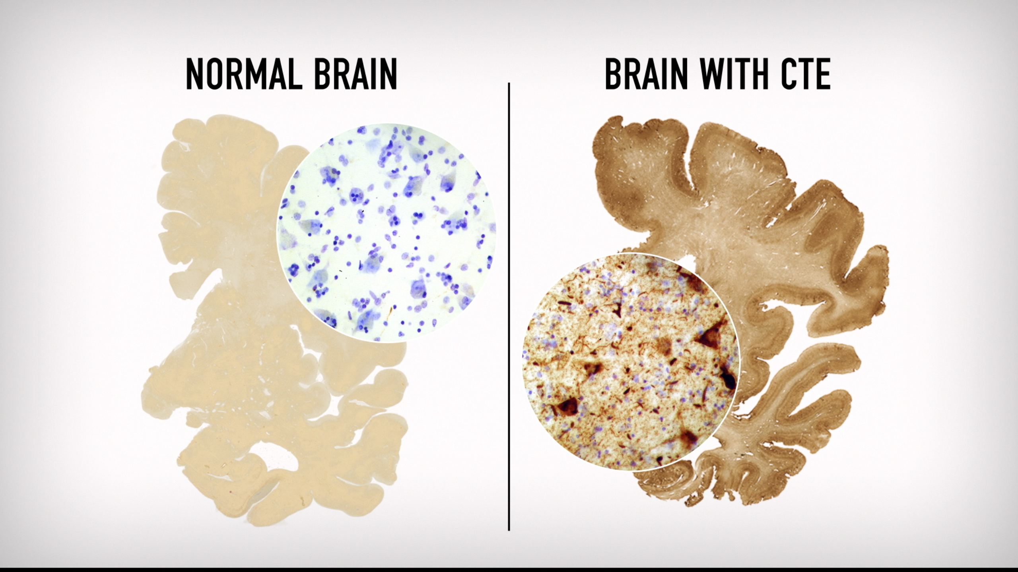
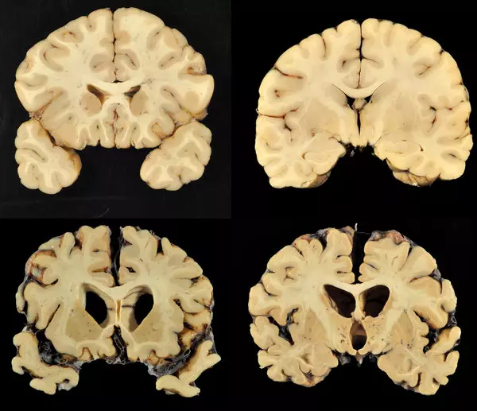
Notes:
They reported that he suffered the most severe case of chronic traumatic encephalopathy — a progressive degenerative brain disease often seen in people with a history of repetitive brain trauma (first pic) — they had ever seen in a person his age.
That difference you see is what we believe to be the cause…proteins blocking the brains ability to function.
This picture (second pic) shows a normal brain at the top and Aaron Hernandez’s brain below.
While experts are using their customary scientific caution in not connecting Hernandez’s brain pathology to his crime, such severe injuries would have caused poor judgment and impulse control, two hallmarks of the bad behavior that landed Hernandez in prison for life.
Given that the rate of traumatic brain injuries among prisoners is about seven times higher than it is in the general population, it’s time to consider that sustaining a head injury can put someone at higher risk of committing a crime and those that are commiting crimes will often be struggling with a TBI and not even be aware of it.

Slide 31
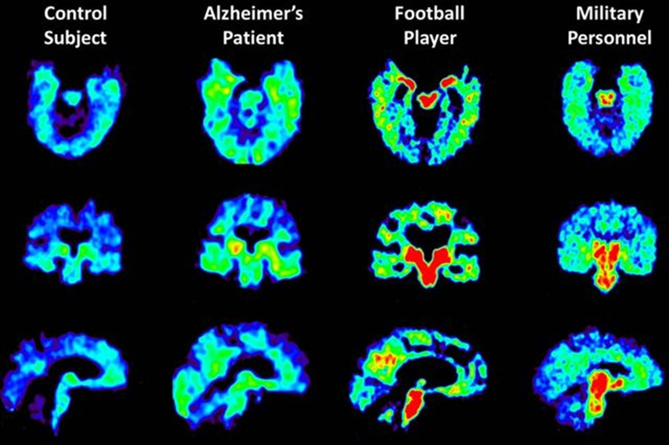

Slide 32
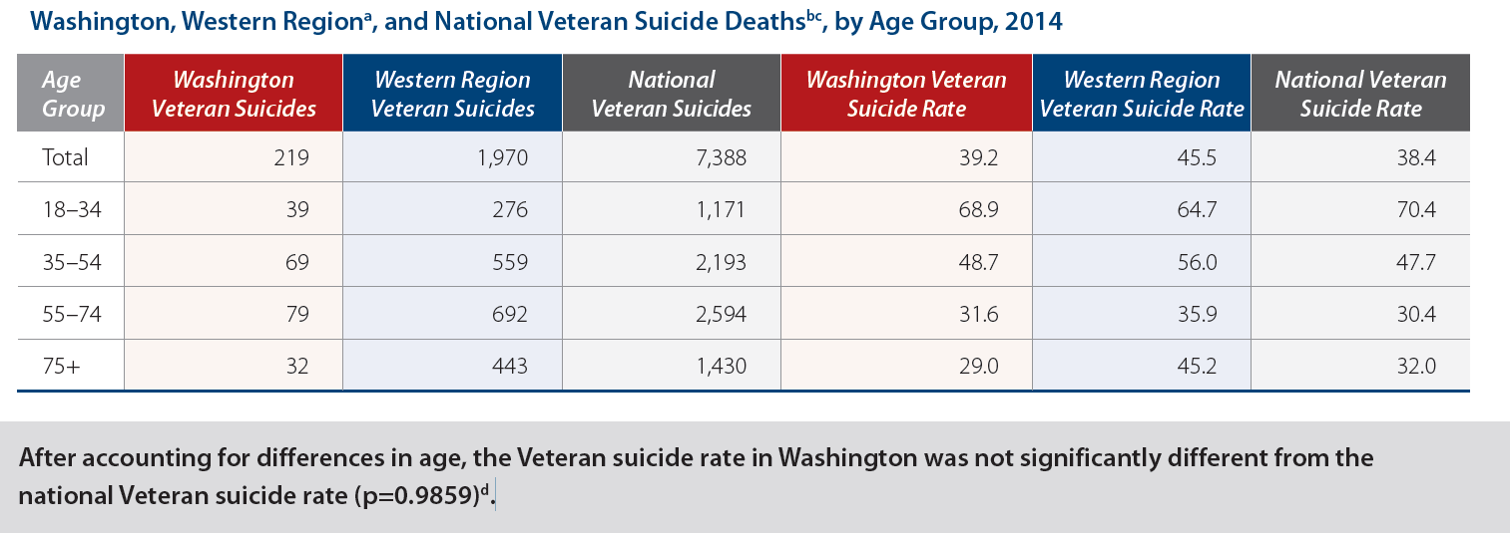
Suicide prevention
10% of the population
20% of all suicides
Notes:
Suicide risk management in the Department of Veterans Affairs (VA) health care system is particularly challenging because of both patient characteristics and aspects of the delivery system. The prototypical suicide-prone person is an older white male with alcoholism, depression, physical problems, and poor psychosocial support. This describes a large portion of the veteran patient population. Suicide risk factors that are common in VA patients include male gender, older age, diminished social environment support (exemplified by homelessness and unmarried status), availability and knowledge of firearms, and the prevalence of medical and psychiatric conditions associated with suicide. A variety of characteristics of the VA system complicate suicide management. Efforts under way to emphasize ambulatory care and decrease the VA culture of reliance on inpatient treatment heighten the importance of accurate suicide assessment. The authors recommend several strategies that VA administrators can consider for improving the assessment and management of veterans with long-term suicide risk factors

Slide 33
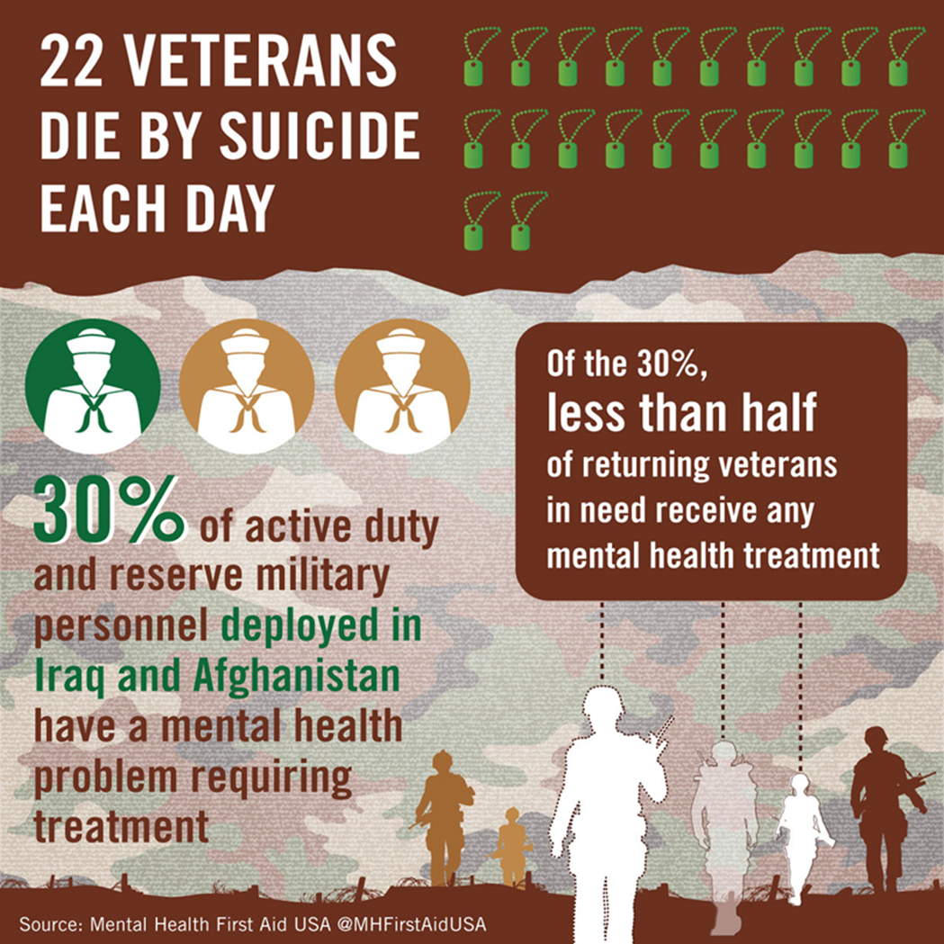
Notes:
Risk factors vs protective factors differ in the veterans
Risk factors specific to veterans are things like:
Peer suicide
Loss is “part of the job”
Once a Sgt. now a neighbor / “Baby killer” (perception)\
Remember the experiences list?
Distinction between military and Civilian “family”
Separation from (military) social support
Military cultural influence
Disciplinary actions (UCMJ, NJP)
Reduction in rank
Career threatening change in fitness for duty
Perceived sense of injustice or betrayal (unit/command)
Command/leadership stress, isolation from unit
Transferring duty station (PCS)
Administrative separation from service/unit
Adverse deployment experience

Slide 34
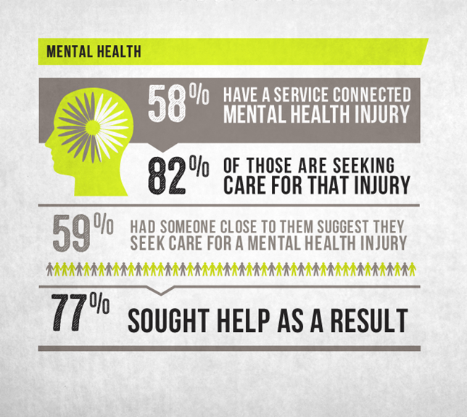
Protective Factors
Notes:
Problme is not a lot of protective factors are in place
Social Context Support System is gone or distant often
Strong interpersonal bonds may be in conflict with their non-military family
Intact marriage which may be strained
Child rearing responsibilities which they have been away from on deployment
Responsibilities/duties to others that is now survivor guilt
A reasonably safe and stable environment except if you have ptsd
Basically the veteran experinces
Concept of misunderstanding social support (secrets)
Bonds may already be weakened by acceptance of impermanence
Duty = Survivor Guilt
No sense of safety
Somebody needs the help more than me
Identity crisis once released
Culture still influenced by military and witness to war = existential crisis / unresolved
Loss of hope for positive outcome

Slide 35

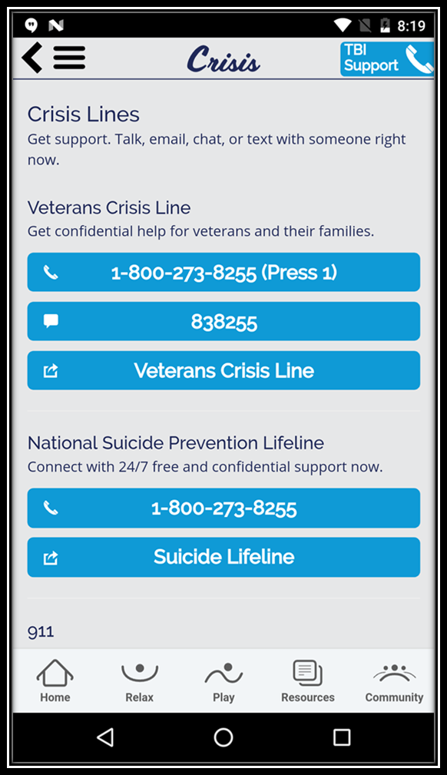
Resources
Us!!!!!
Max!
VTSC!
Online training.
Us!!!
Time for questions

