Slide 1
Women Veteran’s Health Mann Grandstaff VA Spokane WA
Megan Chandler MD – Women’s Health Medical Director
Julie Liss RN – Women’s Health Program Manager
Ann Guillory BSN, RN CLC – Women’s Health Clinical Navigator, Maternity Care Coordinator

Slide 2
VA WOMEN’S CLINIC WITHOUT WALLS

Slide 3
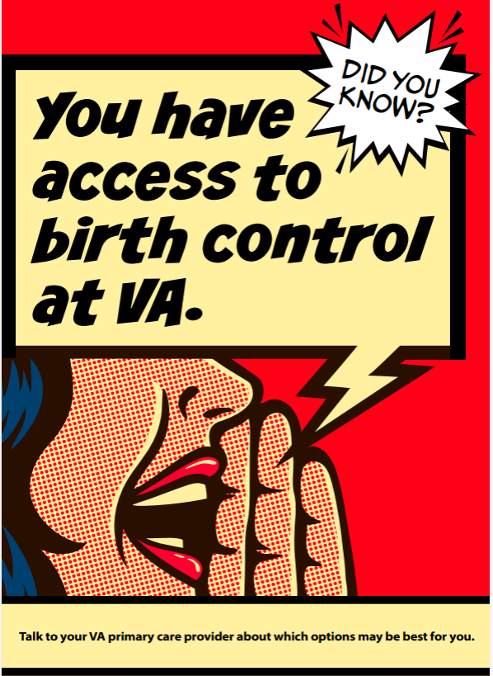
WHAT WOMEN’S CARE IS PROVIDED WITH VA BENEFITS?
Contraception on Demand
365 Day Supply of Contraception with one prescription
Emergency Contraception
Gynecology Access for Long Acting Reversible Contraception
Male Veterans are eligible for Vasectomy with our Urology department
We can mail you condoms!

Slide 4
WHAT WOMEN’S CARE IS PROVIDED WITH VA BENEFITS?
Maternity Care Coordination During and Ongoing for 1 year post partum
Obstetrical Referral to Community Obstetrician
Breast feeding Durable Medical Equipment
Post Partum/Intrapartum Mental Health
Pregnancy and Parenting Education Classes

Slide 5
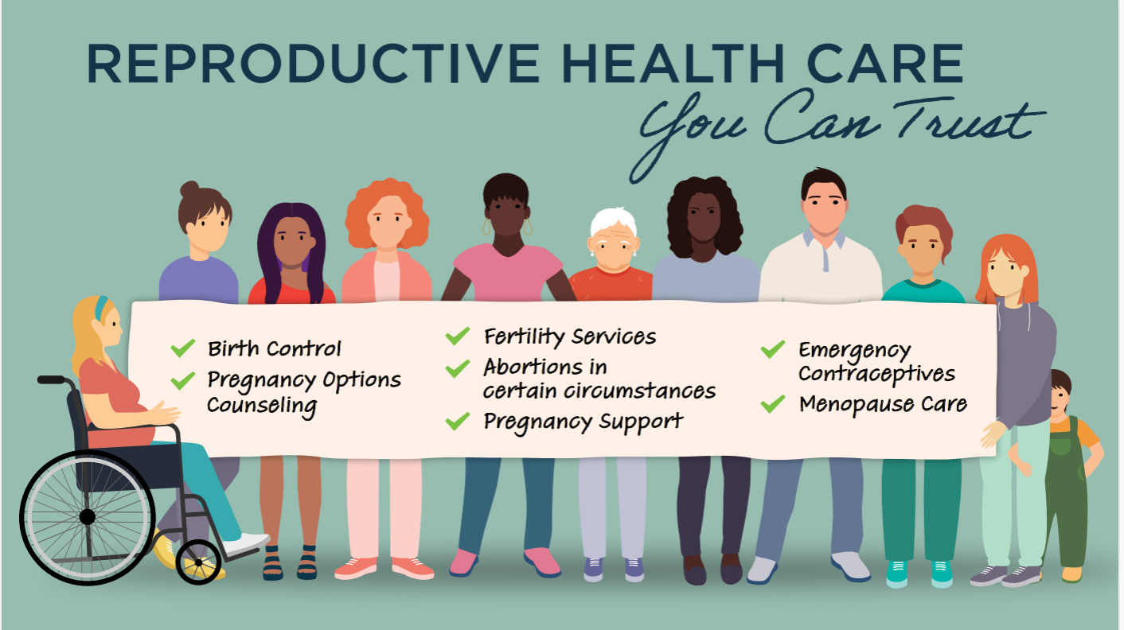
WHAT WOMEN’S CARE IS PROVIDED WITH VA BENEFITS?
Notes:
All veterans who are enrolled for health care are eligible for fertility services up to IUI
IVF is covered for veterans with a service connected condition/diagnosis and their spouses.
New benefit where veteran can now use donor gametes for that IVF.

Slide 6
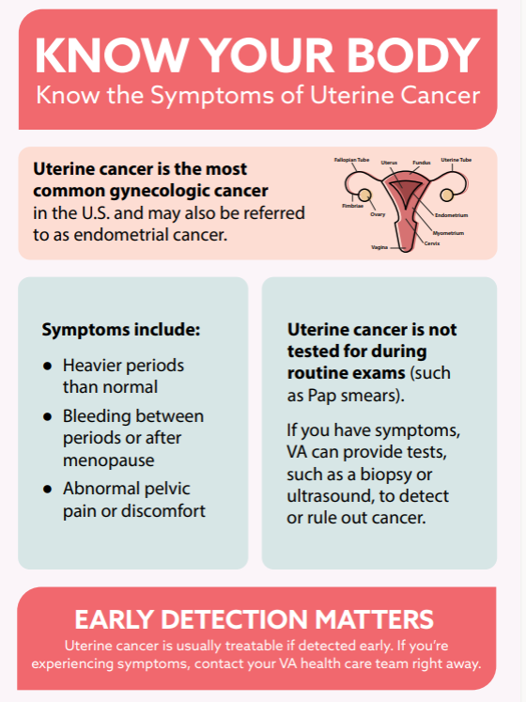
WHAT WOMEN’S CARE IS PROVIDED WITH VA BENEFITS?
CANCER SCREENING, DIAGNOSIS AND TREATMENT FOR ALL FEMALE CANCERS

Slide 7
WHAT WOMEN’S HEALTH IS PROVIDED WITH VA BENEFITS?

Slide 9
THE CULTURE OF VA CARE HAS CHANGED
Notes:
Trauma-Informed Care

Slide 10
THE CULTURE OF VA HAS CHANGED

Slide 11
THE CULTURE OF VA HAS CHANGED
Notes:
Trauma-Informed Care

Slide 12
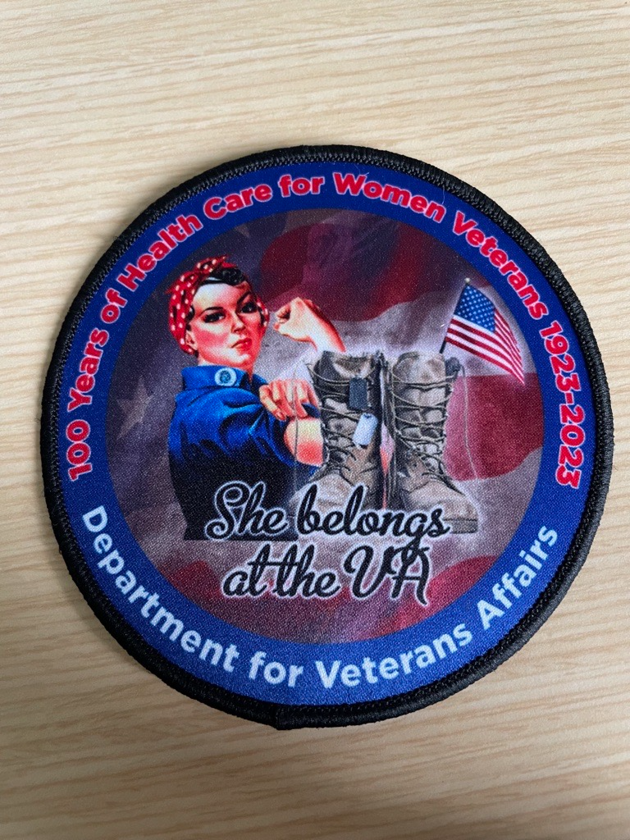
Thank You

