Slide 1
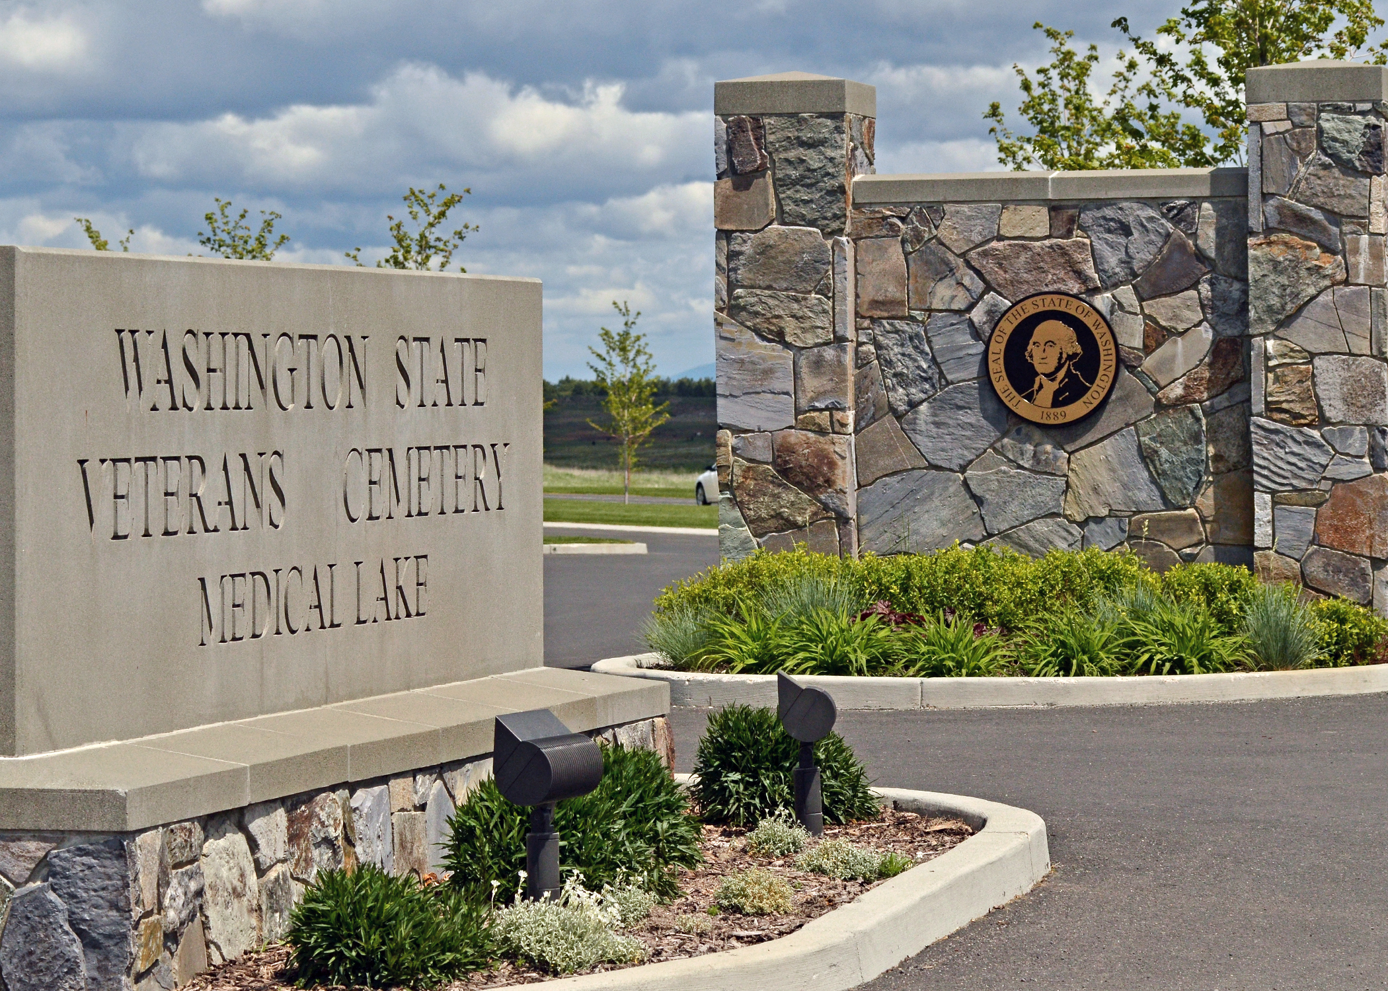
WSVC, Medical Lake
The cemetery provides for casketed burial, columbarium niches, and burial plots to support cremations. Committal services are held in a shelter, providing families privacy.
21702 West Espanola Rd
Medical Lake, WA
Eligibility mirrors that of the U.S. Department of Veterans Affairs Cemeteries.
Armed Forces License Plates help support the State Veterans Cemetery
$28 from the sale or renewal of each Armed Forces License Plate are directed to operating and maintaining the state veteran’s cemetery, and to providing programs, and services for veterans without homes, and other activities that benefit veterans
Notes:
Located in Medical Lake, WA the cemetery has a committal service shelter, and provides for casketed burial, columbarium niches, and burial plots to support cremations, as well as a scatter garden.
Burial in the Washington State Veterans Cemetery – Medical Lake is open to all members of the armed forces who have met a minimum active duty service requirement and were discharged under conditions other than dishonorable. A Veteran's spouse, widow or widower, minor dependent children, and under certain conditions, unmarried adult children with disabilities may also be eligible for burial. Eligible spouses and children may be buried even if they predecease the Veteran. Members of the reserve components of the armed forces who die while on active duty or who die while on training duty, or were eligible for retired pay, may also be eligible for burial.
You can help support the State Veterans Cemetery by purchasing an Armed Forces License plate for your vehicle. $28 from the sale or renewal of each Armed Forces License Plate is directed to operating and maintaining the state veteran’s cemetery, and to providing programs, and services for veterans without homes, and other activities that benefit veterans
[Rudy]
Great way for Veterans and their Family members to pay it forward (back) to those who precede us in death. Honoring their service and sacrifices
RCW 48.18.210 – you do not need to be a veteran to purchase, may purchase multiple license plates. Obtained from any Licensing Office (DD214 or signed affidavit)

Slide 2
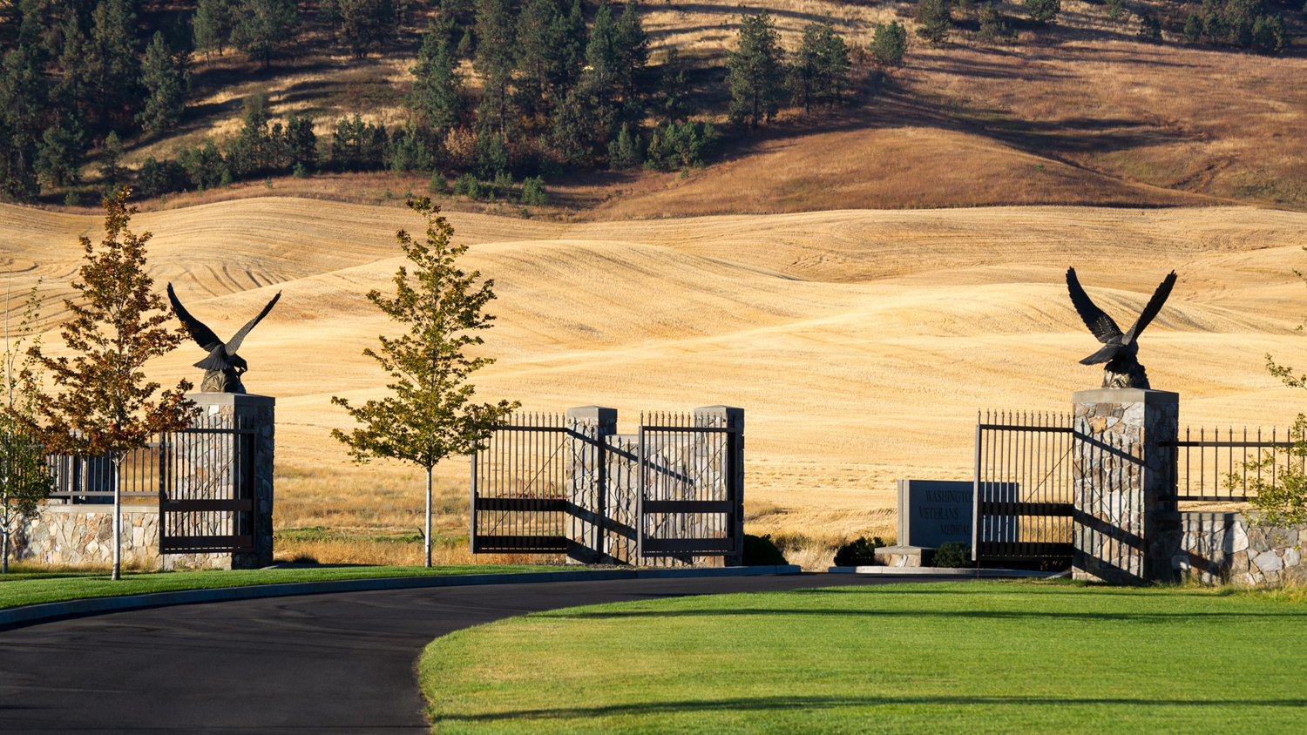
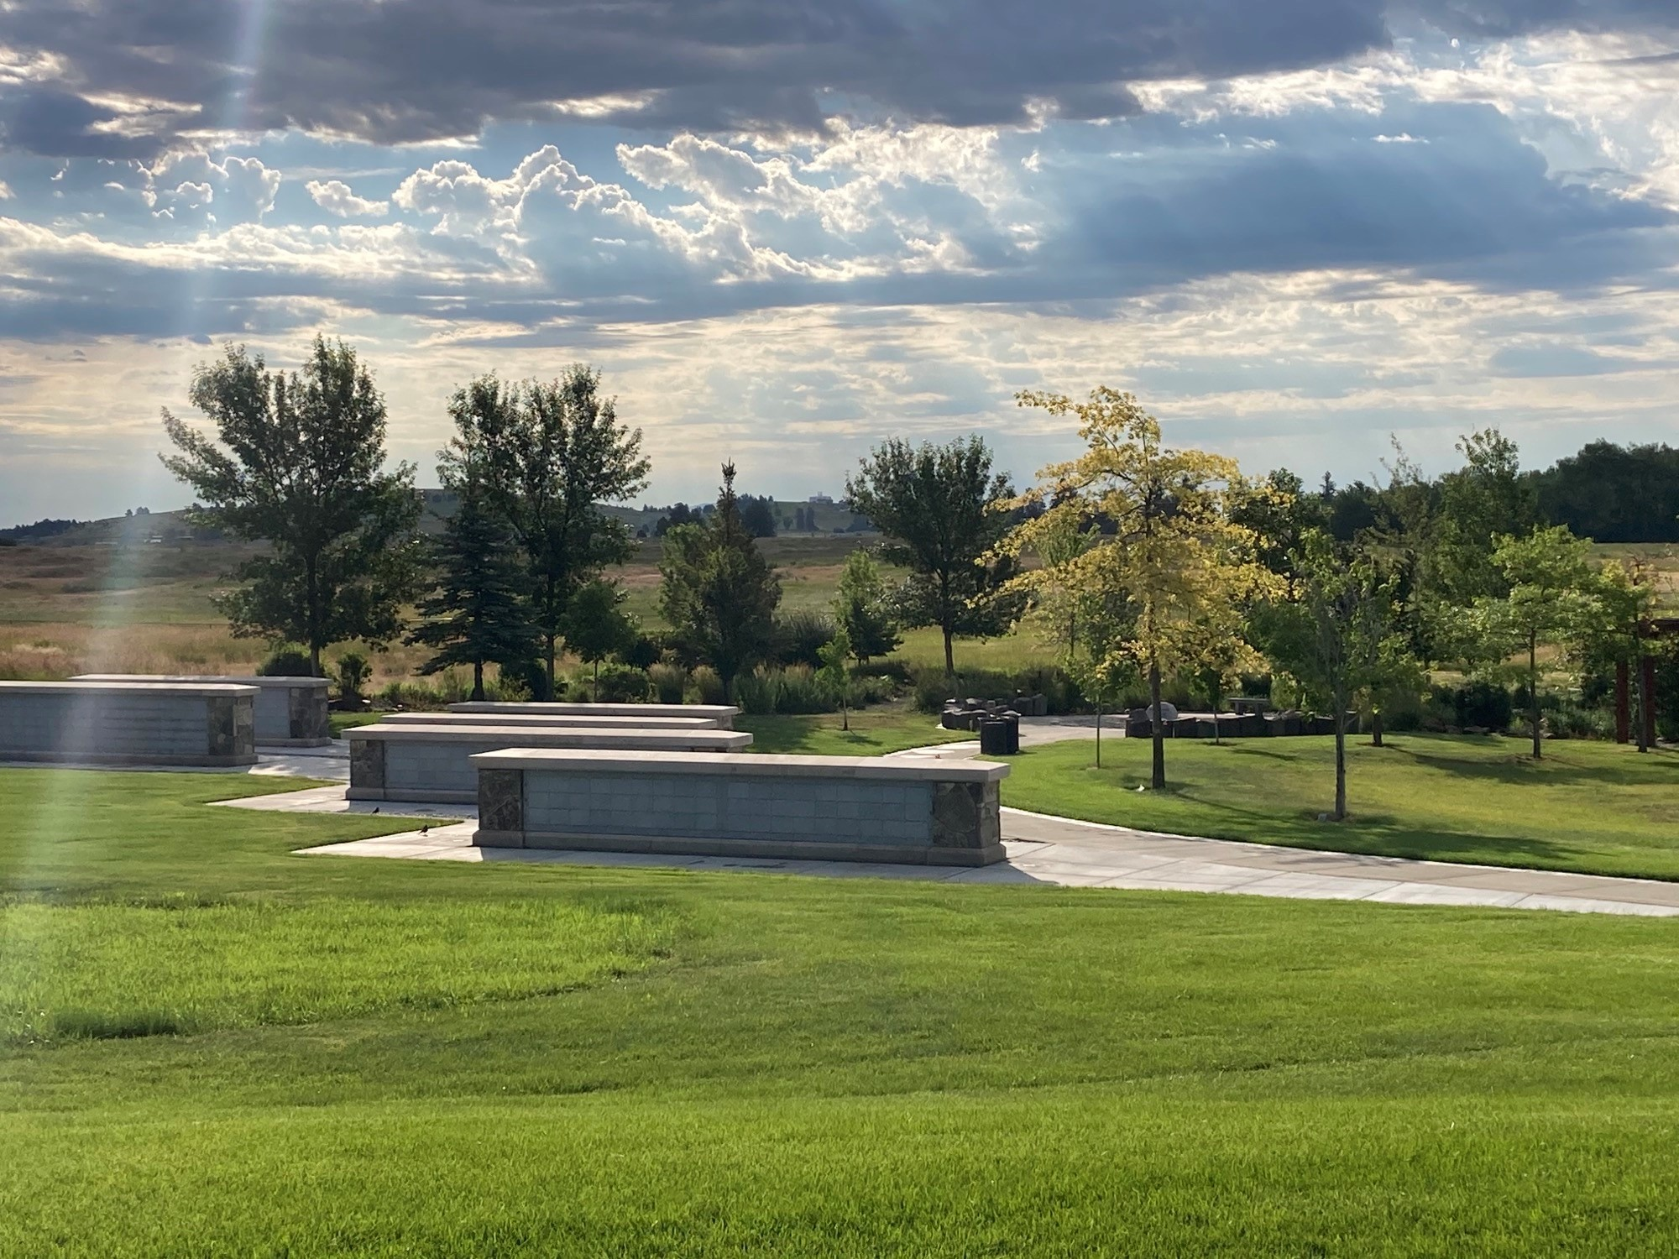
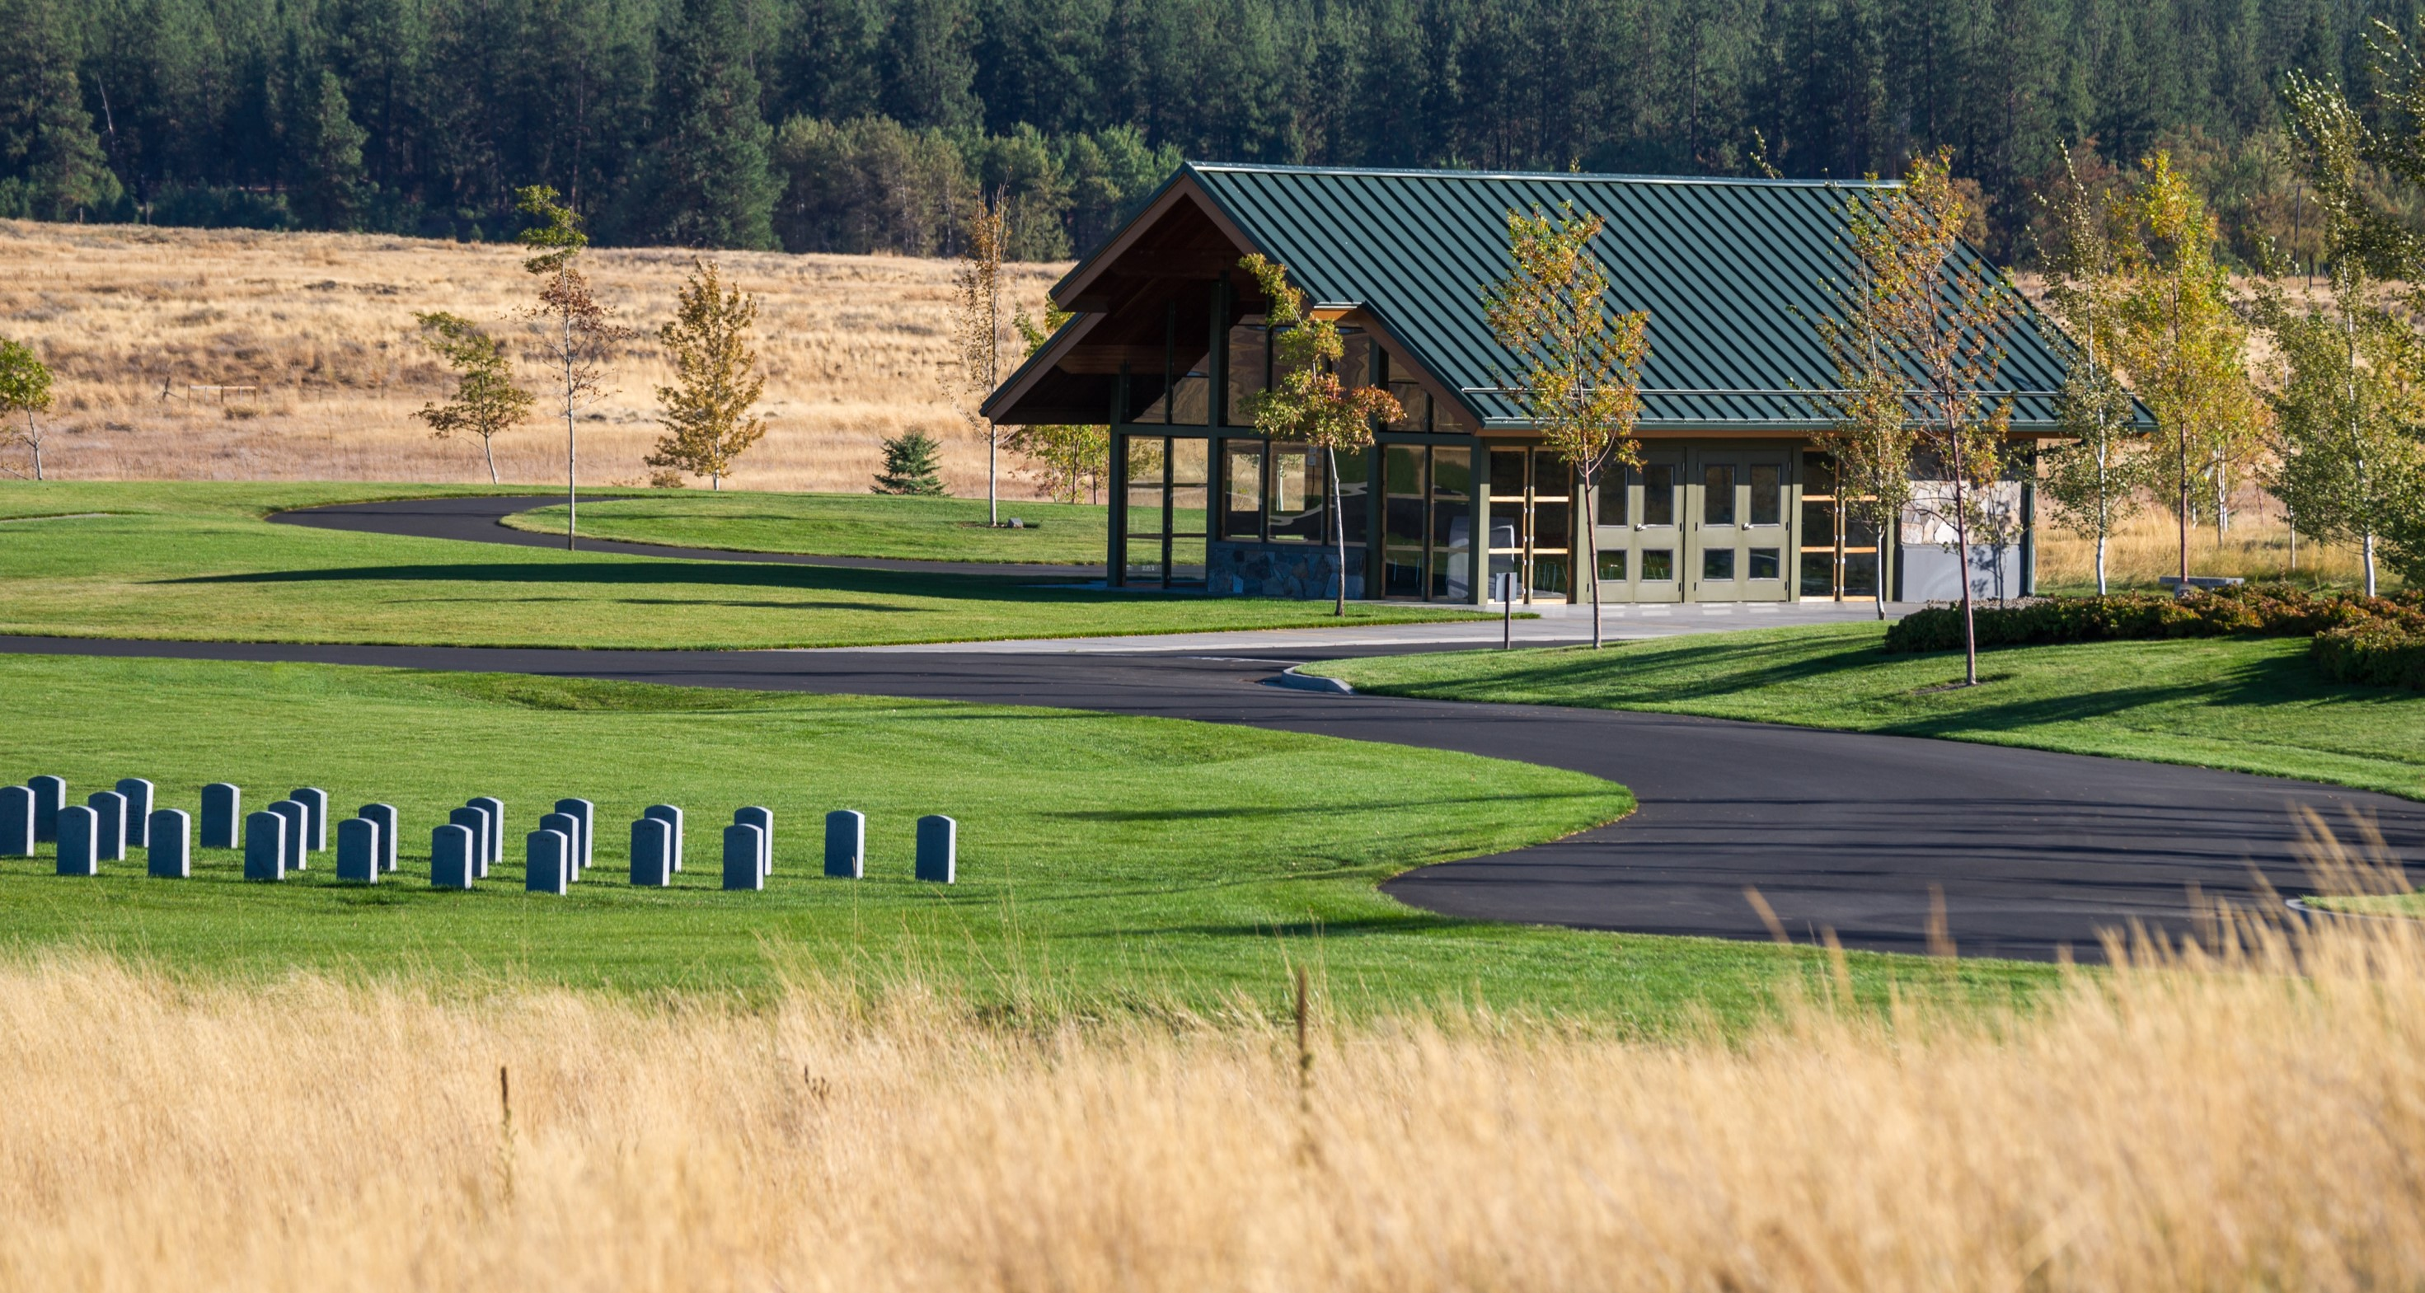
WSVC, Medical Lake
Vet & Family Member Interments Mon – Fri 8am-4pm
900 annually, 10K since 2010
Preneed & Interment Scheduling
DD214, Marriage Cert, Will/POA
Peace of Mind
Death related expenses – family or estate responsibility
Notes:
[Rudy]
What does a State Veterans Cemetery Provide?
- Burial needs for qualifying Veterans and their family (spouse, reg domestic partner, qualifying dependent children [very limited cases])
10K interments represents a tremendous need for a facility to serve E WA.
Respected by and well supported by the Veteran community in E WA/N Idaho (Rudy – this may be an opportunity to stress that we don’t do this alone, we need community support, participation, buy-in…!)
Volunteers (buglers, ministers, ushers, VSO rifle teams, VSO and philanthropic organizations
Public events well attended: Memorial Day, Forgotten Heroes Interments, Veterans Holiday Remembrance (Rudy – can you highlight that these are just public events, these are community events, bring community together, provides a very visible way for community members to honor Veterans and their families, becomes a learning opportunity for local schools and organizations like the scouts…)
Initial Estimate – 65 years burial capacity based on the acreage, relative population served and burial type (cremation vs casket: 60:40 split)
Cremation Rate rise – WSVC, ML interments vary between 80-85% cremation annually = greater use out of the existing land
CBW 3:1 over In Ground burials
Caskets the remaining 15-20%. Vaults or concrete liners – double depth meaning they can hold 2 caskets (married couple) are preplaced w grant projects

Slide 3
Cemetery Cost Comparison
WSVC
Private Cemetery Estimates
Plot: Veteran – no fee
Plot: $1K – $9K
Family member – $300
Note: subject to increase
Open/Close: no fee
Open/Close Grave: $350 – $3K (Nat’l avg. = $1,250)
Grave Liner/Vault: provided
Grave Liner/Vault: $700 – $7K
Govt. Monument: provided
Setting Fee – none
Monument: $500 – $3K
Setting Fee – $150 to $450
Perpetual Cemetery Care: provided
Perpetual Cemetery Care: trust funds (annual or one time, $X00 or 5%-15% of plot purchase price)
VA Burial earned benefit saves families large burial expenses
Notes:
[Rudy}
What does a Veterans Cemetery do for families
Huge cost savings (avoidance) through this earned benefit
Death is not free. Please know VA does not cover all burial expenses – huge misperception which results in a lack of planning
Vet Cemeteries provide: plot (niche), grave marker, and perpetual care at no charge for the Veteran. Misc costs itemized on the slide are expenses families can expect for burial in private cemeteries.
NCA and DVA have a commitment and obligation to maintain our Veterans Cemeteries in pristine condition in perpetuity – long after the last plot is used. Sacred Shrine

