Slide 1
WDVA Counseling and Wellness Programs
Keith Meyer
Counseling & Wellness Programs Director
keith.meyer@dva.wa.gov

Slide 2
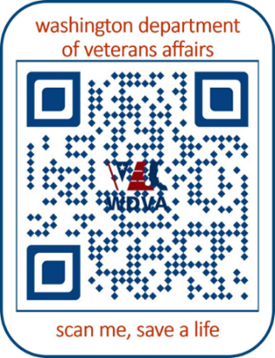
Counseling and Brain Injury and Recovery Programs
Counseling Program
Free Services
Eligibility
NE Washington Family Counseling
Brain Injury & Recovery
Eligibility
Community Resources
Education Brain Injuries
2

Slide 3
Veterans Commercial and Tobacco Cessation Program
Eligibility
Assessment
Education and Outreach Events
Nicotine Replacement Therapy
3

Slide 4
Veterans Training Support Center
Training on Veteran-Related Topics
Posttraumatic Growth
Opioid and Stimulant Impact on Military Veterans
Assessing and Managing the Risk of Suicide
Mindfulness on Well-Being and Reducing Stress
Veteran Service Organization Leadership
Veterans Training Support Center
4

Slide 5
DVA’s Suicide Prevention Program
Purpose: Suicide Prevention provides support, resources, and outreach to Service Members, Veterans, or Family Members (SMVF) facing emotional distress, fostering communities of hope, resilience, and connection to prevent the tragic loss of life.
Vision: Every Washington State SMVF knows they are valued, heard, never alone in their battle against despair, and receive support with dignity and respect.
5

Slide 6
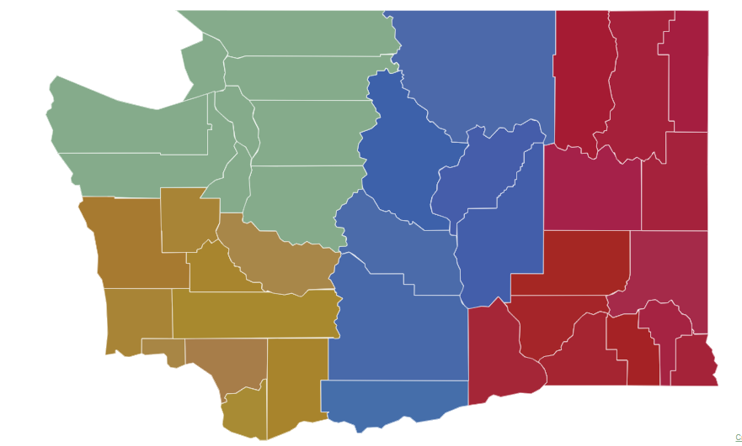
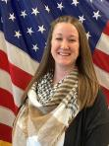
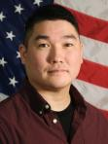
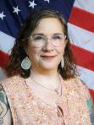
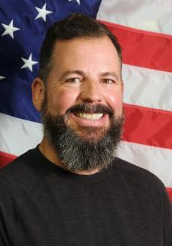
Suicide Prevention Program Team
Central –
Brandon Kapp
brandon.kapp@dva.wa.gov
Northwest – Jen Prewitt
Jennifer.Prewitt@dva.wa.gov
Southwest - Don Seese, MSW
Donald.Seese@dva.wa.gov
Eastern - VACANT
Program Manager:
Connie Chapman, LICSW
Connie.Chapman@dva.wa.gov
Grant Specialist: Derek Foster
Derek.Foster@dva.wa.gov
Administrative Assistant: Malia Keremius
Malia.Keremius@dva.wa.gov
6

Slide 7
988 Emblem, Donations & Community Grant Fund
The account consist of revenues received from the prevent veteran suicide emblem sales, & all receipts from gifts, grants, bequests, devises, or other donations from public and private sources.
Funds will go to community organizations that provide evidence-based Suicide Prevention programs to Veterans.
The first grant to be awarded in May.
$10 each + $8 one-time processing fee
7

Slide 8
Advertising Campaigns
8

Slide 9
LEARN® Trainings
Created by the UW School of Social Work and managed by Forefront Suicide Prevention
The LEARN Steps
LOOK for Signs
EMPATHIZE and Listen
ASK Directly About Suicide
REDUCE the Dangers
NEXT STEPS
To request a LEARN training email: Connect@dva.wa.gov
FY Training Participants Avg Size
52 463 9
2024(YTD) 30 430 12
TOTAL 80 893
9
Notes:
: In partnership with Forefront Suicide Prevention the Peer Specialists are providing LEARN trainings across the state.
: In our effort to create suicide safer communities we are training in ways to address suicide.
: The goal is to make the uncomfortable topic one that is openly discussed with compassion and attention.
: Turn over to Keith to tell you about peer support and the SSG Fox grant program.

Slide 10
Contact US
Want to work for the Suicide Prevention Team?
Visit: careers.wa.gov
Interested in scheduling a LEARN training for your organization or business? Contact the Suicide Prevention team at Connect@dva.wa.gov
10

