Slide 1
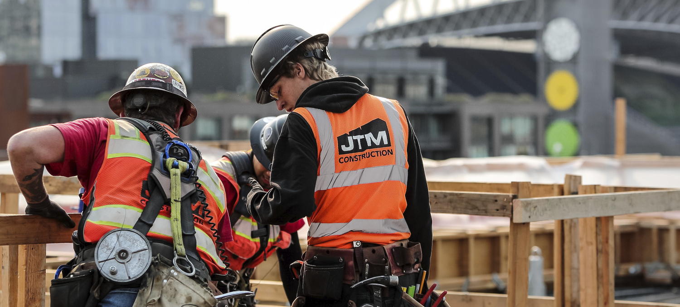
Welcome
3:30 – 4:00 Networking, resource tables, and refreshments
4:00 – 4:30 Presentation by Cara Buckingham from Washington APEX Accelerator
4:30 – 4:45 Upcoming opportunities with JTM
4:45 – 5:30
Networking, resource tables, and refreshments

Slide 2
Bellevue Club Expansion
Bellevue, WA
This project is planned for the parking lot east of the Bellevue Club and will feature six levels of above-grade parking with 1,103 stalls. Above the podium, two 16-story towers—either condo or multifamily—will complete the development, enhancing the area's residential offerings.
Estimated Start:
January 15, 2026
Estimated Completion: June 1, 2028
Estimated Cost:
$375,000,000

Slide 3
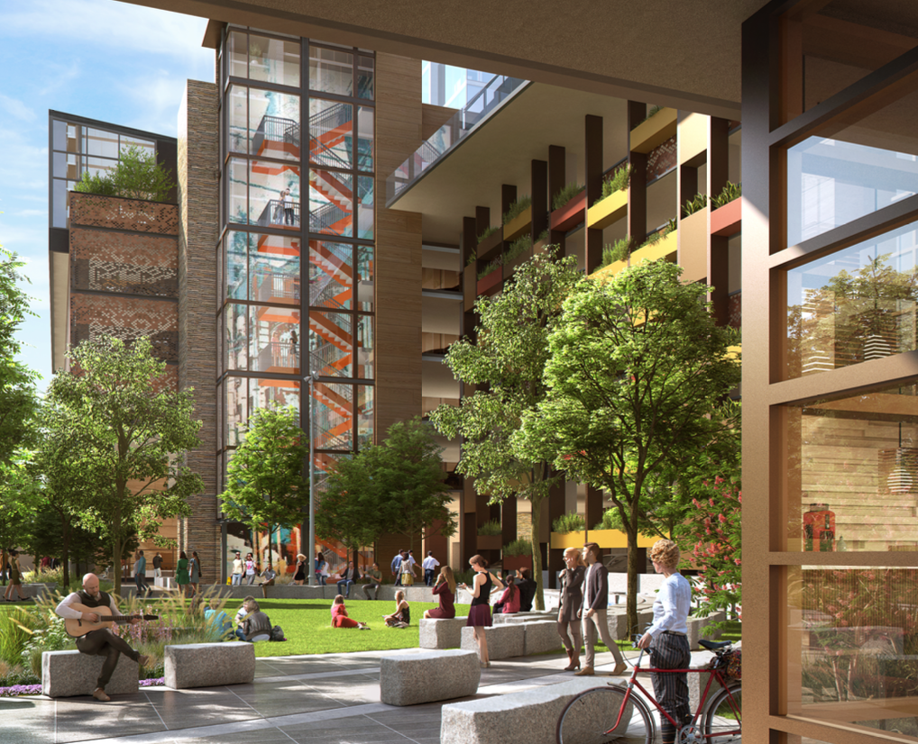
MAJOR SCOPES
Façade (CW/WW)
Finishes
Roofing
Sitework
Piles

Slide 4
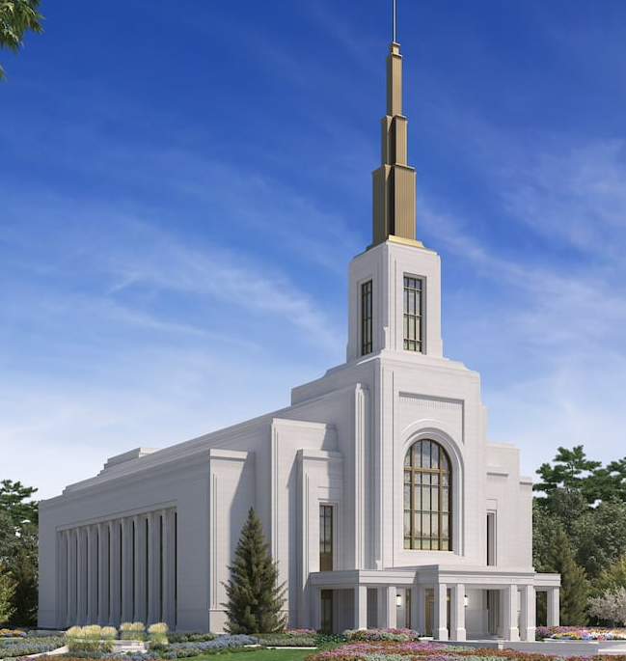
LDS Temple - Vancouver
Camas, WA
A multistory temple of approximately 43,000 square feet, the Vancouver temple will sit on a 15.11-acre site at the northwest corner of the intersection of SE 20th Street and SE Bybee Road in Camas, Washington, just east of Vancouver proper.
Estimated Start: February 3, 2025
Estimated Completion: April 28, 2028
Estimated Cost:
$137,000,000

Slide 5
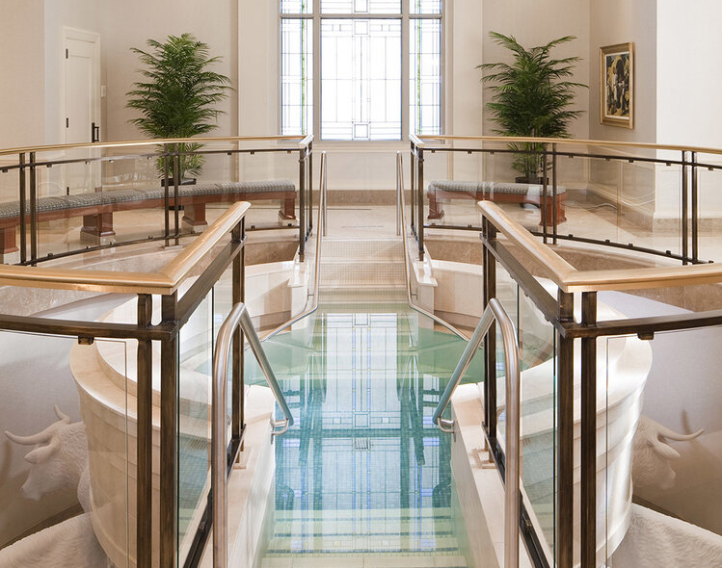
MAJOR SCOPES
Millwork
Façade (Stone / Art Glass)
Drywall
Finishes
Sitework

Slide 6
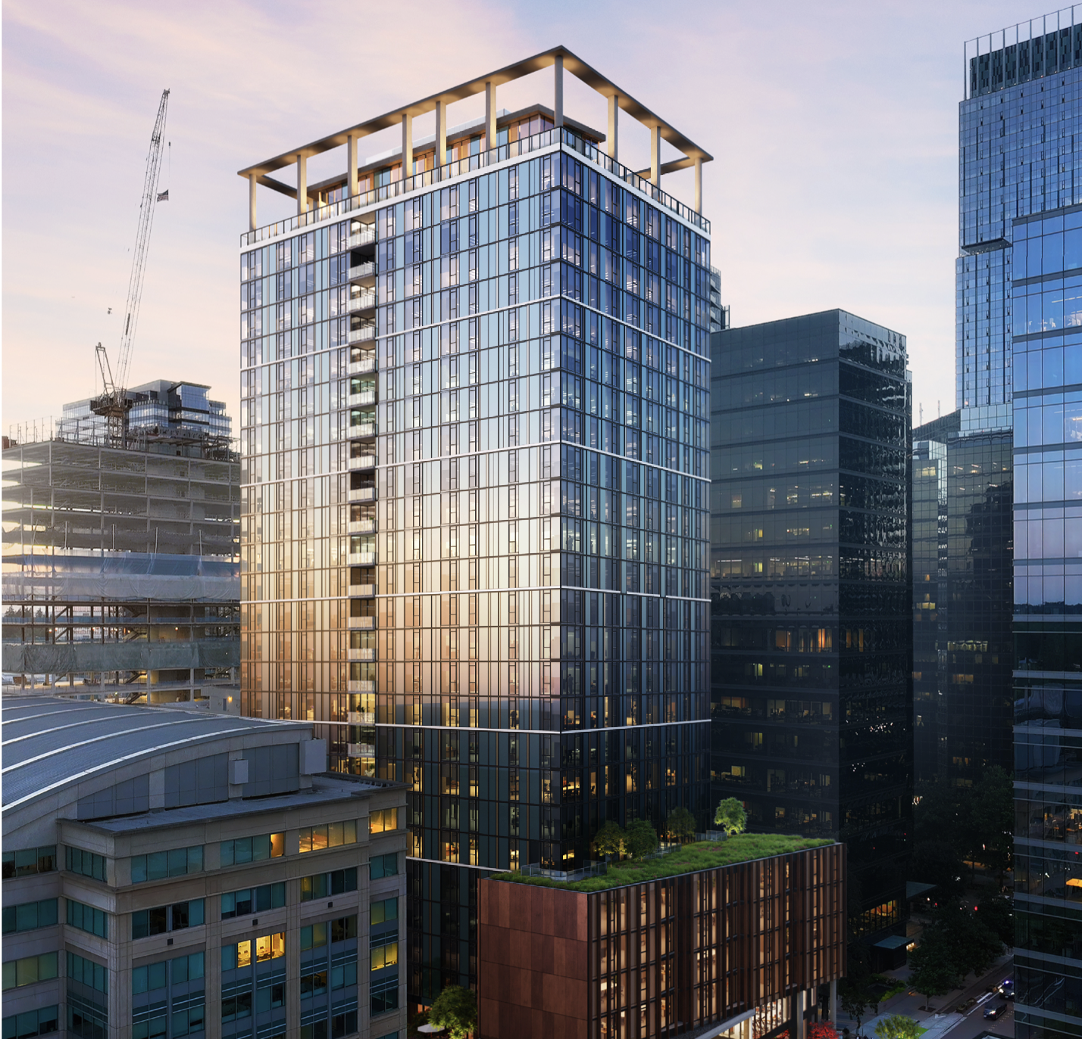
Bellevue 305 –
Residential Tower
Bellevue, WA
This project features a 29-story high-rise with four levels of below-grade parking, totaling 491,936 square feet of space. The building houses 350 residential units designed to meet modern standards of comfort and convenience. The below-grade parking structure provides secure, efficient parking options while maximizing the building’s footprint above ground.
Estimated Start:
October 1, 2026
Estimated Completion: August 1, 2029
Estimated Cost:
$210,000,000

Slide 7
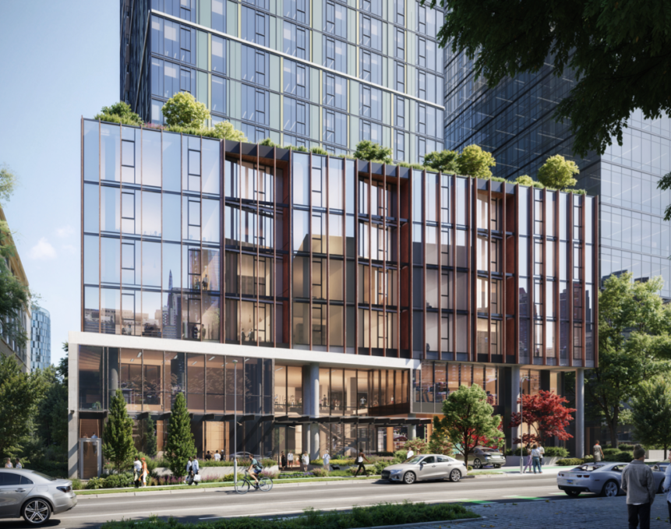
MAJOR SCOPES
Reinforcing
Glazing
Utilities
Millwork
Landscape

Slide 8
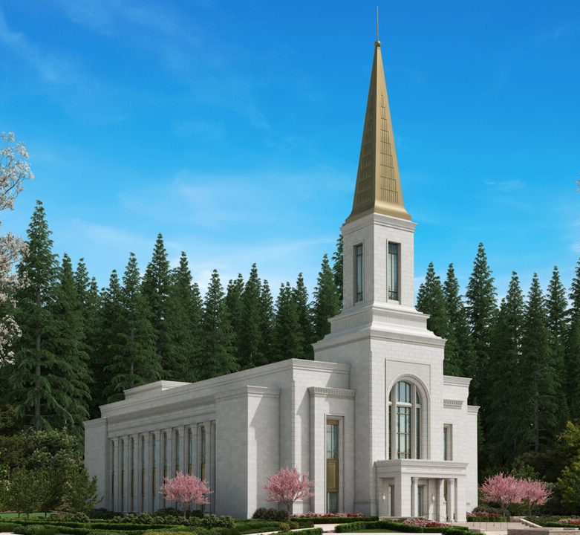
LDS Temple - Tacoma
Tacoma, WA
This project occupies an 11.6-acre and features a single attached end spire. Its design incorporates four instruction rooms, three sealing rooms, and one baptistry, all within a total floor area of 45,000 square feet (4,181 square meters). Rising to an elevation of 200 feet (61 meters), the building highlights both architectural elegance and thoughtful spatial organization.
Estimated Start:
October 5, 2026
Estimated Completion: September 15, 2028
Estimated Cost:
$135,000,000

Slide 9
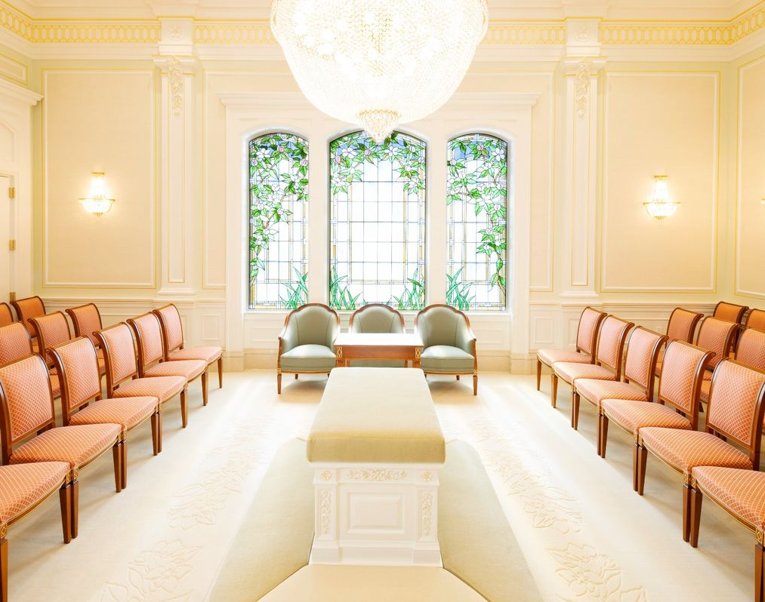
MAJOR SCOPES
Grading
Steel
Painting
Flatwork
Glazing

Slide 10
South Hill, South Building
Puyallup Police
Puyallup, WA
50,000 sq ft tenant improvement job. Bidding 100% set 1Q 2025.
Estimated Start:
May 1, 2025
Estimated Completion: December 30, 2025
Estimated Cost:
$18,000,000

Slide 11
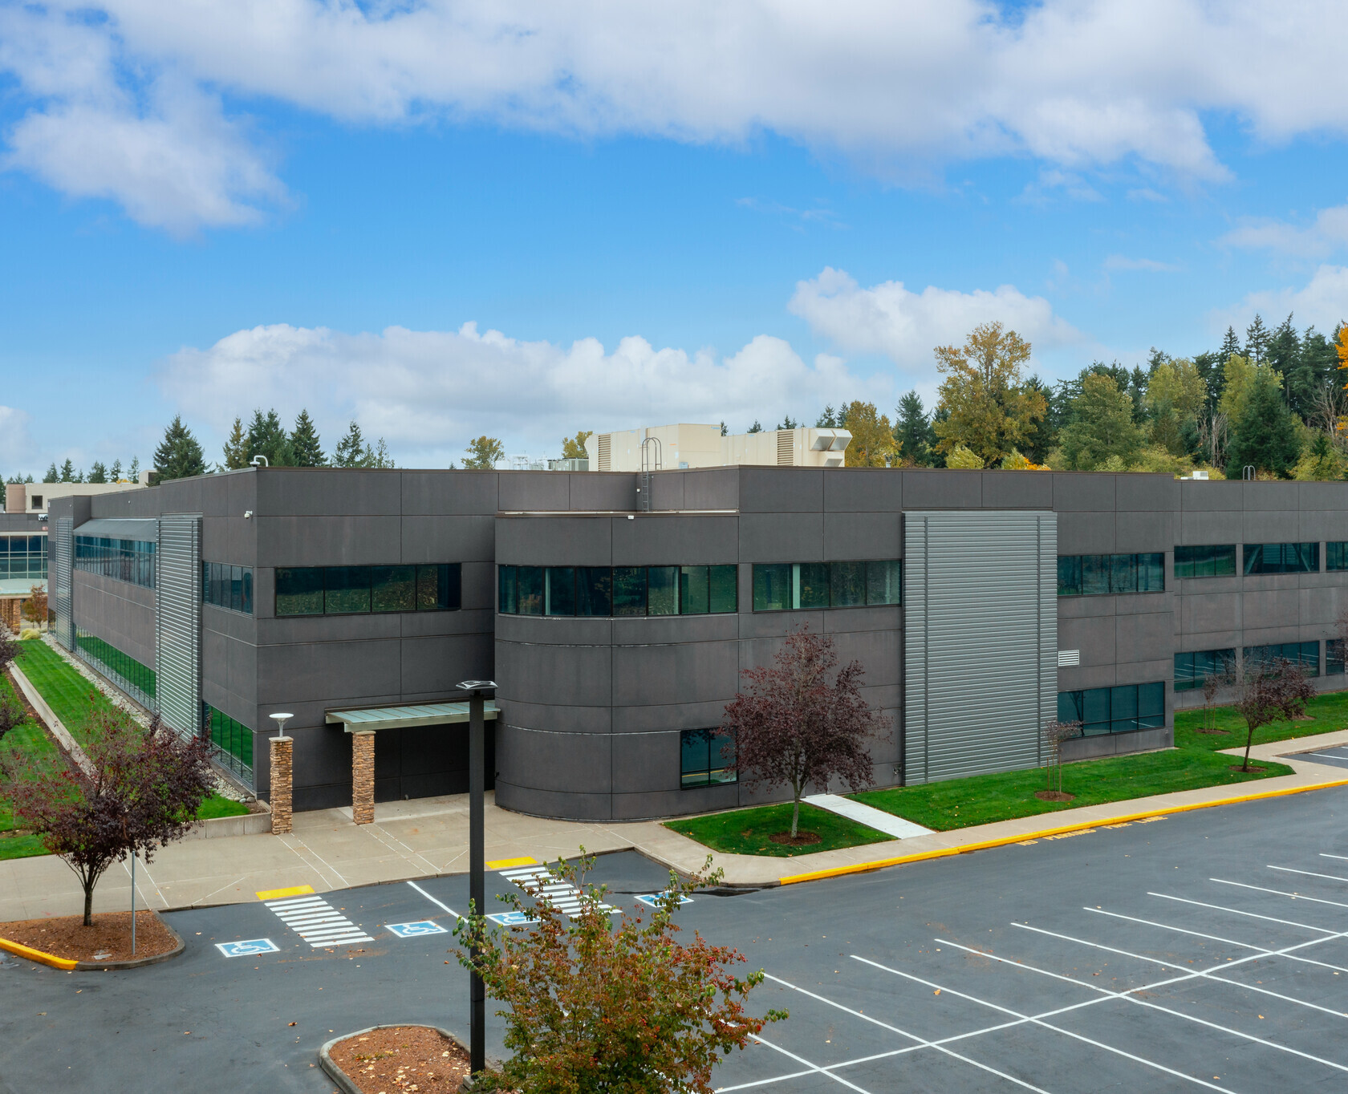
MAJOR SCOPES
Finishes
MEP, FP

Slide 12
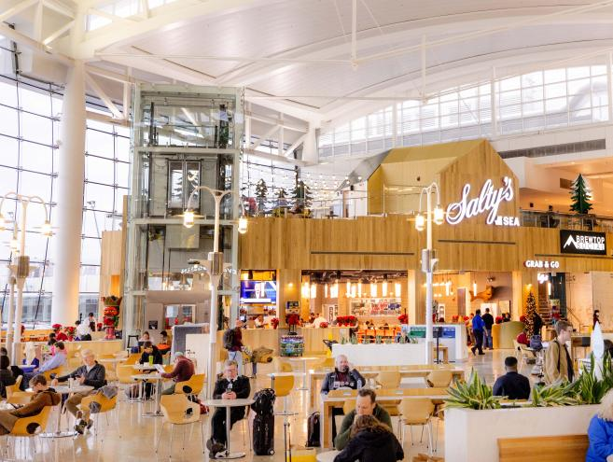
Port of Seattle – Airport Food and Beverage Kiosks
Bothell, WA
PPC improvement project for 2 food and beverage kiosks on concourse level of main terminal. Concourse B and Central Terminal.
Estimated Start:
June 1, 2025
Estimated Completion: January 17, 2026
Estimated Cost:
$3,000,000

Slide 13
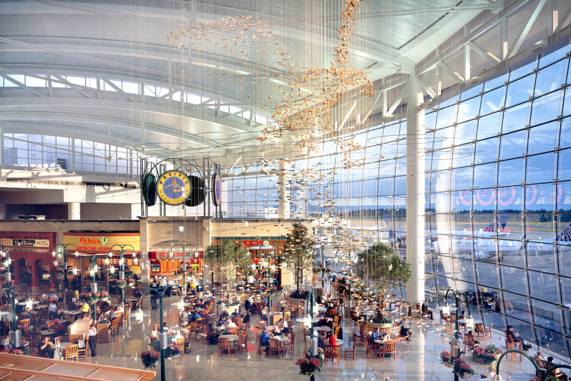
MAJOR SCOPES
Steel
Framing & Drywall
Moisture Protection
Doors
Interior Finishes
MEP

Slide 14
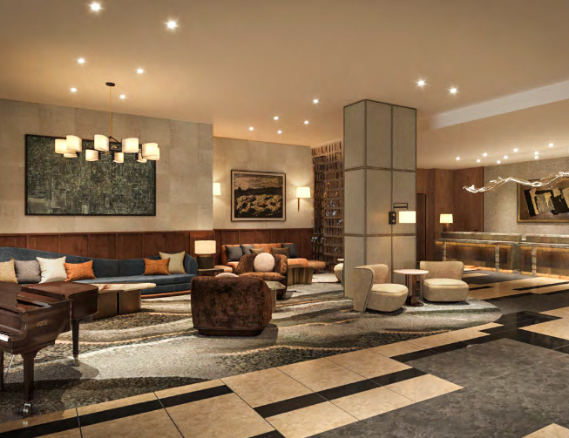
Four Seasons Lobby TI
Seattle, WA
PPC improvement project for 2 food and beverage kiosks on concourse level of main terminal. Concourse B and Central Terminal.
Estimated Start:
November 1, 2025
Estimated Completion: March 1, 2026
Estimated Cost:
$3,500,000

Slide 15
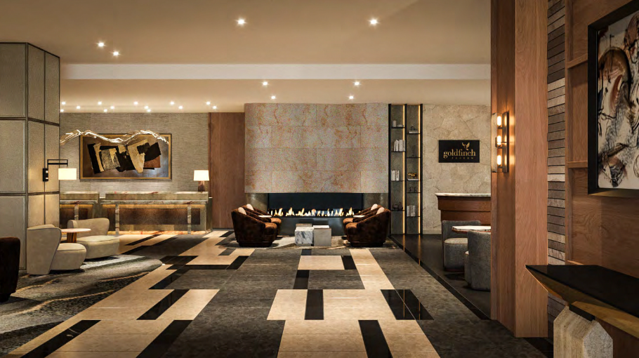
MAJOR SCOPES
Steel
Framing & Drywall
Moisture Protection
Doors
Interior Finishes
MEP

Slide 16
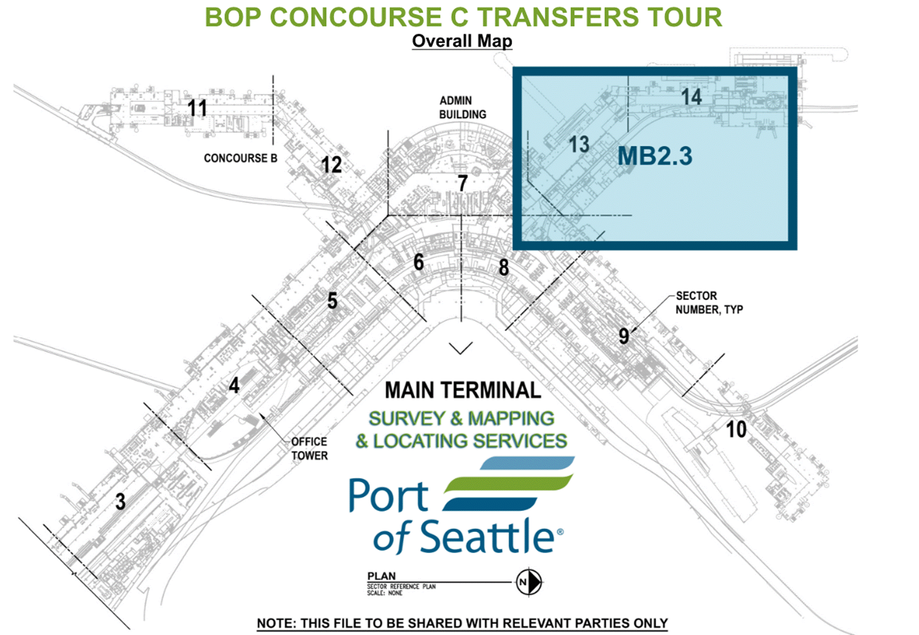
Baggage Claim Optimization Project – Concourse C
Seatac, WA
Additions and Alterations to Concourse C of the SEATAC airport related to a phased change out and upgrade to the baggage handling system for the entire airport.
Estimated Start:
November 9, 2025
Estimated Completion: March 31, 2026
Estimated Cost:
$8,500,000

Slide 17
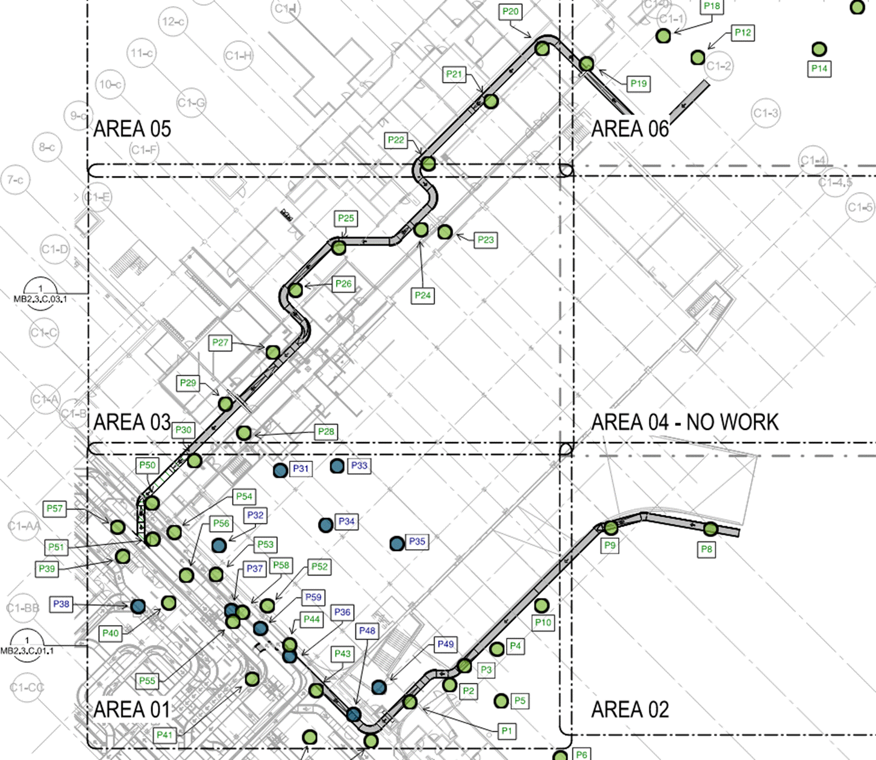
MAJOR SCOPES
MEP
Finishes
Conveying System

Slide 18
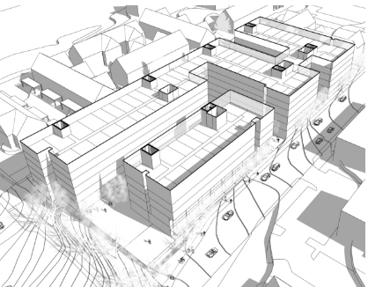
164th & Larch
Seattle, WA
2.3 Acre site with 400 residential units and 375 stall parking garage with two levels of retail and office space.
Estimated Start:
January 1, 2027
Estimated Completion: June 1, 2028
Estimated Cost:
$100,000,000

Slide 19
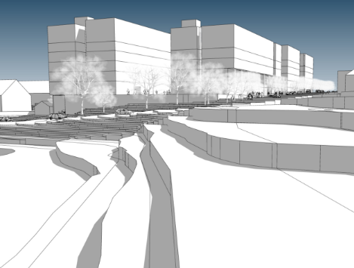
MAJOR SCOPES
Framing & Drywall
MEP
Landscaping
Interior Finishes
Doors & Glazing

Slide 20
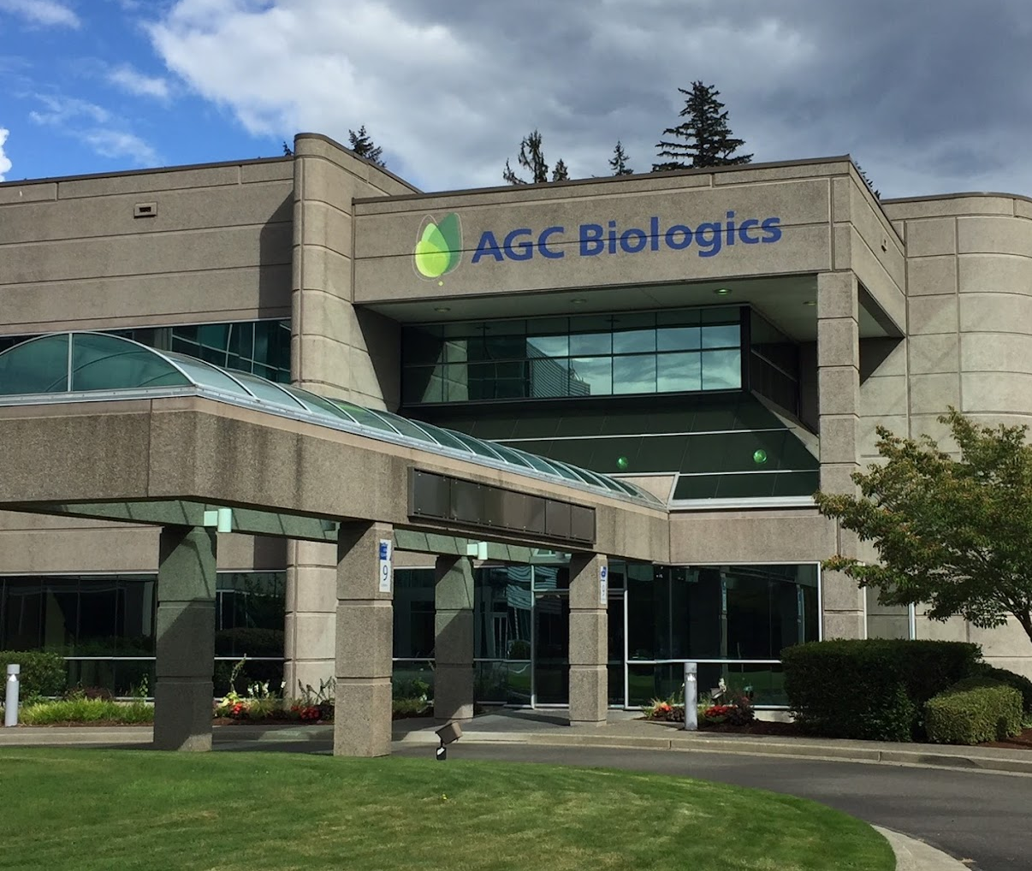
AGC B2 – Clean Corridor FRP Replacement
Bothell, WA
Corridor renovation in an operating clean facility.
Estimated Start:
September 1, 2025
Estimated Completion: October 1, 2025
Estimated Cost:
$440,000

Slide 21
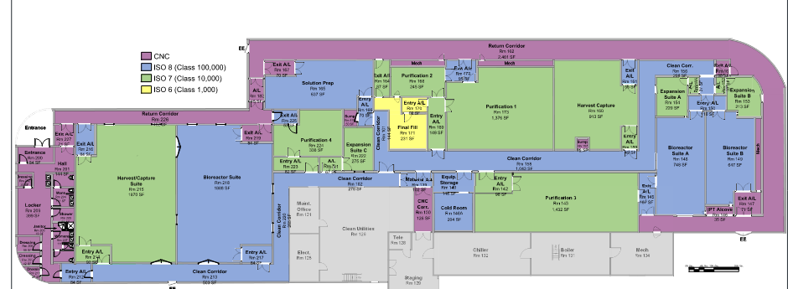
MAJOR SCOPES
GWB
FRP & Corner Guards
Demolition
Electrical

Slide 22
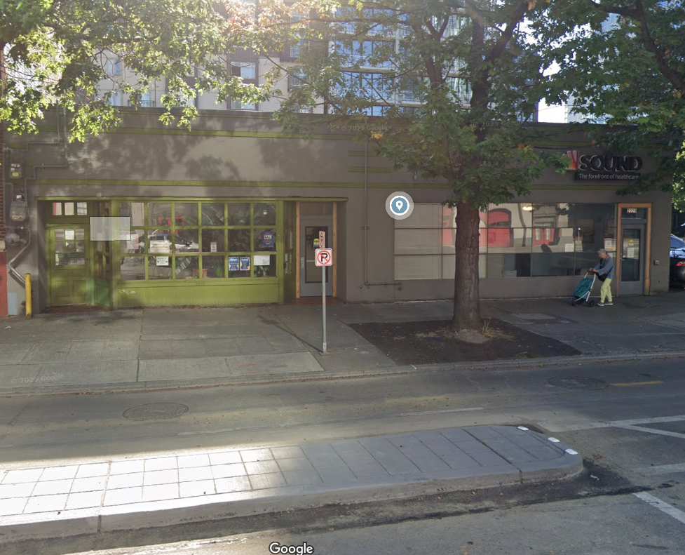
Sound Health – Belltown Clinic Remodel
Seatle, WA
Renovation of existing reception, waiting, treatment, and group rooms. Work includes remodel and reconfiguration of the exterior front façade and parapet bracing.
Estimated Start:
June 1, 2025
Estimated Completion: August 1, 2025
Estimated Cost:
$950,000

Slide 23
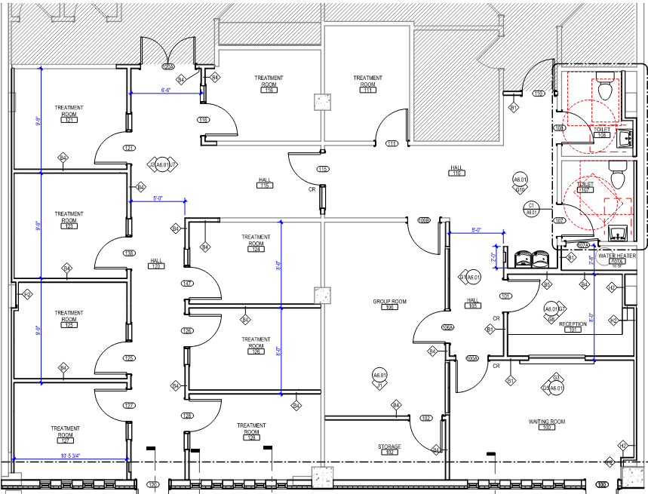
MAJOR SCOPES
GWB
FRP & Corner Guards
Demolition
Electrical

